Slide 1
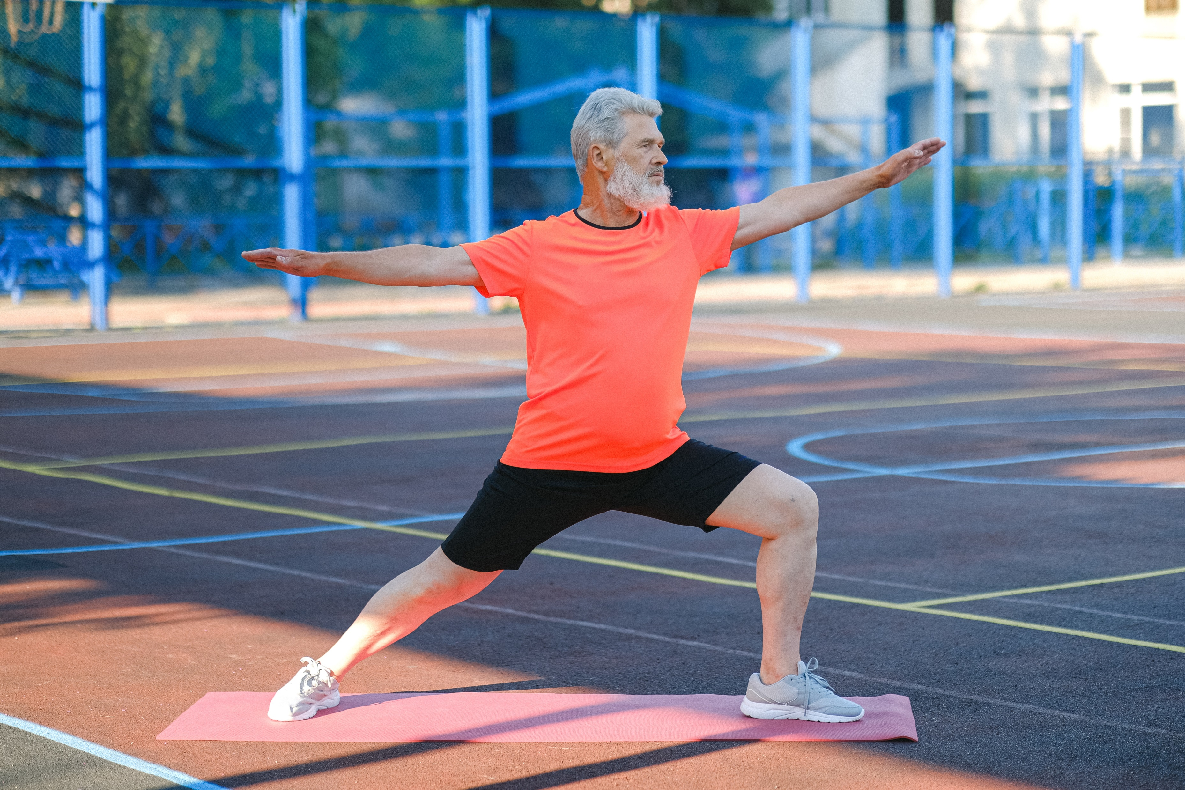
Healthy Aging

Slide 2

What Causes Us to Age?
Weight gain
Cancer
Heart Disease
Diabetes
Auto-immune
Depression, etc.
Inflammation
Oxidative stress
Insulin resistance
Nutrient depletion
Integrity of the cell
CAUSE
Notes:
That lead to the vast majority of age-related , longevity-impairing conditions (1-3)
(1) Lemon JA, Boreham DR, Rollo CD. A complex dietary supplement extends longevity of mice. J Gerontol A Biol Sci Med Sci. 2005 Mar;60(3):275-9.
(2) Aksenov V, Long J, Liu J, et al. A complex dietary supplement augments spatial learning, brain mass, and mitochondrial electron transport chain activity in aging mice. Age (Dordr). 2011 Nov 27.
(3) Aksenov V, Long J, Lokuge S, Foster JA, Liu J, Rollo CD. Dietary amelioration of locomotor, neurotransmitter and mitochondrial aging. Exp Biol Med (Maywood). 2010 Jan;235(1):66-76.

Slide 3
DEADLY INFLAMMATION
The Major Physiologic Cause of
ALL Pain & Disease

Slide 4
What Is Inflammation?
White blood cells receive instructions to flow to and defend any area that is injured or under attack and spray chemical weapons to neutralize injury or infection.

Slide 5
The Light Side and Dark Side
LIGHT SIDE
A critical, powerful solution designed to be short-term
DARK SIDE
The “cytokine storm!”
When inflammation becomes systemic and goes unchecked for months or years, the same chemicals used for healing can cause suffering, weight gain, aging, and disease
Notes:
The same inflammation that can save your life in the short term can also kill you if inflammation becomes chronic.
When our bodies are in such an emergency, there is a complicated process through which more pro-inflammatory prostaglandins are created than anti-inflammatory ones, and the immune system is in a steady state of responsiveness

Slide 6
BAD IDEA FOR INFLAMMATION
Over the counter NSAIDs, prescription pain killers and steroids seem like quick, easy, sensible solutions to lower inflammation.
All come at potentially great cost with greater likelihood of
Heart attack, stroke, and serious intestinal conditions.

Slide 7
A Silent Killer
Systemic inflammation does not create pain like a sprained ankle.
It is therefore generally dismissed as signs of “normal” aging, immune related conditions, or obesity and being out of shape from poor lifestyle.
Notes:
As people age and gain weight, chronic systemic inflammation increases and leads to our most common disease.
Blood sugar imbalance is one of many ways we can cause inflammation in our bodies.
Inflammation can be silent – meaning we don’t necessary “experience” any major signs or symptoms.
With acute inflammation, we experience pain, redness, heat at the site of injury. This is our body’s way of repairing damage – so short term inflammation can be very beneficial
Long term inflammation is a concern because it can shift our biochemistry, which leads to many concerns

Slide 8
The #1 Killer of Men & Women
Beats about 100,000 times/day
Moves approx. 2,000 gal of blood through 60,000 mi of blood vessels/day
Blood circulates through the entire system once/minute.
The heart beats 2.5 billion X+ in your lifetime
Pumping more than 1 million barrels of blood

Slide 9
Atherosclerosis: Inflammation and Your Arteries
Inflammation from C-reactive protein (CRP) and elevated homocysteine
Also: Oxidation of LDL cholesterol by free radicals, elevated insulin, blood sugar, bad fats, poor diet, toxins, chemicals, and heavy metals.
CAUSE ATHEROSCLEROSIS
Notes:
The inner layer, called the intima or endothelium gets damaged over time by issues like: high blood pressure, oxidation of LDL cholesterol, cigarette smoke, free radicals, elevated homocysteine levels, elevated C-reactive protein (CRP) levels, elevated blood sugar and insulin levels, bad fats, poor diet, toxic chemicals and metals.
Inflammation most commonly leads to atherosclerosis
Atherosclerosis is the hardening of these arteries most commonly due to excessive amounts of plaque. This plaque contains cholesterol, calcium, white blood cells, collagen, elastin, platelets, and other materials driven there through chronic inflammation.
The saddest and perhaps most frustrating part to cardiovascular disease is that it is the #1 killer of men and women – causing more than 1 in 3 deaths in the U.S. each year, it is one of the most treatable and preventable of all health problems.

Slide 10
Causes and Provokes ALL Disease
Chronic inflammation is a symptom of virtually every disease and aggravates all disease.
FOR EXAMPLE: Being overweight creates inflammation and inflammation provokes weight gain.
Notes:
Constant inflammation creates inflammatory cytokines, which are destructive, cell-signaling chemicals that lead to the most common forms of degenerative diseases: atherosclerosis, heart disease, cancer, arthritis, Diabetes, Alzheimer’s, immune conditions like allergies and asthma, autoimmune like colitis, Crohn’s, diabetes, and celiac disease, and liver conditions like hepatitis.
Inflammation causes cancer and cancer causes inflammation – a double edged sword and a vicious cycle in 1. Thankfully, inflammation can be addressed and gotten under control.
Research from Sweden showed that the higher the number of elevated inflammatory proteins, the greater the chances of weight gain.
Prior to these reports experts assumed that obese people had higher levels of inflammatory proteins because of the cytokines their fatty tissues secreted. In other words, doctors thought that obese individuals continued to deal with greater inflammation because they were obese. When you decrease your body’s inflammatory response, you will also lower your weight and your waist size.
The National Cancer Institute brought out a report highlighting inflammation research is too often ignored by oncologists.*
The report describes in great detail the processes by which cancer cells manage to lead the body’s healing mechanisms astray. Just like immune cells gearing up to repair lesions, cancer cells need to produce inflammation to sustain their growth. Through the inflammation process, they begin an abundant production of the same highly inflammatory substances—cytokines, prostaglandins, and leukotrienes—seen in the natural reparation of wounds, but now working against the future of the same body these process were designed to protect.
*Peek, R. M., Jr., S. Mohla, and R. N. DuBois, “Inflammation in the Genesis and Perpetuation of Cancer: Summary and Recommendations from a National Cancer Institute-Sponsored Meeting,” Cancer Research 65, no. 19 (2005): 8583-86.”

Slide 11
What causes Inflammation?
Free Radicals
Blood sugar imbalance
Stress and poor rest
Sugar and processed foods
Toxins
Consumption of artificial sweeteners
SUBLUXATION!
Chronic health conditions
Being Overweight
Sedentary lifestyle
Smoking
Chronic overconsumption of carbs
Notes:
Free radicals: These are defective molecule that sends out molecular shrapnel, damaging the coronary arteries and other cells in our bodies. They lead to advanced aging and changing of our DNA, therefore involved with cancer.
Occur from several causes to be named later, but include normal daily living such as when you metabolize food into energy, oxygen oxidizes (or burns) the food in order to produce energy which create by-products known as free radicals.
Also called “oxidation” – your body normally contains anti-oxidants that keep this under control. However, with modern over-exposure to free radicals, we use up our anti-oxidants.

Slide 12
Sugar and Inflammation
OUT OF CONTROL (“Modern”) SUGAR CONSUMPTION
Ancestors: 2 kilograms (4 pounds) a year per person.
(This would be where our original genetic makeup was created.)
1830: 5 – 8 kilograms (11-18 pounds) a year
TODAY: 68 - 77 kilograms (150 - 170 pounds) a year
Notes:
Research has shown that those with the highest level of IGF were seven times more likely to develop breast cancer than those with the lowest.
Additional research from Harvard and the University of California at San Francisco in the United States and McGill in Canada, demonstrated the same phenomenon for prostate cancer> For men, the risk was as much as nine times greater for those with the highest levels of IGF. Additional studies have shown that a high glycemic index is likewise associated with cancer of the pancreas, colon, and ovaries.
The study, published in the Journal of the National Cancer Institute, concludes that it is not obesity per se that is a risk factor for breast cancer, but rather high insulin levels that tend to be associated with excessive body weight. The women with the higher insulin levels (and who were not diabetic or taking hormone replacement therapy) had almost twice the risk of developing breast cancer during the follow-up period compared to those whose insulin levels were the lowest.
Peek, R. M., Jr., S. Mohla, and R. N. DuBois, “Inflammation in the Genesis and Perpetuation of Cancer: Summary and Recommendations from a National Cancer Institute-Sponsored Meeting,” Cancer Research 65, no. 19 (2005): 8583-86.”

Slide 13
The Sugar = Disease Effect
Insulin production causes IGF (Insulin-like Growth Factor) to be released and creates INFLAMMATION.
IGF stimulates faster cell growth and along with inflammation- is linked to disease; especially cancer.
Notes:
When we deliver high glycemic nutrients into the blood, glucose levels rise quickly.
The result is the release of insulin necessary to allow glucose to enter the cell. When insulin is released, another molecule called IGF (insulin ike growth factor)is released as well. IGF stimulates cell growth allowing sugar to provide for tissue nourishment and faster growth. A major negative to this duo of molecules is that they cause inflammation and are linked to several health issues including cancer.
The cell growth caused by IGF stimulates cancer cell growth.
This connects to diabetes. With high blood sugar levels, people with diabetes are known to be at above-average risk for cancer.

Slide 14
Bad Fats!
Too many Omega-6’s and not enough Omega-3’s creates potent inflammatory agents
Notes:
Omega Balance, Disease, and Inflammation
Omega-6 fats lead to the formation of “eicosanoids.”
These are inflammatory hormones. In fact, the action that allows many painkillers like aspirin to work is by inhibiting the enzymes that convert Omega-6 to inflammatory agents that are called prostaglandins.
Over time, it’s been estimated that the overabundance of Omega-6’s and the resulting deficiency of Omega-3’s is involved in the causes of heart disease, vascular disease, homicide, depression, bronchial disease, and many other brain, joint, and organ disorders.

Slide 15
CRP: The Marker of Inflammation
Fat cells, infections, blood sugar, insulin resistance, free-radicals, and toxins produce the inflammatory cytokine C-Reactive Protein (CRP)
Elevated CRP sparks full systemic, chronic inflammation and radically increases risk of both heart attack and stroke.
The more fat cells, health, and physiologic issues you have; the more inflammatory markers like CRP you will create.
Notes:
When the body produces more inflammatory mediators, such as CRP, this in turn sparks chronic systemic inflammation.
Essentially the more fat you have (particularly belly fat) or other issues you are managing, the more inflammation you suffer.
Several studies show the inflammation and fat connection. A particular study showed inflammation increased more than 50 percent in obese women whose fat was in their hips.*
* G. Davi, M. T. Guagnano, G. Ciabattoni, et al., “Platelet Activation in Obese Women: Role of Inflammation and Oxidant Stress,” Journal of the American Medical Association 288, no. 16 (2002): 2008–2014.”

Slide 16
Consequences of Inflammation (High CRP)
Cancer
Heart attack
Stroke
Migraines or headaches
Poor memory
Intestinal dx
Diabetes or pre-diabetes
Arthritis, Joint Pain
Weight gain
Injury
Depression
Auto-immune dx
Notes:
The major concerns associated with chronic inflammation are things like cancer, heart attack, stroke
This is especially scary because we can address chronic inflammation but addressing nutritional deficiencies, modifying our diet and lifestyle.
CRP is the blood marker you test to measure inflammation levels in your body

Slide 17
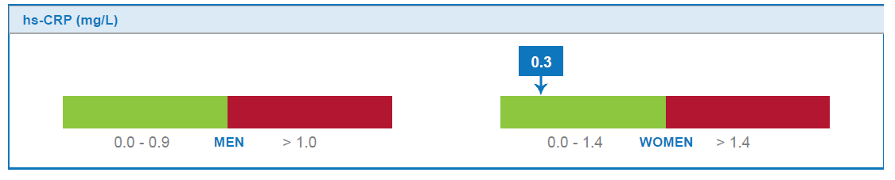
THE RANGES AND EFFECT OF CRP
MEN (Goal: <1)
CRP (mg/L) HEART ATTACK STROKE
>2.11 3X 2X
1.15 - 2.10 2.6X 2X
.56 -1.14 1 2X 2X
<0.55 1X 1X
WOMEN (Goal: <1.5)
CRP (mg/L) HEART ATTACK OR STROKE
>7.3 5.5X
3.8-7.3 3.5X
1.5-3.7 3X
<1.5 1X
Notes:
In a Harvard Women's Health Study, CRP test results were more accurate. Twelve different indicators of inflammation were looked at in healthy women who had already had menopause. Three years later, those with the highest CRP levels were more than four times as likely to have died from coronary disease, or had a heart attack that wasn’t fatal, or stroke, compared with those with the lowest levelsRP is one of, if not the most important marker to check to maximize both current and future health.
CRP is one of the most, if not the most important marker of health to get tested – other inflammatory markers like homocysteine or Lp-PLA2 are inflammation markers as well.

Slide 18
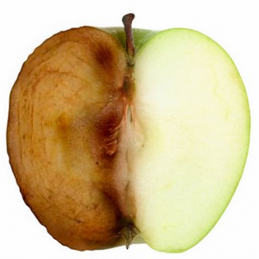
Oxidative Stress
Notes:
Oxidation causes inflammation.
Many of the same causes and conditions are related to both..

Slide 19
ANTI-AGING
“Premature” aging is caused by chronic inflammation, oxidation, and the other biomarkers for bodily stress
Life-extension is achieved through managing these issues through addressing their causes

Slide 20
Oxidative Stress
Oxidative Stress refers to the burden of free radicals that damage the cells all the way down to the DNA and cause inflammation.
Notes:
What is oxidative stress?
This term refers to a burden of free radicals in our body. (Reactive oxygen species)
Free radicals are unstable molecules in our body that can damage other cells and lead to the progression of cancer, cardiovascular disease and age related decline
To prevent free radical damage, we use antioxidants:
Antioxidants provide us with a defense mechanism against free radical damage by stabilizing these unstable molecules, but can’t keep up under heavy exposure. We end up running low on antioxidants and the free-radicals overcome our health.

Slide 21
IT’S NOT THE CHOLESTEROL, IT’S THE INFLAMMATION
When LDL cholesterol is oxidized, it is especially damaging to the arterial lining and causes plaque

Slide 22
What causes Oxidative Stress?
Exposure to toxins
Cigarette smoke
Pollution
Dehydration
Excess sugar
Processed foods
SUBLUXATION
Medication
Preservatives in foods
Alcohol consumption
Stress
Notes:
Our bodies are exposed to free radicals and oxidative stress in the environmental and internally by our own metabolic processes – the food and drinks we consume can help contribute to our oxidative stress
oxidative stress.
Toxins, emotional stress, radiation, physical stress like intense exercise, sugar, weight gain, insulin issues, inflammation, and can increase oxidation and make it even more difficult for your antioxidant defenses to keep up. So you can see where inflammation and oxidation are closely tied together in terms of cause and impact.

Slide 23
Consequences of Oxidative Stress
Inflammation
Cancer
COPD
Asthma
Alzheimer’s Disease
Depression, anxiety
Lack of energy and stamina
Joint or muscle pain
Premature aging
Heart disease
Diabetes
Notes:
The effects of long term oxidative stress can affect many different body systems and create chronic and deadly conditions

Slide 24
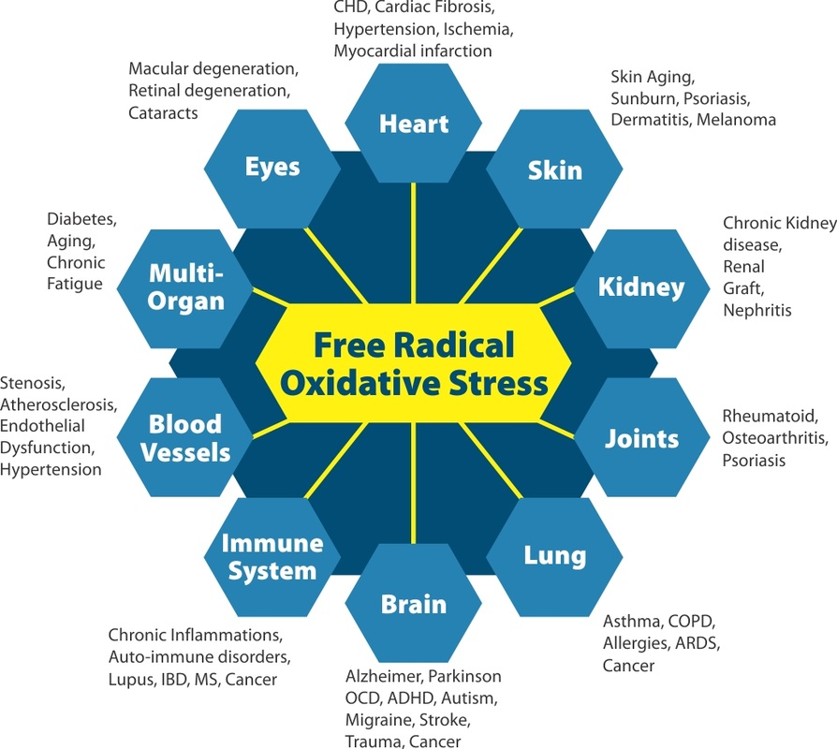
Notes:
These are a few examples of how oxidative stress can affect different body systems. Its systems specific and there are both general anti-oxidants as well as specific ones that help unique areas of the body.

Slide 25
Your Toxic Burden
Overwhelm bodily functions
Cross the blood-brain barrier and poison the nervous system
Damage your cells
Lead to chronic inflammation and oxidation
Slow your metabolic rate.
Disrupt absorption of critical
Disrupt hormonal activity due to changes in receptor sites.
Lower thyroid function.
Bind to fats making them tough to lose.

Slide 26
What causes Toxicity?
Exposure to mold, pesticides, and other environmental toxins
Use of plastic water bottles
Unfiltered water which contains chlorine, fluorine, heavy metals and toxins
Benzene, xylene, toluene exposure through fabrics, detergents, dyes, gasoline
Medications, vaccinations
Glyphosates
Cigarettes, alcohol
Commercial foods
Use of artificial sweeteners
Personal care products like shampoo, soap, and toothpaste
Pesticides, herbicides, fungicides and fertilizers
Household cleaners
Dental work
Notes:
Our bodies are constantly exposed to toxins in the environment, through our diets and through lifestyle choices
Our liver provides protection against toxins by filtering them out of our system
When we are chronically exposed toxins, the liver becomes overburdened and works less efficiently
We can overburden our liver with all of these things: [listed on slide]

Slide 27
Consequences of Toxicity
Cancer
Depression
Decreased vitamin levels
Antioxidant wasting
Breakdown of energy pathways
Chronic pain
Weight loss resistance
Inflammation/oxidation
Hormonal imbalances
Body odor, belching and gas
Bad breath
Skin problems
Notes:
Toxicity affects many pathways, and can lead to deadly cancer, depression, pain, hormonal imbalances etc

Slide 28
SOLUTION TO TOXICITY (And Free Radical Oxidation)
Support detox channels
Glutathione is the main antioxidant of the body and your Master Detoxifier
Our bodies naturally produce glutathione, but toxins, stress, trauma, and sickness cause deficiency.
Toxins must be absorbed and removed from the body through channels
Notes:
Glutathione is the primary antioxidant of the body. It is unique because it actually recycles itself and will continuously seek out and destroy toxins! Glutathione is made up of the amino acids cysteine, glycine and glutamic acid. Sulfur specifically attracts and binds toxins which will allow glutathione to destroy it.
Sulfur Rich Compounds like glutathione bind toxins for removal
Glutathione
Vitamin U
Cultured Dairy Proteins
Whey Proteins (lactalbumin)
Glutathione has multiple functions:
It is the major endogenous antioxidant produced by the cells, participating directly in the neutralization of free radicals and reactive oxygen compounds, as well as maintaining exogenous antioxidants such as vitamins C and E in their reduced (active) forms.
Regulation of the nitric oxide cycle, which is critical for life but can be problematic if unregulated.
It is used in metabolic and biochemical reactions such as DNA synthesis and repair, protein synthesis, prostaglandin synthesis, amino acid transport, and enzyme activation. Thus, every system in the body can be affected by the state of the glutathione system, especially the immune system, the nervous system, the gastrointestinal system and the lungs.

Slide 29
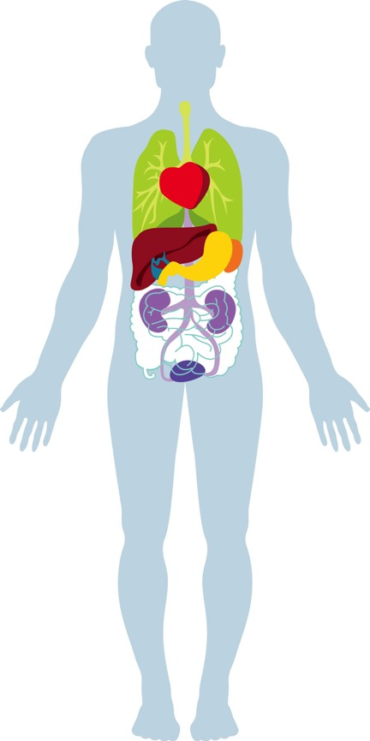
Your Body’s Detox Channels
Skin
Lungs
Colon*
Kidneys
Liver*
Lymphatic system
Fat cells
*Centers for processing and removal
Notes:
The toxic burden also causes a burden on the liver, which is your body’s detox super organ.
To maximize detox we need to look at all the detoxification channels. They include the skin, lungs, colon, kidneys, liver, lymphatic system and fat cells. Detoxification happens both inside cells and outside of them.
Skin
Lungs
Liver
Lymphatic System
Fat cells – researchers are leaning towards classifying body fat more like an organ rather than simply fat that is hanging around…Refer to visceral fat and its link to major health issues…fat as repository for toxins, carcinogens, and endocrine disruptors
Here is an interesting recent article on increased incidence of major diseases in obese Indian women, linking it to toxins stored in fat as major contributing factor:
http://dailypioneer.com/nation/42244-risk-of-breast-cancer-high-in-obese-indian-women-study.html
Perhaps a quick overview of what each organ/system is responsible for in the elimination spectrum.

Slide 30
The Consequence of Low Vitamin D
Depression, osteoporosis, heart disease, auto immune disease, infection, hypertension, and cancer
AND YOU CANNOT GET ENOUGH FROM YOUR DIET
Notes:
New research has confirmed the importance of vitamin D3 in preventing cancer, particularly in countries where the lack of sunshine means that the skin cannot synthesize enough of this vitamin during the winter. I’ve therefore given more attention to this topic, and made new and more specific recommendations.”
“has recently been shown that a significant supply of vitamin D reduces considerably the risk of several cancers (by more than 75 percent with a daily intake of 1,000 international units [IUs] of the 25-hydroxyvitamin D form), in a Creighton University study published in 2007.121 In a Canadian pilot study of fifteen patients with prostate cancer, researchers reported on the effects of taking just 2,000 IUs of vitamin D3 daily over a median of eight months (up to sixty-five months for one of the patients). Fourteen of them saw a slowing of progression of their PSA levels (the most common marker of prostate cancer, used to follow its growth over time). And these levels actually dropped significantly in nine of the patients compared to their levels at the start of treatment.122
Other studies published recently have shown positive effects of vitamin D3 on breast cancer, non-small-cell lung cancer, colon cancer, and prostate cancer. Many researchers now believe that vitamin D3 contributes to slowing down all forms of cancer, at least in the early stages. Moreover, we now know that vitamin D3 very likely protects us from colds and flu and contributes to maintaining a[…]”
“Foods that contain the most vitamin D are cod liver oil (1,460 IUs in a tablespoon), salmon (360 IUs in 100 grams), mackerel (345 IUs in 100 grams), sardines (270 IUs in 100 grams), and eel (200 IUs in 100 grams). Milk enriched with vitamin D contains only 98 IUs per glass, an egg 25 IUs, and calf liver 20 IUs per 100 grams.”
“Long-chain omega-3s found in fatty fish (or in high-quality purified fish oil supplements) reduce inflammation. In cell cultures, they reduce cancer cell growth in a large number of tumors (lung, breast, colon, prostate, kidney, etc.). They also act to reduce the spread of tumors in the form of metastases. Several human studies show that the risk of several cancers is significantly lower in people who eat fish at least twice a week.125,126,127,128,129,130,131,132ai”

Slide 31
The Most Proven Vitamin: Proper Levels of D
33% less heart disease
55%, less Type II Diabetes
51% less weight loss resistance, high blood pressure, and high triglycerides)
Optimal level is over 80 ng/mL – average person has less than half and labs have considered that “normal”

Slide 32
Test and Take Vitamin D
Boost heart and bone health
Lessen inflammation and the risks of certain diseases
Over 900 genes and several areas of the body have vitamin D receptors
Inhibit unwanted and unhealthy cell proliferation

Slide 33
Addressing Inflammation, Aging, and Disease
Test CRP, Food allergies
Test Vitamin D
Address daily exposure to toxins and detox
Fight inflammation with anti-inflammatory nutrients
Increase Omega-3 Fats
Fight Free Radicals with Anti-oxidants
Optimize Nutrient levels
Whole-food, Low glycemic diet

Slide 34
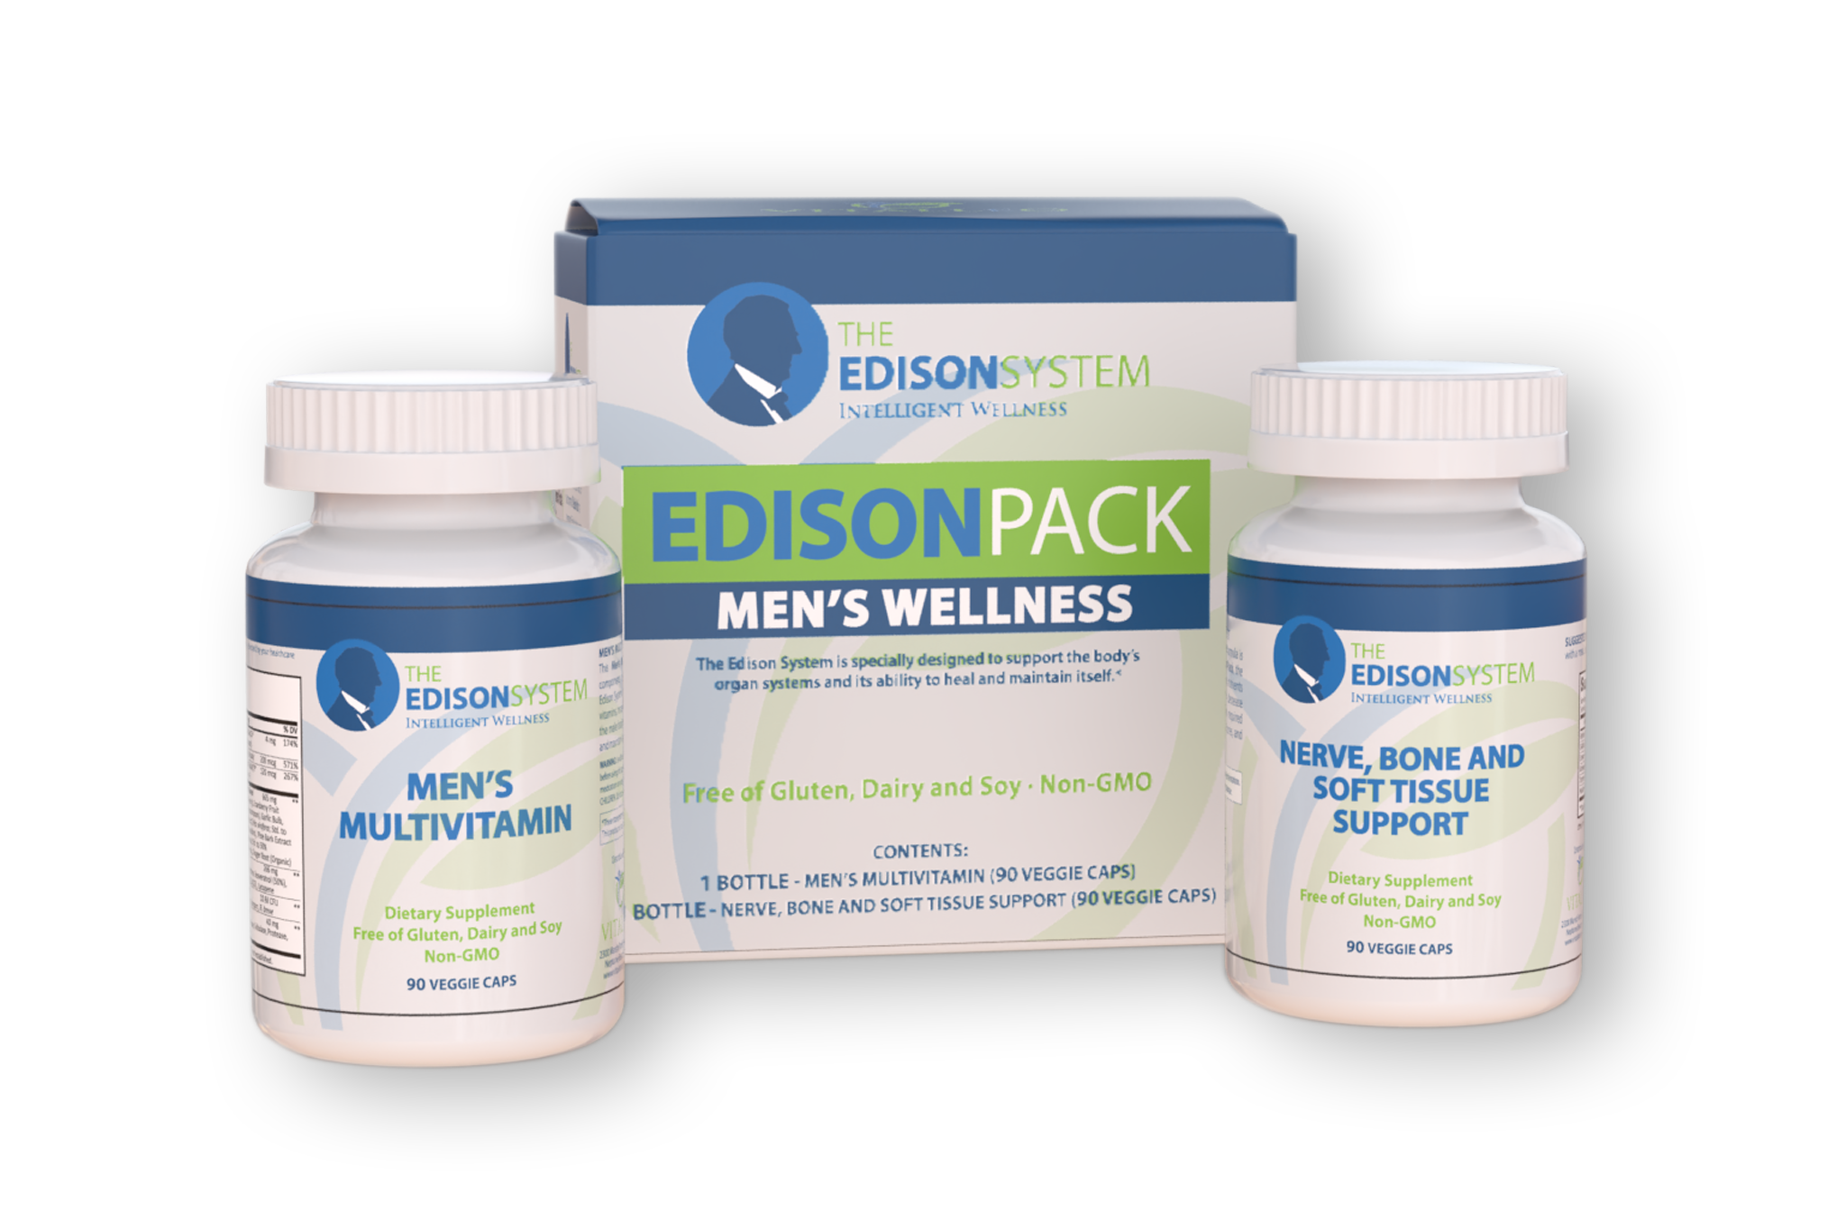
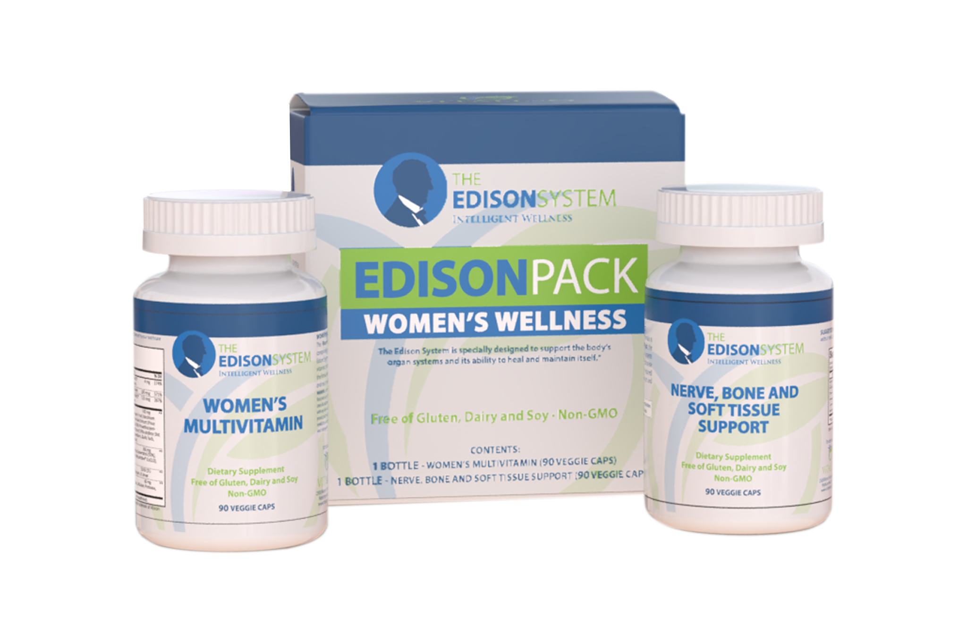
The Edison Pack

Slide 35
Anti-inflammatory Nutrients
TURMERIC: It’s the curcuminoids
The source, amount, and concentration that gives it the anti-inflammatory and other disease-fighting benefits.
Boswellia
White Willow Bark

Slide 36
Vitamin E: Potent Antioxidant
Body's most potent fat-soluble antioxidant
Crucial for protecting against free radical damage
Strengthens and regulates heartbeat (very important in preventing and treating heart disease and cardiac conditions)
Increases body's production of CD4 (natural killer cells) and certain antibodies
Slows down the mental decline associated with some neurological disorders

Slide 37
FIGHTING THE #1 KILLER
EDISON PACK HEART BLEND – FIGHT THE DAILY FIGHT!
D-ribose: repairs and prevents heart damage and improves recovery
Anti-oxidants specific to the heart
Resveratrol
CoQ10
Lycopene (Along with Saw Palmetto in the Men’s – also helps to prevent conditions of the prostate)
Notes:
Chemicals and stress raise free radicals and use up our antioxidants like Selenium and critical Vitamins A, C, and E as well as the vital mineral Zinc
Fight the good fight against damage to your heart through replacing these antioxidants and taking nutrients that fight free radicals that attack the heart and support the cardio vascular system’s ability to heal and repair.

Slide 38
MEN’S WHOLE FOOD ANTIOXIDANT BLEND
MEN’S: Saw Palmetto
Supports the urological system
Supports prostate health
Helps mitigate issues leading to hair loss
Assists in retaining testosterone levels

Slide 39
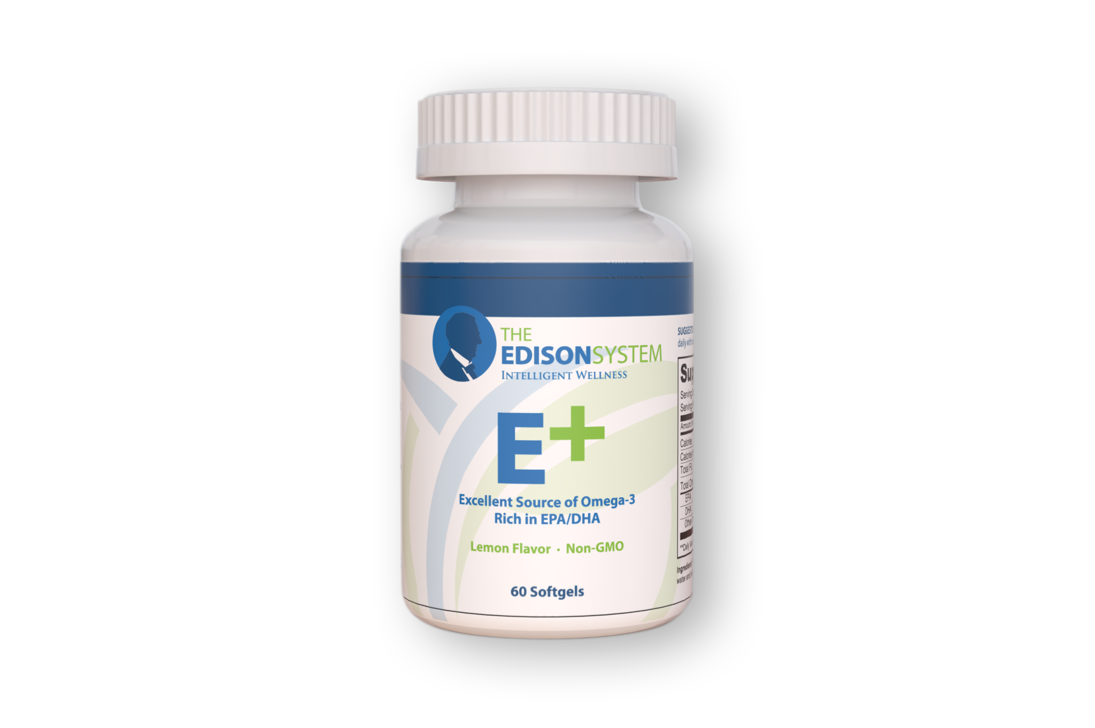
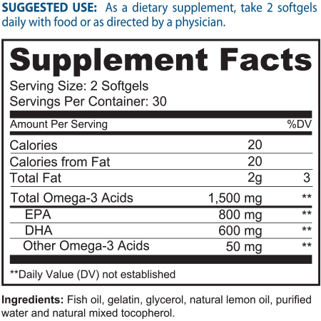
E+ Omega
Notes:
Don’t Miss Upcoming Events - I want you to do is take out the card that says, “Help my friends and family” do you guys see that card? Hold it up for me. On the back it says “Sign me up.” On the side that says “help my friends and family” I want you to write down the name of the friends and family that you want to invite to the Recipe night that we have coming up on Sept 19th.
We’re not telemarketers so I want to make sure that you call them and let them know that we will be reaching out to them ahead of time. I want you to write your name and number at the top and their names and numbers below. Make sure that you call them ahead of time and let them know that we will be calling; if they don’t want us to call, please let us know, but otherwise we will be calling within the next couple of days to get them to one of our events to see if we can get them the help they need. People are praying for answers, and we have the answer. If you write down four names and turn it in today, we’ll provide you with recipes for homemade non-toxic household cleaning items that will help you live healthy and save money all while reducing your exposure to toxicity – the less toxic you are, the faster you’ll lose weight and keep it off.
On the back of that page it says sign me up. Write your name, number, and email. If you want to receive weekly newsletters with recipes and information regarding future events, let us know. If you want to get registered for the Max Life Call – Fast Intense Results on June 12th, or our Recipe Night on June 16^{th,} or our PAD on June 30th, check the box on this card. You can drop these cards off with __________. __________ raise your hand. We have plenty of time so take your time filling this out, and once it’s complete drop it off in the back with __________. Don’t forget your products and resources are 15% off today only. You can go to the back to pick up the resources that you need, turn in your “Sign me up” card, and guests if you didn’t hand in your Exam form earlier, you can do that now. Thanks.

Slide 40
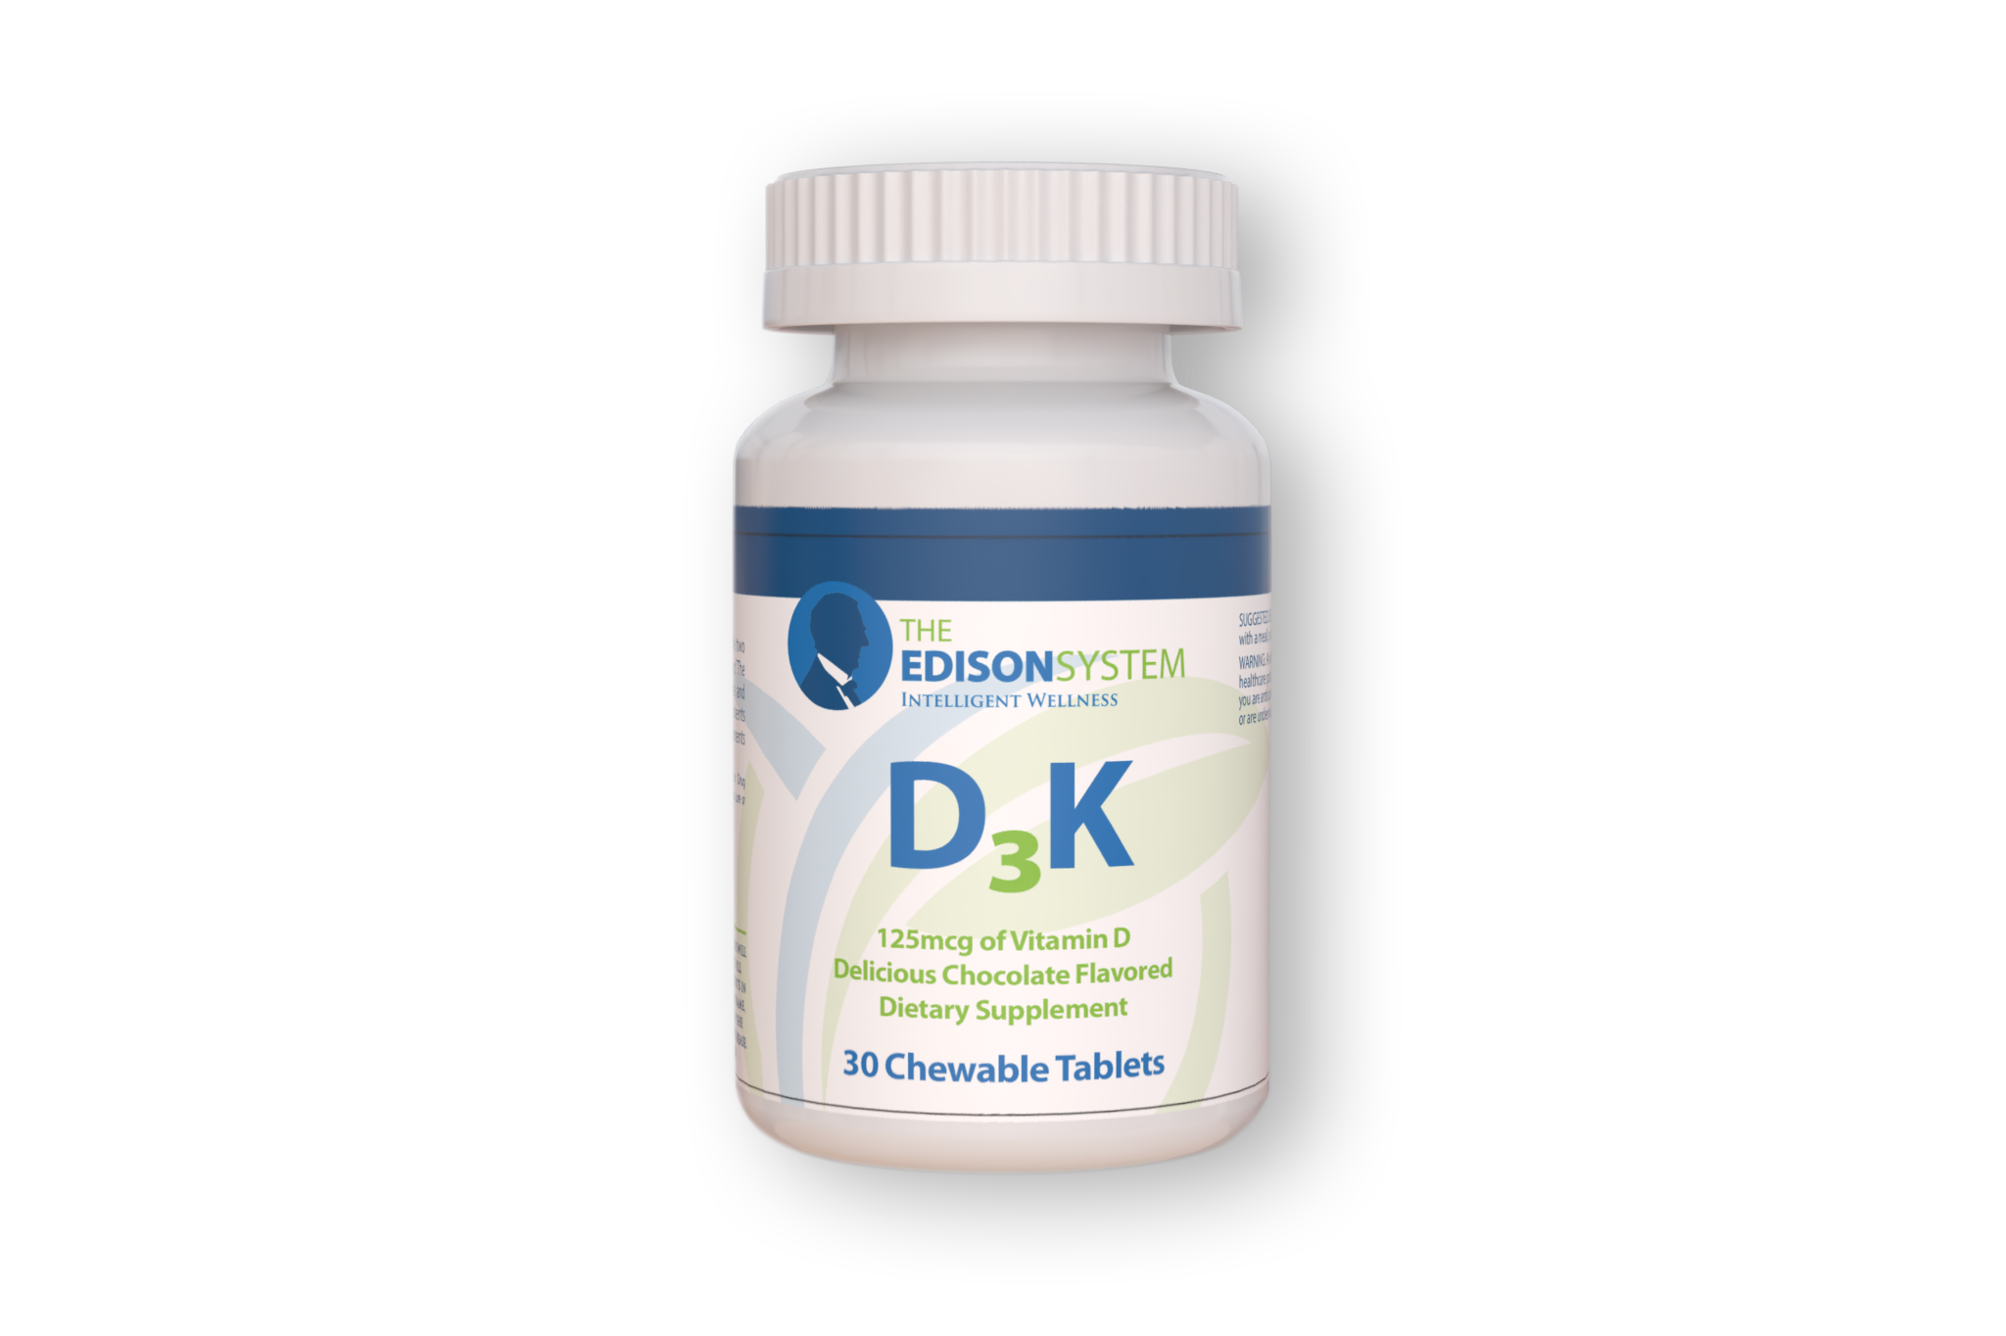
VITAMIN D
Normal immune function
Fighting infection
Muscle function
Cardiovascular regulation
Respiratory system support
Brain development
Notes:
100,000 people study showed that people with higher than average Vit E had a 43% lower risk of any heart or vascular metabolic disease. High Vit D had 33% less CV disease, 55%, less Type II Diabetes, and 51% less metabolic syndrome (Diabetes precursor with weight loss resistance, high plod pressure, and high triglycerides).
Optimal level is over 60 ng/mL – average person has less than half and labs have considered that “normal”
Depression, osteoporosis, heart disease, auto immune disease, infection, hypertension, and cancer (50% drop in intestinal cancers).

Slide 41
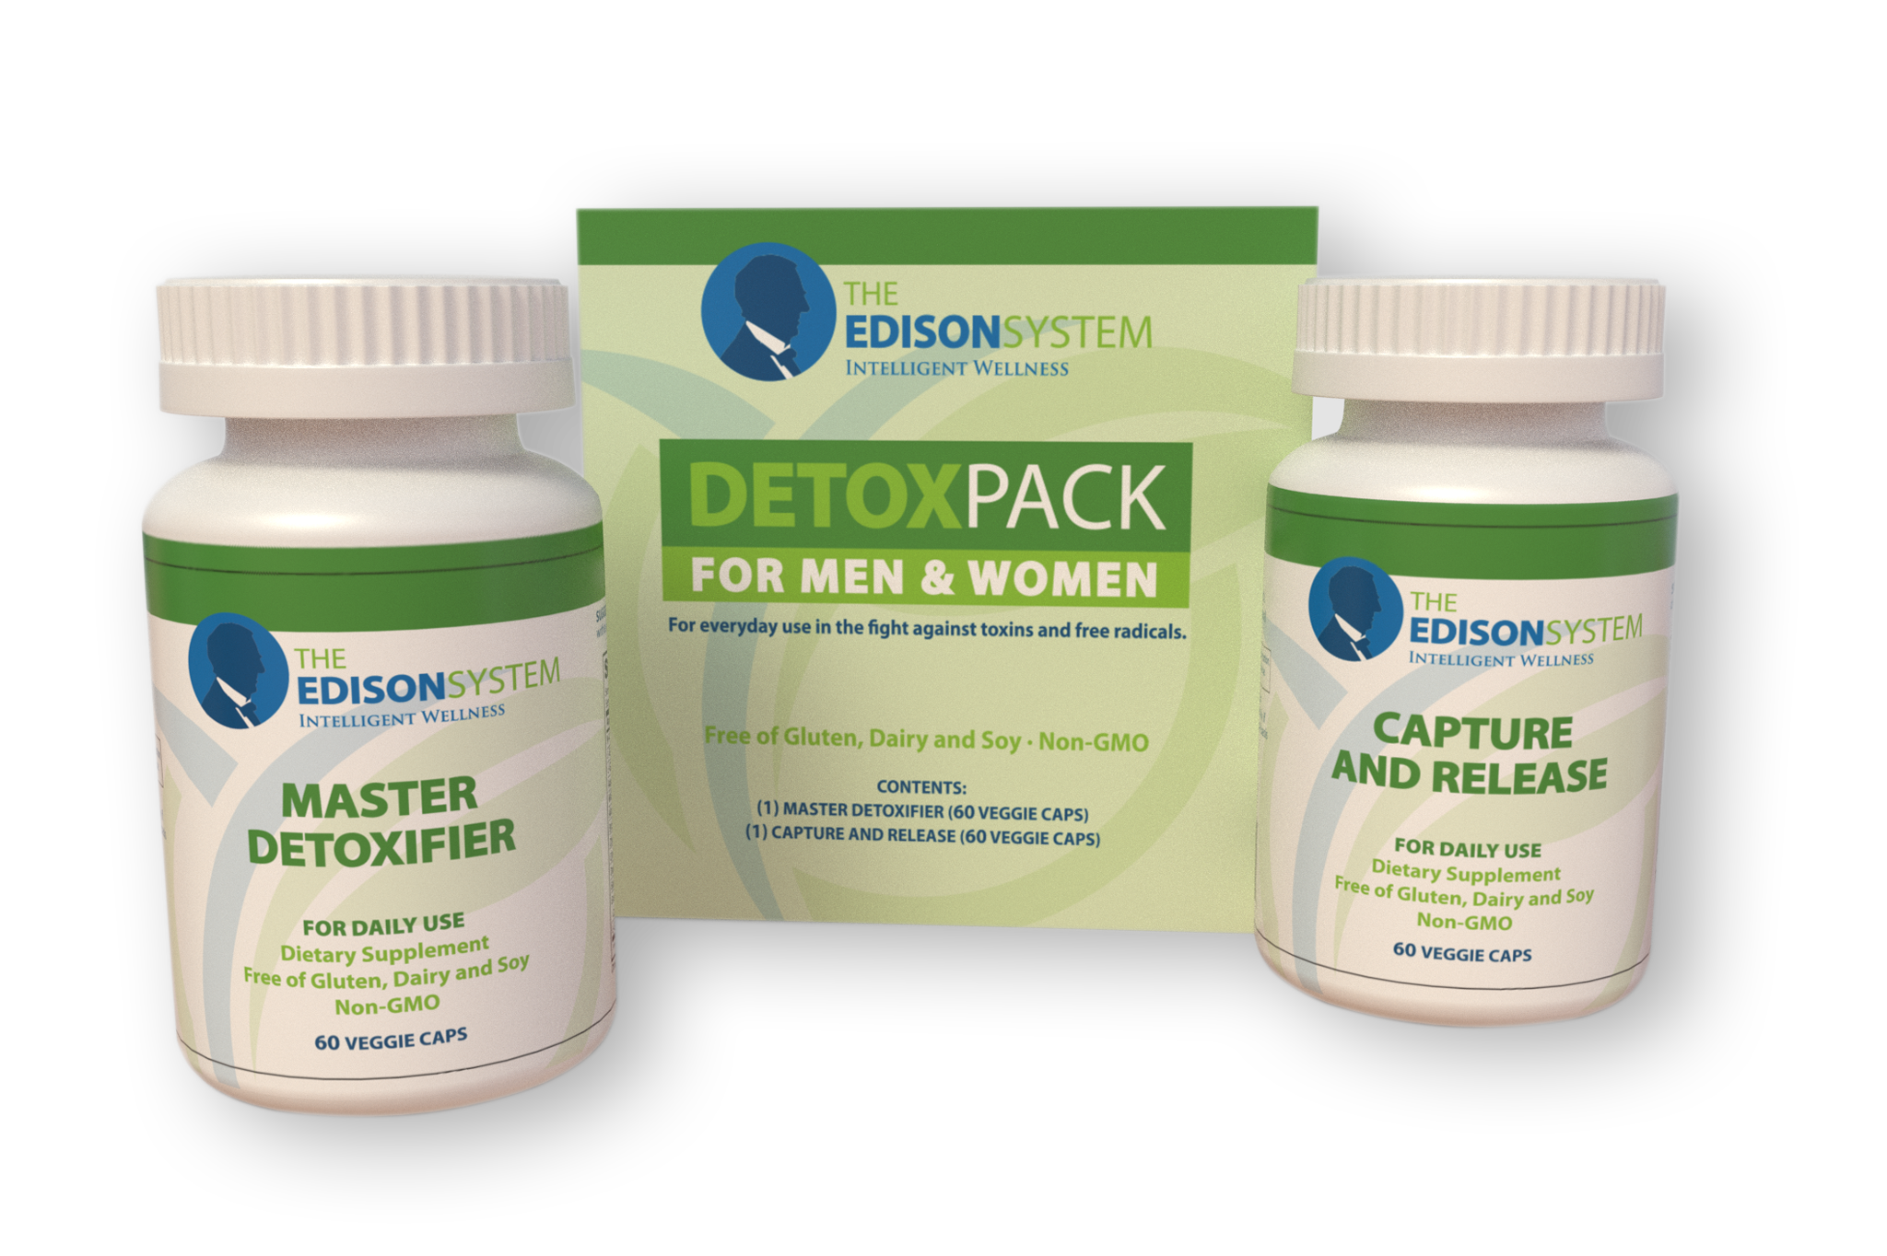
Notes:
NOTE: We have added a lot of information to this presentation. Please use what you need, and what you have time for, and delete slides that you don’t need. We thought it better to provide you with a robust presentation and allow you to modify to suit your needs. You will need to practice the presentation for timing.

Slide 42


