Slide 1
Leaky Gut

Slide 2
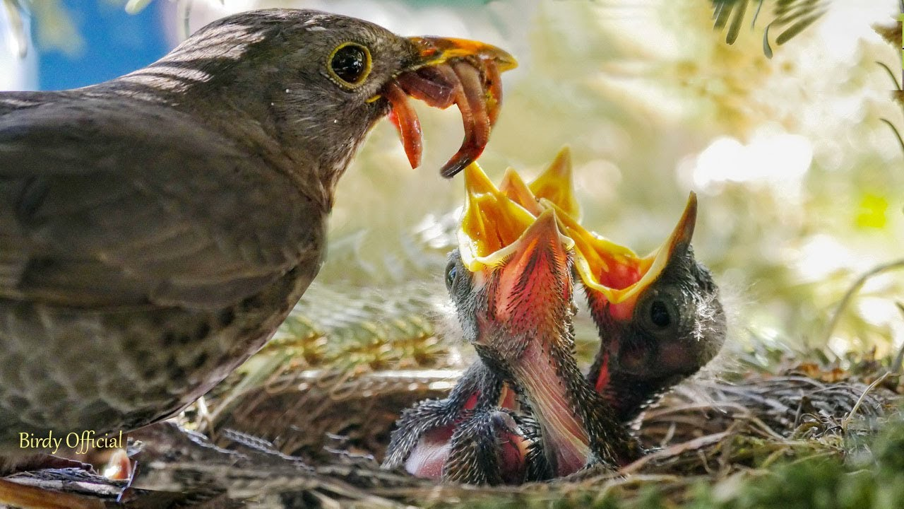
GI Ecology-
Your Microbiome Eats What You Eat

Slide 3


Reclaiming the GI Tract Neighborhood

Slide 4
DYSBIOSIS
Dysbiosis is the overgrowth of one or more less than favorable microbes, yeast or other organisms; or the lack of sufficient friendly flora to sustain a healthy GI neighborhood (called the microbiome).
Probiotics can be taken to help re-establish a healthier GI Tract, yet they require an “optimized ecology” to flourish. Put simply, which seems more hospitable?

Slide 5
Fungus, Yeast, & Candida albicans 101
Candida albicans is considered a normal commensal fungus in very small amounts yet when risks of yeast overgrowth manifest (previous slide); this opportunistic yeast takes advantage of a warm, moist, abundant food and welcoming GI Tract or mucus membranes.
The Human Body + Sugar –Weakened Immune System = Home for Yeast
98.6 degrees + Moisture + Sugar = Human Petri Dish

Slide 6
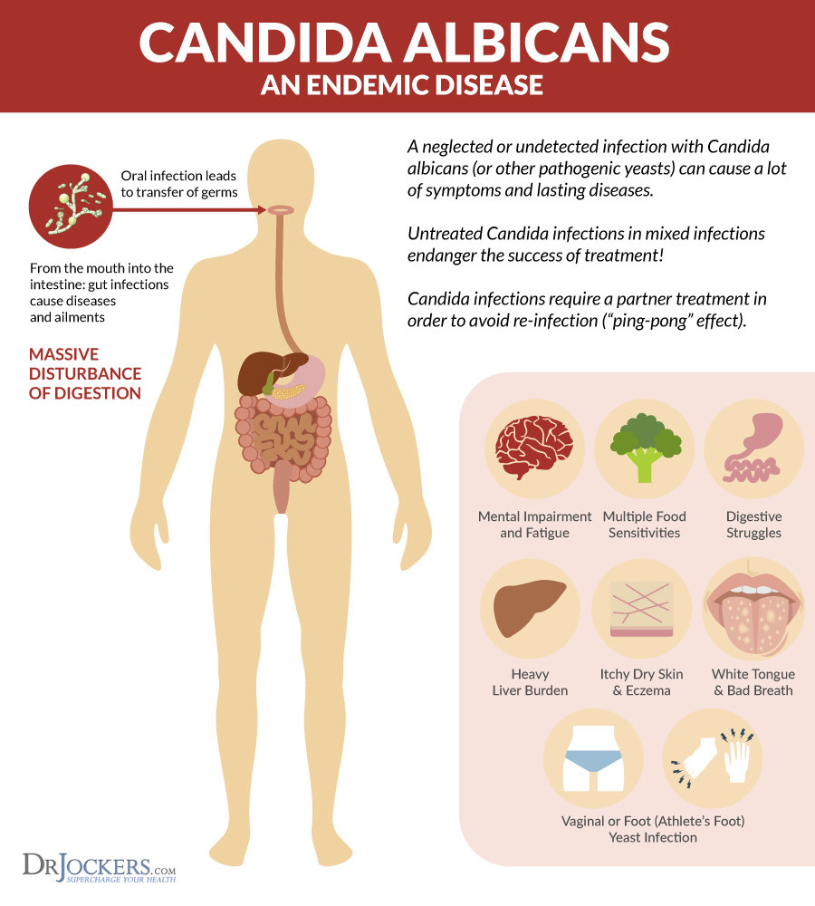

Slide 7
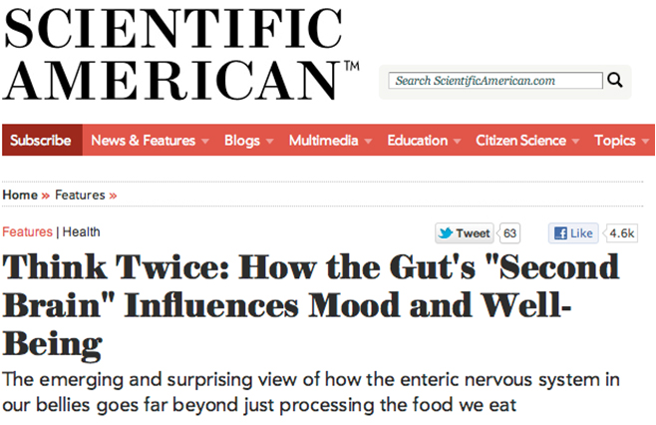
Your second brain (Gut-Brain Connection)
Our gut microbiota play a vital role in our physical and psychological health via its own neural network: the enteric nervous system (ENS), a complex system of about 100 million nerves found in the lining of the gut.
Notes:
Explain how the gut is our second brain.
Raise your hand if you’ve heard of serotonin? What does it do for you? Happy and sleep. 90% of the serotonin in your body is made in the GUT!
Our gut microbiota play a vital role in our physical and psychological health via its own neural network: the enteric nervous system (ENS), a complex system of about 100 million nerves found in the lining of the gut.
The ENS is sometimes called the “second brain,” and it actually arises from the same tissues as our central nervous system (CNS) during fetal development. Therefore, it has many structural and chemical parallels to the brain.
Our ENS doesn’t wax philosophical or make executive decisions like the gray shiny mound in our skulls. Yet, in a miraculously orchestrated symphony of hormones, neurotransmitters, and electrical impulses through a pathway of nerves, both “brains” communicate back and forth. These pathways include and involve endocrine, immune, and neural pathways.

Slide 8
Waiting for the Opportunity to Grow
“Opportunistic”
Candida albicans is a fungus that normally grows in small amounts in the intestines, mouth, and skin. It can grow as either an oval-shaped budding yeast (blastospore) or as pseudohyphae or true fungal hyphae. Both yeast and fungal forms are usually found in infected tissues.
Under certain conditions, a fungal, bacterial overgrowth can occur whereby it proliferates in excessive amounts. This is known as candidiasis and can lead to many health problems including diarrhea, constipation, and other digestive issues, itchy skin and anal itching, fatigue, and recurrent vaginal yeast infections and nail fungus infections.
www.ncbi.nlm.nih.gov/books/NBK2486/
Infect Immun. 1993 Feb; 61(2): 619-26.
Yonsei Med J. 2013 Jan 1;54(1):160-5.
Contraception. 1995 May;51(5):293-7.
Candida Colonization on the Denture of Diabetic and Non-diabetic Patients. 2009 Spring; 6(1):23-7.

Slide 9
Tiredness and Fatigue
Common symptom of associated Candida is fatigue. (though not proven via scientific studies—yet seen in practice)
Candidiasis can be associated with nutritional deficiencies; vitamin B6, essential fatty acids and magnesium.
Low-functioning immune system can contribute to feeling tired and fatigued.
One study suggests that prolonged candidiasis of the gut may even be a potential cause of chronic fatigue syndrome.
.
www.orthomolecular.org/library/jom/1985/pdf/1985-v14n01-p050.pdf
Clin Kidney J. 2012 Feb; 5(Suppl 1): i3–i14.
Med Hypotheses. 1995 Jun;44(6):507-15

Slide 10
Digestive Issues
The health of your digestive system relies heavily on a good balance between the “good” and “bad” microbes
Imbalanced gut bacteria contribute to digestive issues, including constipation, diarrhea, nausea, gas, cramps and bloating.
Overgrowth is associated with several diseases of the gastrointestinal tract, including ulcerative colitis and Crohn’s disease.
Curr Opin Microbiol. 2011 Aug; 14(4): 386–391.

Slide 11
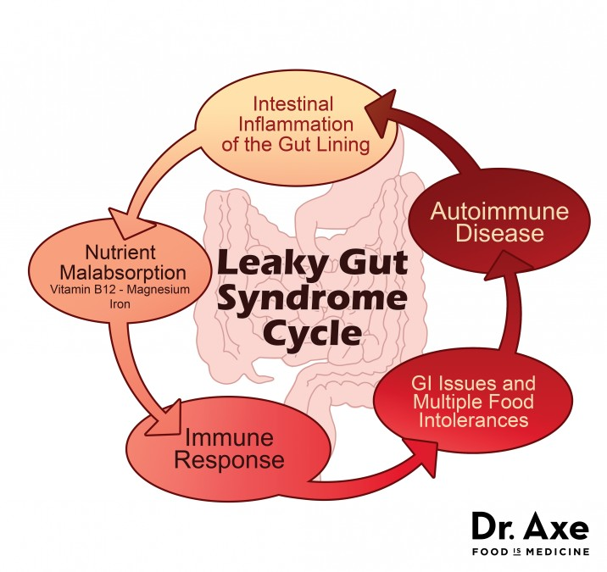

Slide 12
Creating a Sustainable Good Neighborhood
The key is to create a healthy gut ecology that is not conducive to yeast growth and that eliminates the presence of existing fungal overgrowth.
Patience and perseverance will be required as the yeast overgrowth developed over time and has proliferated.
Yeast, fungal overgrowth can also impair intestinal permeability (i.e. cause leaky gut), which can take time to heal.
Cell Microbiol. 2016 Jul;18(7):889-904.

Slide 13
Risks of Yeast, Fungal Overgrowth
Chronic food sensitivities
Taking antibiotics, microbiome imbalance
Diet high in sugar, refined carbs, and lectins
TOXINS!
High alcohol intake
Weakened immune system
Taking oral contraceptives
Diabetes (Consider HA1c)
High stress levels (Consider Cortisol Test)
www.ncbi.nlm.nih.gov/books/NBK2486/
Infect Immun. 1993 Feb; 61(2): 619-26.
Yonsei Med J. 2013 Jan 1;54(1):160-5.
Contraception. 1995 May;51(5):293-7.
Candida Colonization on the Denture of Diabetic and Non-diabetic Patients. 2009 Spring; 6(1):23-7.

Slide 14
IgG
• lgG antibodies – High concentrations of specific lgG antibodies against Candida species may indicate past or chronic infections.
The lgG antibodies are the major class of human immunoglobulins and are evenly distributed throughout both our intra- and extravascular fluids. Specific lgG antibodies may linger for a number of years post-infection.
Sera antibody values within the Equivocal range are considered indeterminant. Following up with another test 2 to 4 weeks later can be useful. This assay does not speciate Candida but is sensitive to numerous pathological Candida species.

Slide 15
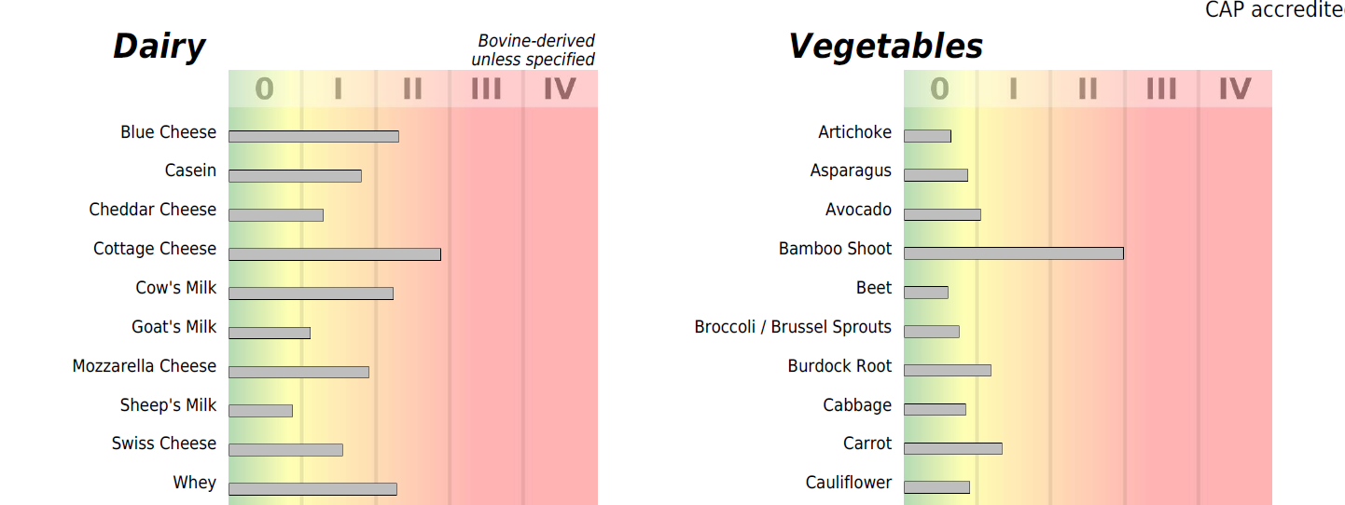
Food Sensitivity Results
Report includes:
Results provided in 2 formats
  Graph section
  Quantitative section
Diet Report Summary
Personalized Elimination/Rotation Diet Guideline

Slide 16
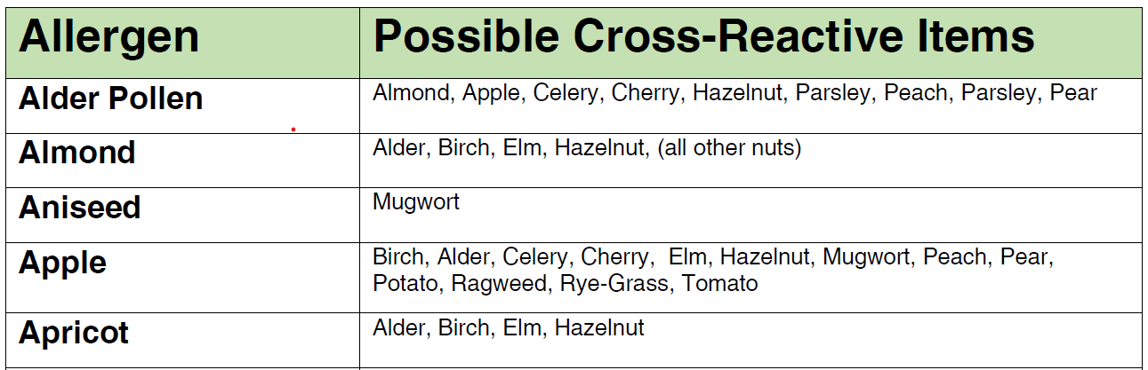
Cross-Reactivity Master List
Files can be found in the Monthly Promotional Material in the Well Aligned Portal on www.vitalleohealth.com:
Master List: Cross-Reactivity Master List
Inhalant List: Inhalant Cross-Reactivity List

Slide 17
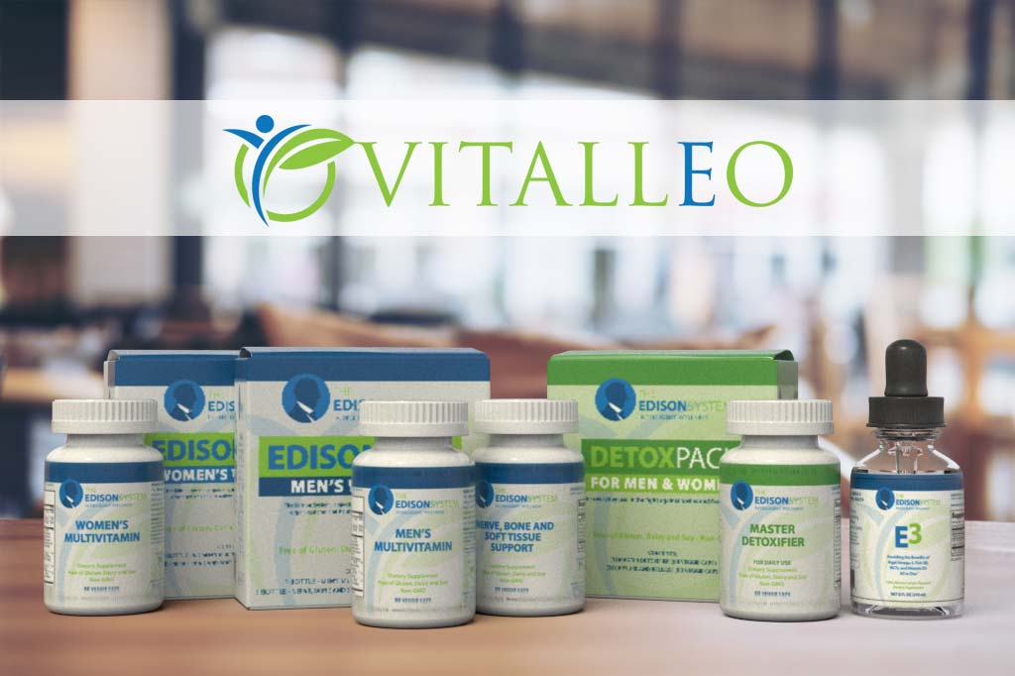
GUT REPAIR:
Supplement Considerations

Slide 18
Nutrients required for Gut Health
B Vitamins
Vitamin C
Selenium
Vitamin D
Zinc
Magnesium

Slide 19
Nutrients and the Gut
Healthy levels of Vitamin D are associated with a reduced risk for colon cancer.*
*Gut.Jun 25, 2015

Slide 20
Magnesium Deficiency
The bacteria in your gut pulls magnesium from other cells, leaving those cells deficient in magnesium – thus aggravating the existing deficiency.
Notes:
Magnesium is needed for more than 300 biochemical reactions in the body. It helps to maintain normal nerve and muscle function, supports a healthy immune system, keeps the heart beat steady, and helps bones remain strong. It also helps regulate blood glucose levels and aid in the production of energy and protein. Jan 7, 2017

Slide 21
Nutrients For Reducing Inflammation in the Gut
Turmeric has been recognized as beneficial for digestive help with heartburn, inflammation, and stomach ulcers.
Omega -3 to increase status for anti-inflammation and improve Omega-6:3 balance

Slide 22
Eliminating Candida Overgrowth
(GUT 90-RX)
Start with 1 capsules 2 times a day; gradually work up to 2 capsules 2 times a day.
Calcium Undecylenate
Pau D’arco Extract (Tabebuia avellanedae)
Enzymes (Cellulase, hemicellulase, proteases, serrapeptase, amylases, lipase, and chitosanase)
Berberine
Resveratrol
Sorbic Acid
Duration 3 to 9 months based on symptom improvement
(based on severity on original testing and diet changes)

Slide 23
Berberine and Pau D’ arco
Berberine has been found to disrupt the cell wall membrane of fungus and yest and it inhibits the alteration .
Pau D’arco Extract (Tabebuia avellanedae) also exhibits anti-Candida effects.
Braz J Biol. 2010 Nov;70(4):1065-8.
Sidahora. 1995 Winter:40-1.

Slide 24
Resveratrol
Resveratrol induces apoptosis (programmed cell death) in fungal/yeast cells, blocks the formation of Candida biofilms, and interferes with already formed biofilms.
Sorbic acid is an antifungal agent that builds up in the cytosol of Candida cells where it disrupts the cellular pH and energy homeostasis.
Curr Microbiol. 2015 Mar;70(3):383-9.
Folia Microbiol (Praha). 2018 May;63(3):261-72.
Front Microbiol. 2013 Nov 26;4:350.

Slide 25
Gut Healing
Multi-Prebiotic SS
2 capsules 2 times a day (does contain shellfish for N-acetyl glucosamine)
L-Glutamine
Inulin
Acacia Senegal
N-Acetyl-D-Glucosamine
Duration 3 to 9 months based on symptom improvement

Slide 26
Glutamine
Glutamine is the most abundant free amino acid in human plasma and skeletal muscle. Its roles include serving as fuel for cells of the gut mucosa and immune system.
Intestinal permeability is thought to increase after intestinal glutamine is depleted, and glutamine supplementation can strengthen the intestinal barrier.
L-glutamine has been found in numerous human trials to reduce intestinal permeability.
Glutamine
Muscle GI Tract Immune
Eur J Appl Physiol. 2017 Dec;117(12):2569-77.
Dig Dis Sci. 2012 Apr;57(4):1000-12.
Tumori. 2006 Sep-Oct;92(5):396-401.

Slide 27
GI Intestinal Permeability Health
L-Glutamine, Inulin, Acacia Senegal, N-Acetyl-D-Glucosamine
Passage of ions, water, and molecules through the intestinal wall is controlled by tight junctions of the epithelium.
Disruption of this pathway can result in increased intestinal permeability (leaky gut), which can lead to the translocation of endotoxins from the intestines into systemic circulation.
Eur J Appl Physiol. 2017 Dec;117(12):2569-77.

Slide 28
Inulin - Fueling a Healthy Microbiome
Inulin and FOS are prebiotics that work synergistically with probiotics to support intestinal health. Acacia Senegal (Gum Arabic) supports colon health and has been found to reduce colon tumors in mice.
N-acetyl-D-Glucosamine strengthens the intestinal barrier.
For example, in a study of rats with induced diarrhea predominant irritable bowel syndrome, the microvilli and tight junctions of intestinal epithelial cells were spaced more widely and the tight junction gap was widened.
After treatment with N-acetyl glucosamine, the microscopic structure of the intestinal mucosa largely normalized.
Nutr Cancer. 2010;62(6):802-10.
Bangladesh J Pharmacol. 2012 Oct;7(4).

Slide 29
Probiotics and Prebiotic
Elimination and Post-Antibiotic Support
ProBiotic Pro 1 capsule with smallest meal of day
Bifidobacterium bifidum
Bifidobacterium breve
Lactobacillus rhamnosus
Saccharomyces boulardii
Duration 6 to 12 months based on symptom improvement
Note: Should be used during and after any antibiotics for 3 to 6 months

Slide 30
S. boulardii
To offset the damaging effects of antibiotics on the gut microbiota and to discourage candidiasis, it is advised that patients taking antibiotics supplement with a high-dose post-antibiotic probiotic formula that includes Saccharomyces boulardii, L. rhamosus, B. bifidum, and B. breve. S. boulardii is a yeast-based probiotic that is not killed by antibiotics and is therefore especially supportive during antibiotic therapy.
World J Gastroenterol. 2010 May 14;16(18):2202-22.

Slide 31
BioFilm Mitigation
GI DR-PRO 1 capsule 2 times a day way
30 minutes before meal or 60 minutes after meal (not for patients with ulcers or gastritis)
Glucoamylase
Chitosanase
Cellulase
Hemicellulase
Beta-Glucanase
Protease/Peptidase, endopeptidase, exopeptidase, DPP-IV
Lysozyme
Serratia peptidase
Duration: 2 to 4 months depending on symptoms (discontinue if patient complains of gastric discomfort)

Slide 32
Probiotics and Prebiotics for Biofilm Disruption and Post-Antibiotics
Bifidobacterium bifidum, Lactobacillus acidophilus, Lactobacillus rhamnosus, Streptococcus thermophilus, Fructooligosaccharides, Saccharomyces boulardii, and Bifidobacterium breve
Restoring the gut microbiota during candidiasis can improve healing, while ongoing probiotic support can inhibit future Candida overgrowth. Lactic acid bacteria exhibits antifungal activity against Candida.
A combination of L. rhamnosus, L. acidophilus, and B. bifidum was found to inhibit the colonization of the oral cavity with Candida in elderly denture wearers.
One mechanism by which probiotics exert anti-Candida actions is through disruption of Candida biofilms.
Prebiotics such as fructooligosaccharides fuel probiotic organisms and can have synergistic actions when combined with probiotics.
Turk J Med Sci. 2019 Feb 11;49(1):375-83.
J Prosthodont. 2015 Apr;24(3):194-9.
Biofouling. 2018 Feb;34(2):212-25.
Appl Microbiol. 2016 Dec;121(6):1737-44.

Slide 33
Diet
Food sensitivity plan.
Eating foods that contain gluten is also discouraged.
Modified Mediterranean: Avoiding carbohydrates is critical to restoring the health of patients with candidiasis. Carbohydrates feed yeast, as illustrated by the fact that bread needs yeast to rise.
Fermented foods such as beer also require yeast, which is why fermented foods are excluded on a typical anti-Candida diet.
This diet also excludes sugar, sweeteners of any kind including honey, white potatoes, and refined carbohydrates including baked goods and white pasta.
Many practitioners also ask their Candida patients to avoid cheese due to the mold content.

Slide 34
Diet – More Food for Thought
Permitted are organic meats, non-starchy vegetables, brown rice, and quinoa. (limit carbs to 100 grams/day)

Slide 35
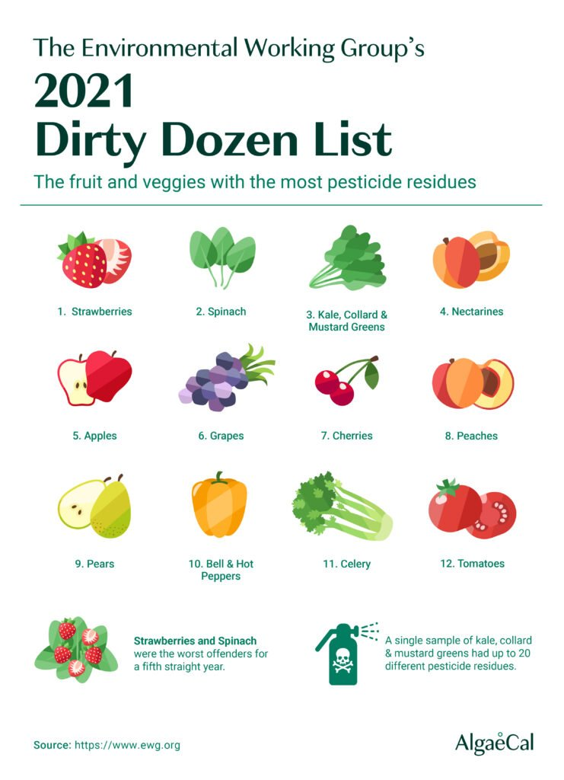
Avoid the Dirty Dozen Foods
The 2021 Dirty Dozen Foods List
Strawberries
Spinach
Kale
Nectarines
Apples
Grapes
Cherries
Peaches
Pears
Bell & Hot Peppers
Celery
Tomatoes

Slide 36
Retesting and Additional Testing
Food Sensitivity Testing- Remeasure 6 months after eliminating reactive foods and working on gut for 4 months health
Difficult cases: Test Cortisol and HbA1C
Severe: Stool

Slide 37


