Slide 1

Gut Microbiota and Healthful Aging
Chris D. Meletis, ND

Slide 2
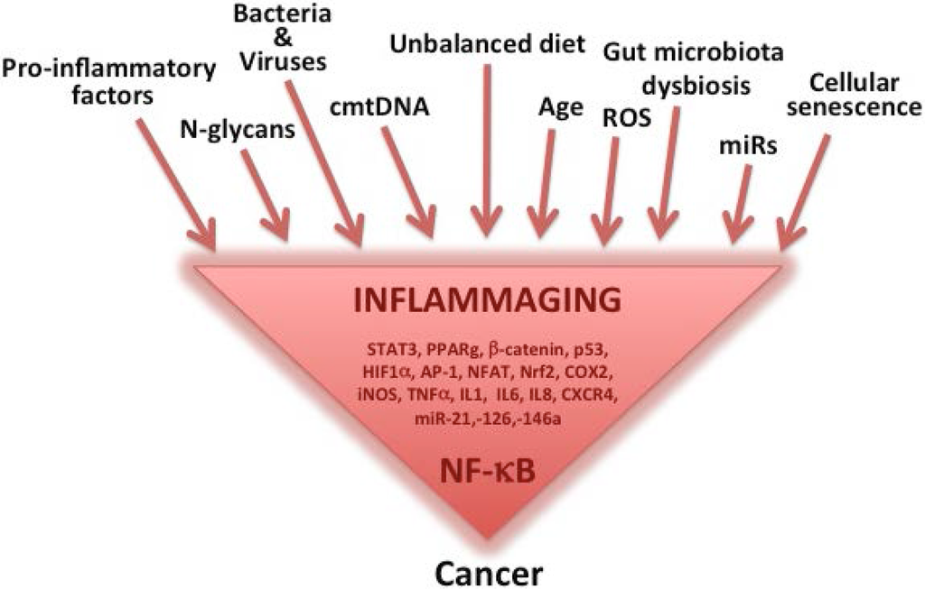

Health Risks
Nutrients 2015, 7(4), 2589-2621

Slide 3
Aging and Dysbiosis
The gastrointestinal tract is home to trillions of microorganisms, including any of 15,000 to 36,000 microbial species.
Each individual is estimated to host at least 160 different species that essentially constitute an organ within the body and exert a profound effect on gastrointestinal function, immune modulation, and metabolic balance.
The gut microbiota is principally acquired during birthing, matures during infancy, evolves during childhood, and changes with old age just as does every other organ system.
Proc Natl Acad Sci USA. 2007;104:13780-5.
Curr Opin Gastroenterol. 2008;24:4-10.
Nature. 2010;464:59-65.
FEMS Microbiol Rev. 2014;38:996-1047.
Acta Paediatr Suppl. 2003;91:48-55.
Nutr Workshop Ser Pediatr Program. 2005;56:43-56.
Adv Nutr. 2016;7:323-30.
BMC Microbiol. 2016;16:90.

Slide 4
Changes in GI Function with Aging
Aging is associated with diminished stomach acid production, increased gastric pH, delayed gastric emptying, and decreased gastrointestinal motility, all of which can negatively affect the microbiota.
These physiologic changes, together with a lifetime of poor diet and repeated exposures to antibiotics, nonsteroidal anti-inflammatory drugs (NSAIDs), and laxatives, contribute to a shift in the gut microbiome from diverse and balanced to dysbiotic.
Nutr Hosp. 2011;26:659-68.
J Neurogastroenterol Motil. 2017;23:3-4.
Appl Environ Microbiol. 2005;71:3692-700.

Slide 5
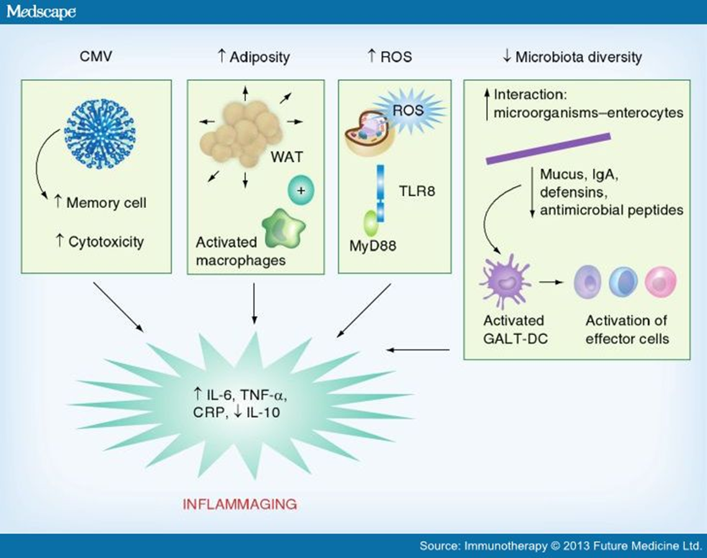

Slide 6
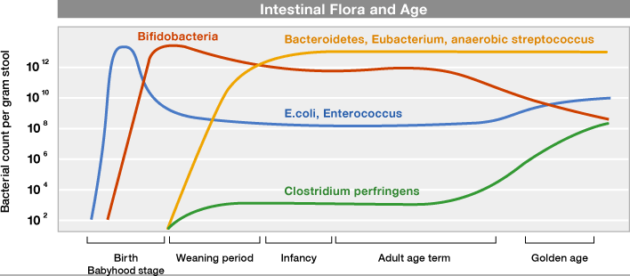
Aged Gut
Although considerations of diet and ethnicity complicate the definition of an “aged” gut microbiota, these data indicate that intestinal microbiota composition and diversity has a significant effect on health maintenance and disease incidence during aging.
www.otsuka.co.jp
Nutrients. 2013;5:162-207.
J Med Microbiol. 2008;57:1007-14.
Appl Environ Microbiol. 2006;72:1027-33.
Nature. 2012;488:178-84.
Proc Natl Acad Sci USA. 2011;108 Suppl 1:4586-91.

Slide 7
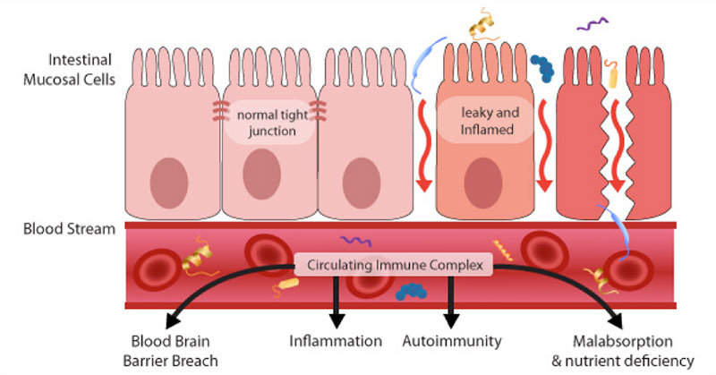
Intestinal Permeability and Inflammation
An age-related increase in gut wall permeability to microorganisms and microbial constituents, reflected by an increase of circulating antibodies against commensal gut bacteria, may contribute to systemic inflammation.
Curr Rheumatol Rep. 2013;15:314.
Clin Sci (Lond). 2015;129:529-31.
Front Immunol. 2015;6:223.
J Gerontol A Biol Sci Med Sci. 2012;67:1212-8.

Slide 8
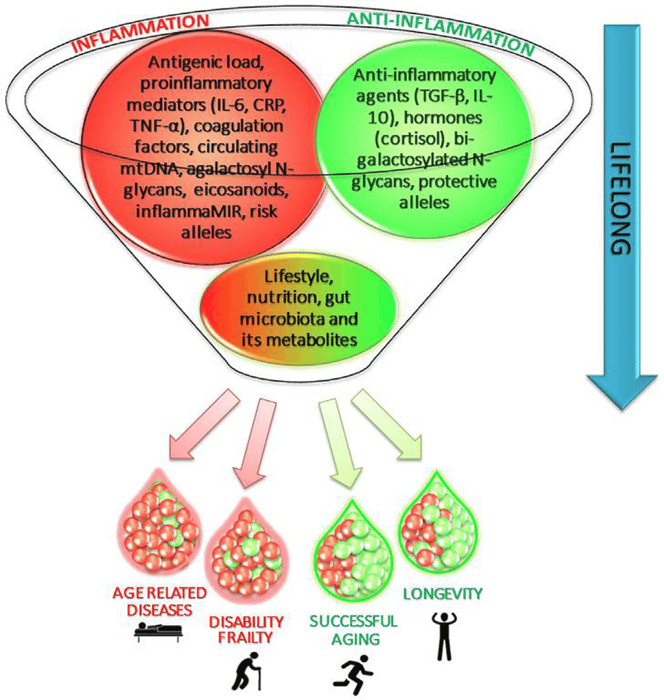
Mechanisms of Ageing and Development, pending publication 2017

Slide 9
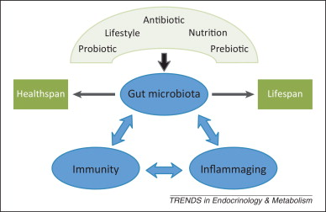
The Gut Microbiota and Healthy Aging
One of the important keys to healthful aging and longevity is to develop and maintain an immune system that minimizes chronic inflammation without compromising the body’s ability to respond to pathogens and neoplastic cells.
Individuals who live to 100 years or more have well-conserved immune parameters such as preserved T cell repertoire and, despite showing some inflammation markers, avoid or delay major inflammation-driven, age-related diseases.
Nutr Rev. 2007;65:S173-6.
Mech Ageing Dev. Dec 31, 2016.
Immun Ageing. 2012;9:5.
Immun Ageing. 2007;4:4.

Slide 11
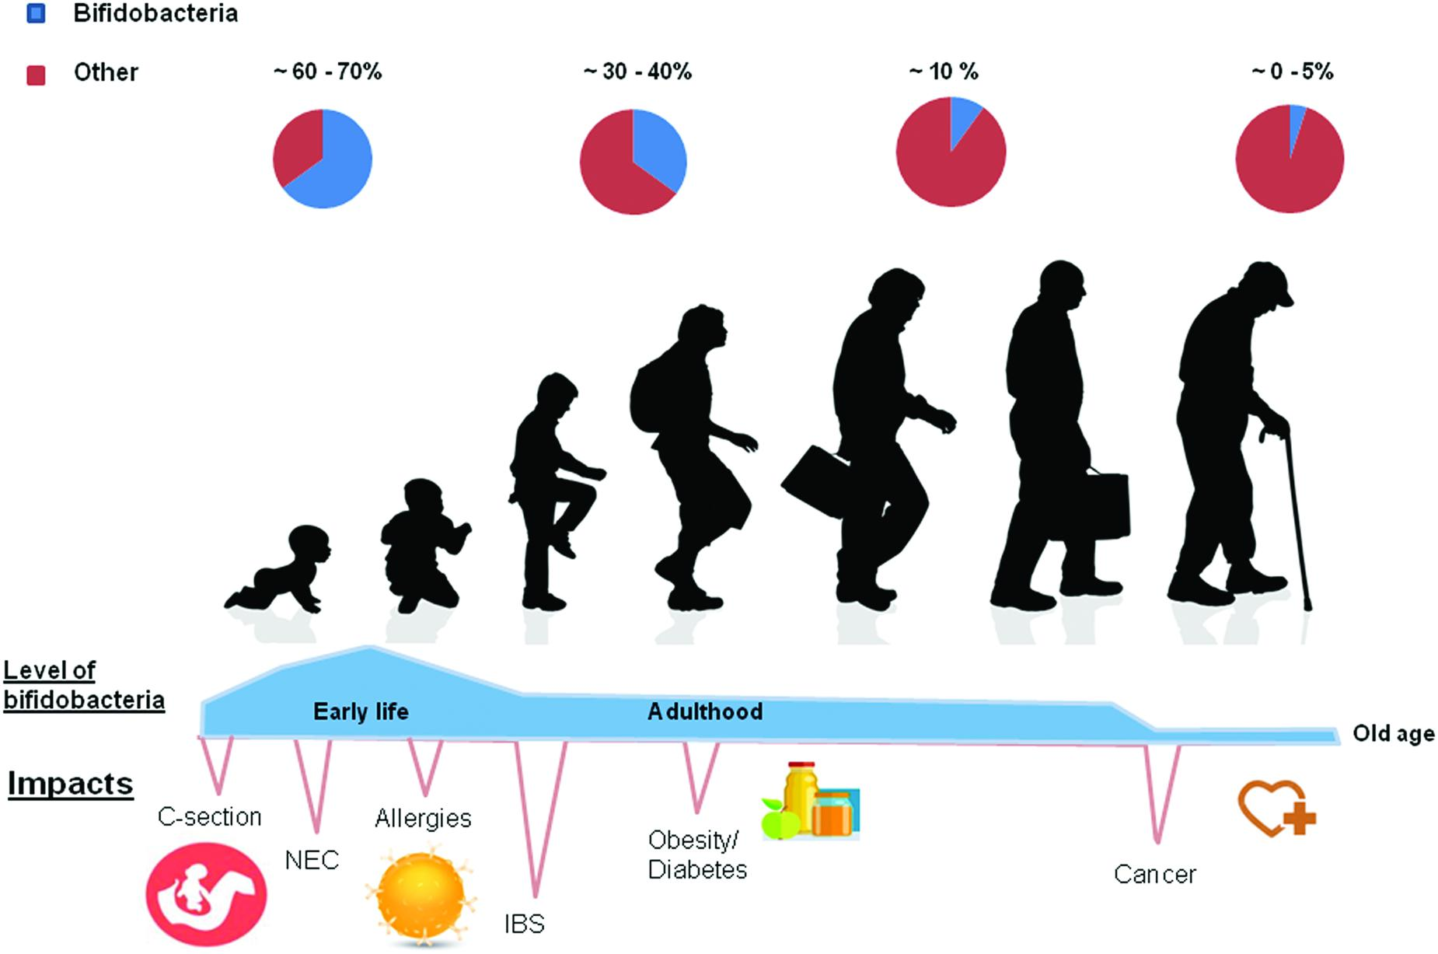
Probiotics for Healthy Aging
Front. Microbiol., 19 August 2016

Slide 12

Aging from Within– Time to Look Deeper
IF WE AREN’T TESTING WE ARE GUESSING!!!

