Slide 1
Condition-Specific Patients

Slide 2
WHAT YOU CAN EXPECT:
HOW TO GET LASTING RELIEF WITHOUT THE USE OF DANGEROUS DRUGS OR SURGERY

Slide 3

Notes:
You’re likely only used to drugs, surgery, or PT as a solution. Some have even tried alternatives like massage, acupuncture, or standard chiropractic. What we’re discussing here are techniques, dietary protocols, and technologies being used in medicine and all over the world successfully every day and with research in the leading medical journals. You may not be aware, but it’s nothing we’ve created on our own or new – so make sure to pay careful attention to the details – it will get you to that 60-100% better.

Slide 4
The Fact Is You Can Experience:
60%-100%
Improvement?

Slide 5
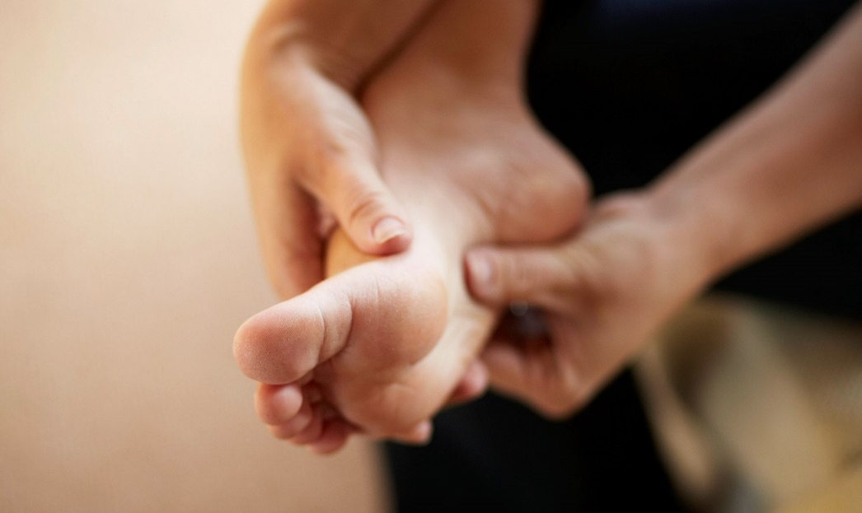
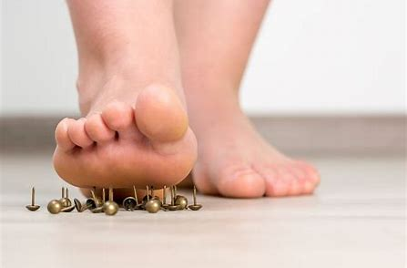
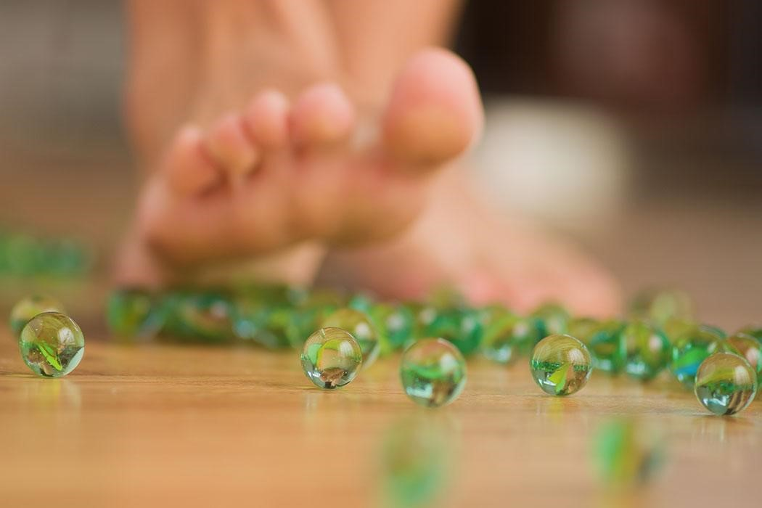
WHAT ARE SOME OF YOUR SYMPTOMS?
Notes:
Severe foot pain, like your stepping on a tac, stepping on marbles?Common symptoms of neuropathy, fibromyaglia, plantar fasciitis and other nerve or soft tissue conditions.

Slide 6

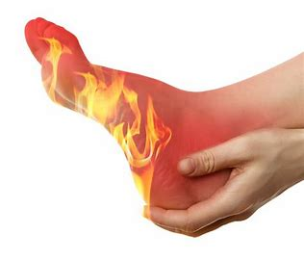
Numbness, Burning, or Cold Feet?

Slide 7
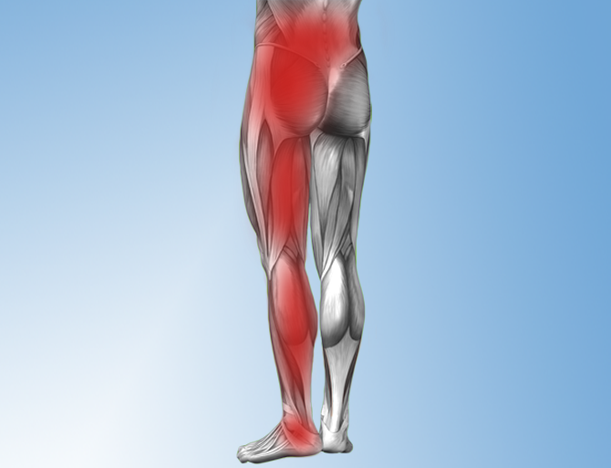
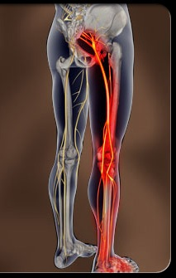
Pain Radiating Into The Hips, Legs, and Feet

Slide 8
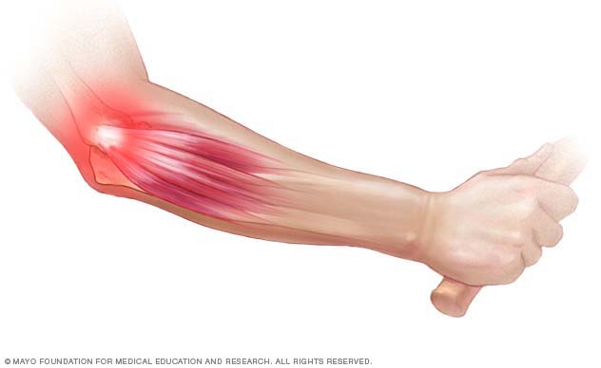
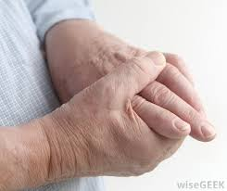
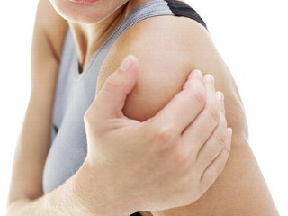
Upper Extremity Pain?

Slide 9
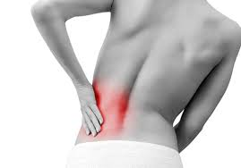
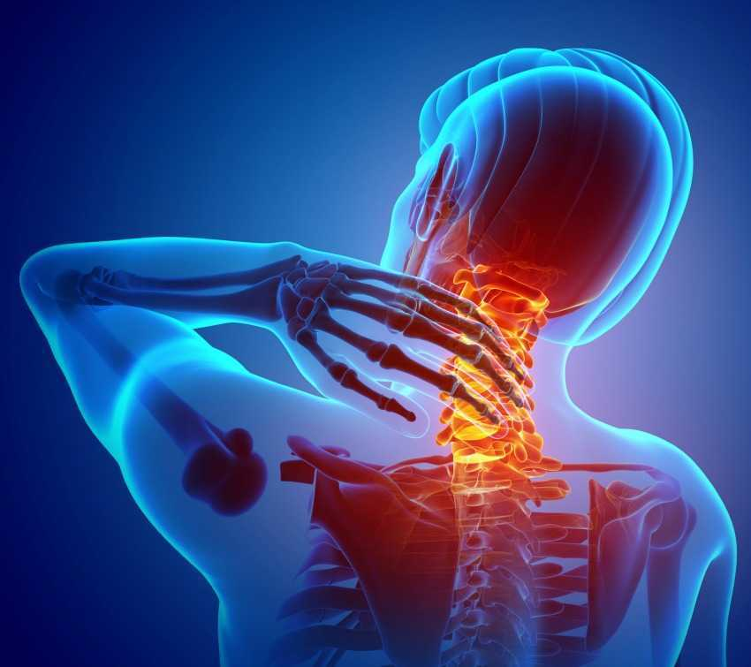
BACK and NECK PAIN?

Slide 10
After Today You Will Know:
The documented facts about standard treatments for common inflammatory conditions
What could be causing your pain
The extreme dangers of uncorrected inflammatory illness
Proven methods for creating lasting relief
Easy steps you can take to today

Slide 11
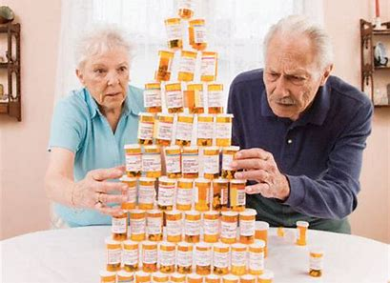
TOO MANY DRUGS!
WE AVERAGE 18 NEW MEDICATIONS EACH YEAR!
The US Consumes 75% Of The Medications
Produced In The World. (NIH, 2014)
Notes:
Who here is tired of the standard: taking medications?
According to a 2014 study, The Institute for Healthcare Informatics found that people aged 65-79 receive more than 18 prescriptions for new drugs per year.

Slide 12
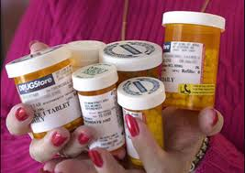
Are you tired of taking medications?
We average 18 new prescriptions per year!
Notes:
(Speaker, raise your hand)
How many of you are tired of taking too many medications every day?
According to a 2014 study, The Institute for Healthcare Informatics found that people aged 65-79 receive more than 18 prescriptions for new drugs per year.

Slide 13

THE U.S. SPENDS $3.3 TRILLION ON HEALTH CARE!

Slide 14
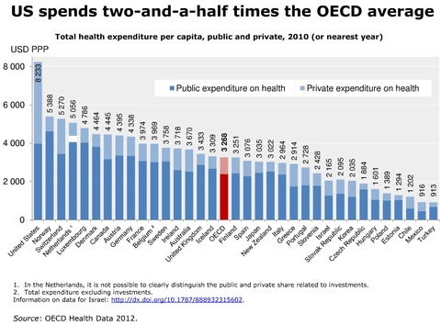
2.5x The Other Economically Developed Countries
Notes:
Organization for Economic Cooperation and Development

Slide 15
ARE WE BETTER OR WORSE?
Notes:
With all of the money and resources we put towards health

Slide 16
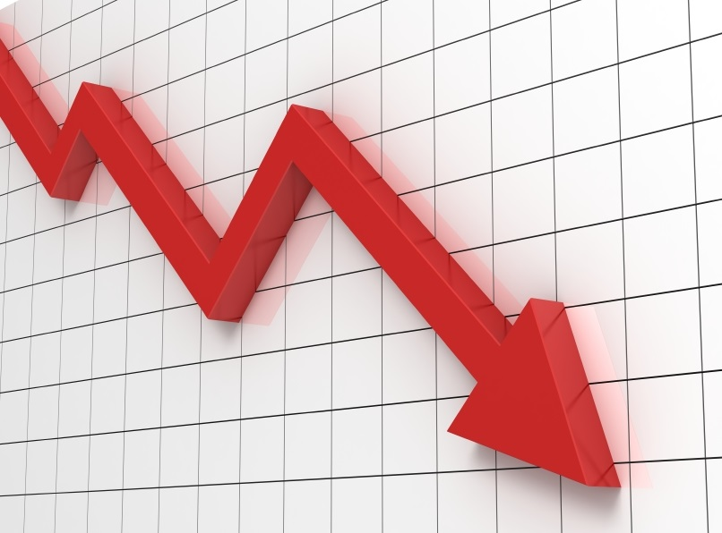
LIFE EXPECTANCY?
Notes:
Life expectancy in the United States declined again in 2017, the government said Thursday in a bleak series of reports that showed a nation still in the grip of escalating drug and suicide crises.
The data continued the longest sustained decline in expected life span at birth in a century, an appalling performance not seen in the United States since 1915 through 1918. That four-year period included World War I and a flu pandemic that killed 675,000 people in the United States and perhaps 50 million worldwide.
https://www.washingtonpost.com/national/health-science/us-life-expectancy-declines-again-a-dismal-trend-not-seen-since-world-war-i/2018/11/28/ae58bc8c-f28c-11e8-bc79-68604ed88993_story.html?noredirect=on&utm_term=.2bf8887912a3

Slide 17
We are Seeing Concerning Increases...
Diabetes
Heart Disease
Neuropathy
Notes:
And we are seeing concerning increase – diabeties, Hearth disease, and Neuropathy
The healthcare statistics in the United States tells us that we are losing ground these chronic conditions. The numbers are skyrocketing, going up very quickly, As a matter of fact, with conditions like diabetes, we are seeing in younger and younger patients now, it used to be unheard of to see 13-14 year-old type II diabetes, now it is epidemic.
The youngest documented case of type two diabetes was just released September 2015. She is only 3 years old.

Slide 18

Going Up or Down?
Diabetes THEY’RE ALL UP!
Cancer
Neuropathy
Fibromyalgia
Alzheimer’s
Depression
Auto-immune Dx, Etc.

Slide 19

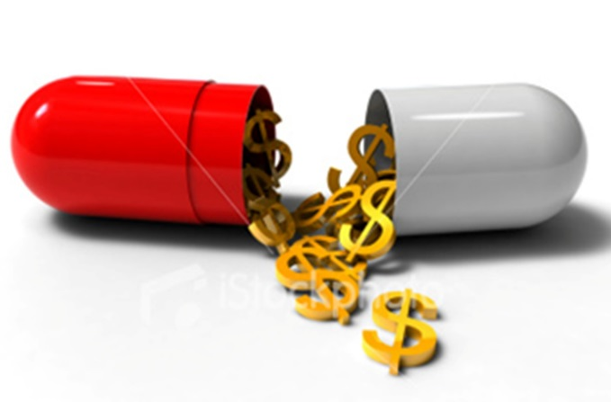
OUTRAGEOUS!!!
$3.2 Trillion!
** Centers for Medicaid and Medicare Service, 2015
Notes:
According to the Centers for Medicaid and Medicare Service, 2015 – we are spending $3.2 trillion on medical costs! …. Would you agree that this is outrageous?

Slide 20
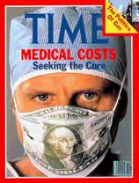
How Much Do We Spend On Health Care In The U.S.?
Notes:
Here’s another cover of Time Magazine – in which the article discusses that we are literally drowning in medical costs….
Who here can guess how much we are spending on medical costs? (pause for audience feedback)

Slide 21
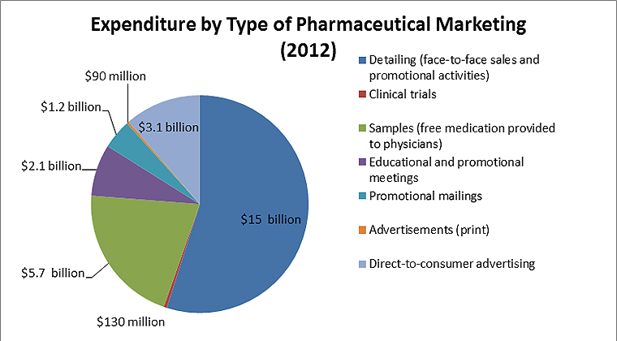
WHY DO WE DO IT?
Notes:
Brainwashed and It’s Free
Story of a man with his whole life ruined by health problems and drug side-effects. Asked why he doesn’t look for alternatives; it’s not covered. Hasn’t had a life in 20 years, but at least it’s covered.

Slide 22
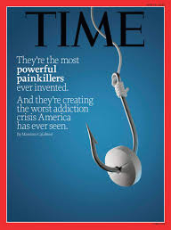
The Disturbing Trend in Medicine
Notes:
Nearly 200 people are dying from opioid addiction each day
Americans more likely to die of opioid overdose than car crash, says council report
This is the cover of Time magazine . Can you see what this cover is saying?
They ran a story on healthcare in America and this was the cover story for their magazine. What the article says, from June of 2015 - is that US Citizens feel that we were overmedicated, and that as a country we were taking far too many medications – all of these being recommended by our doctors.. More importantly, there is an epidemic of addiction attacking our society today
How many of you feel the same way?

Slide 23
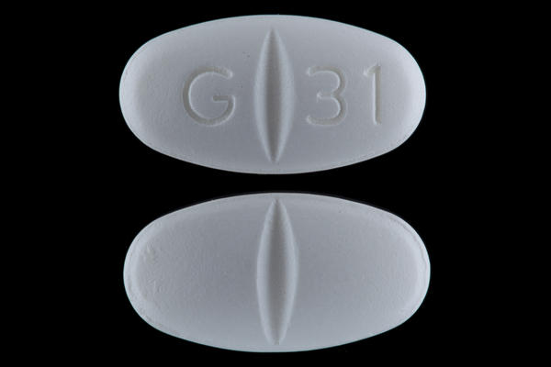
Neurontin (Gabapentin) & Lyrica
Anti Seizure Medications
Attempt to block your brain from feeling pain
Do not treat or stop the progression of the disease
Notes:
Ask this question to keep involvement- Who here has heard of Neurontin aka gabapentin, raise your hand?” This is the number one medication that doctors prescribed for neuropathy pain and it’s made by Pfizer. How many of you think Neurontin was made to treat Neuropathy?
It's actually an anti-seizure medication, it's for seizures, -- so what do you think a seizure medication is going to do for neuropathy, how do you think it works?
WAIT AND LISTEN FOR AUDIENCE TO GIVE YOU ANSWERS
It’s a pain management medication, so what it literally does is slow your brain down so you stop feeling the pain signals from your feet. It doesn’t heal your nerves, it’s not healing neuropathy, it’s not keeping it from getting worse. What is it actually doing, then? (let audience answer).. That’s right – masking the pain

Slide 24
Gabapentin, Lyrica, and Opioids
Disrupts the formation of new synapses, hindering the neuroplastic health and development of the brain.
New synapse formation is our brains fight to stay young and prevent dementia
Gabapentin/Lyrica are part of the opioid concern as addiction and overdose are common and deadly

Slide 25
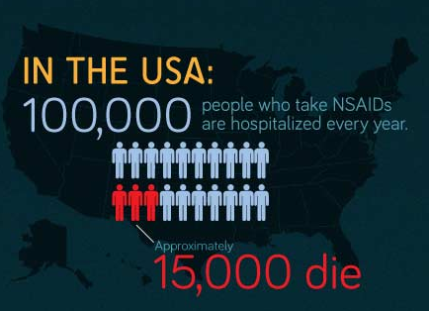

Slide 26
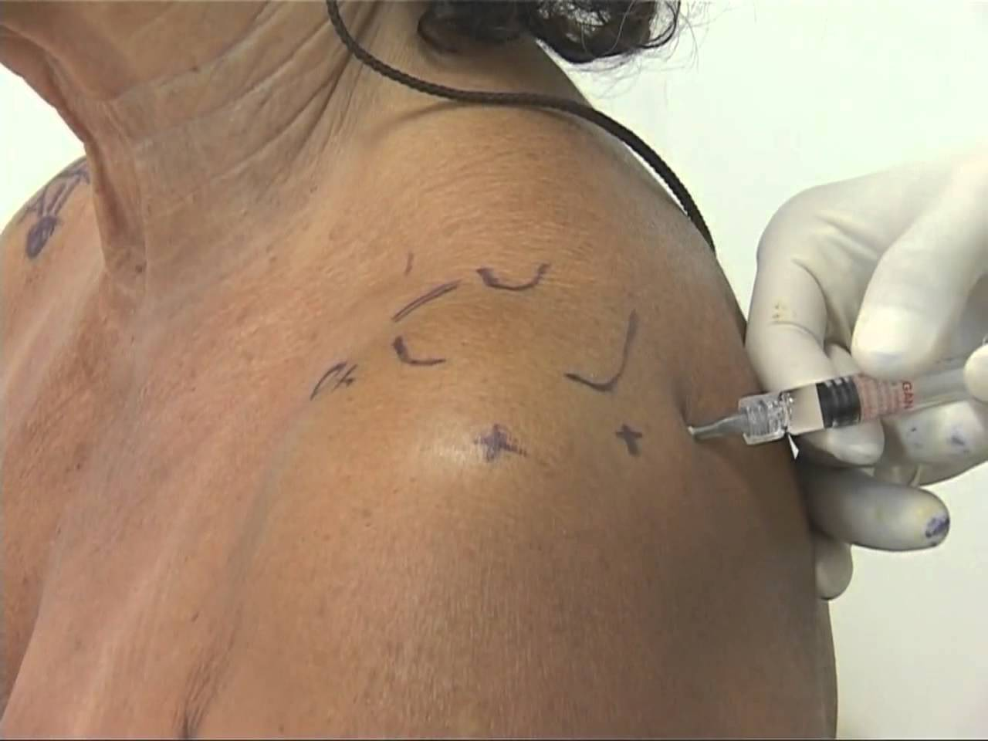
Other Solutions: Injections

Slide 27
Cortisone Injection Side-Effects
Dural puncture ("wet tap") Bleeding
Nerve damage Damage the joint and ligaments
Localized increase in pain Non-positional headaches
Facial flushing Anxiety
Sleeplessness Fever the night of injection
High blood sugar Decreased Immunity
Stomach ulcers Severe arthritis of the hips
Cataracts (avascular necrosis)
Notes:
A dural puncture (wet tap) may cause a post-dural puncture headache (also called a spinal headache) that usually improves within a few days. Although infrequent, a blood patch may be necessary to alleviate the headache. A blood patch is a simple, quick procedure that involves obtaining a small amount of blood from a patient from an arm vein and immediately injecting it into the epidural space to allow it to clot around the spinal sac and stop the leak.

Slide 28


Slide 29
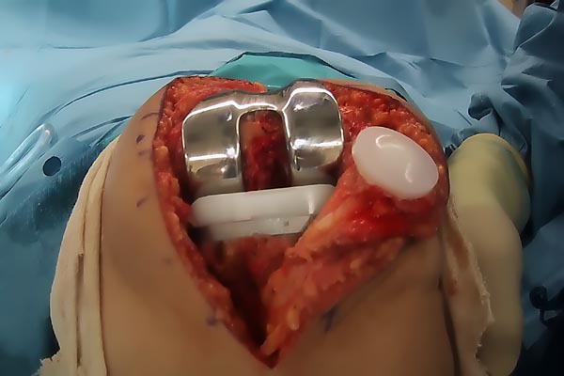
Joint Replacement Surgery
Notes:
This is a real picture. A good ending to avoid wherever possible.

Slide 30
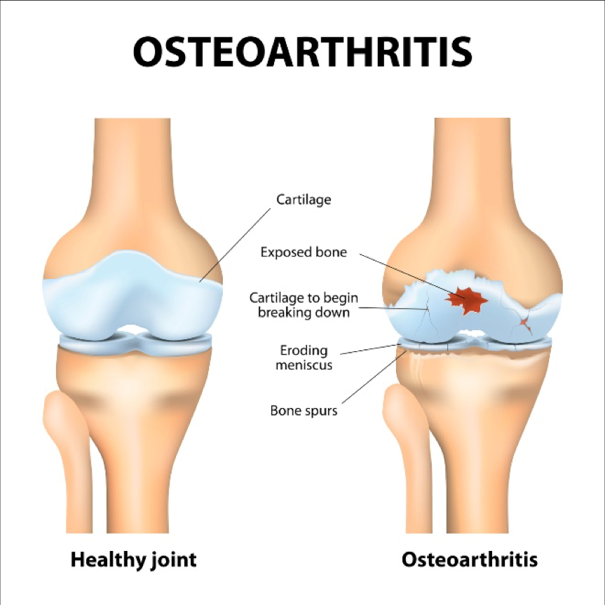
CAUSES?
Notes:
Unresolved injury
Subluxation
Poor biomechanics
Inflammation
Not Corrected with a drug or surgery. Masked or masking taped, but not healthy.
Not only that, the despite the drugs and surgery – the causes continue if not addressed. Even if you believe the drugs or surgery are needed or have already participated, you have to address the cause or it will eventually catch up with you – and usually with a vengeance. Just look at most people’s mobility after 55 or walk into the growing number of nursing homes in every community in N. America.

Slide 31
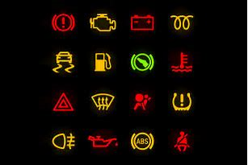
What Do You Do When The Light Flashes?
Notes:
Take it to the mechanic or cover it up with a piece of duct tape and keep going?
If you did keep driving, what eventually happens to the car?
Breakdown or – worse; engine or some vital part blows out completely, needs to be replaced, or the car becomes permanently damaged.

Slide 32

7 Common Warning Signs that you have Neuropathy:
Numbness
Burning Pain
Cramping
Sharp Electrical Pain
Prickling/ Tingling
Balance Problems and Falls
Can’t Sleep From Foot Pain
The Neuropathy Association, 2013.

Slide 33
Addressing The Causes of Peripheral Neuropathy
Diabetes/ Pre-diabetic
Poor circulation (micro-circulation)
Chemotherapy and medications
Spinal issues: subluxation, herniated discs
Spinal stenosis
Post-surgical
Autoimmune diseases
Infections (viral or bacterial)
Toxins, metals, and alcohol
Liver disease, kidney disease, thyroid conditions
Notes:
Diabetes is the number one cause of neuropathy, but it’s not the only cause, a lot of things can damage your nerves and cause neuropathy damage, this is a top 10 list.
You can be a pre-diabetic and still develop neuropathy.
Number two on the list is poor circulation, you are not getting enough blood supply to your peripheral nerves. Number three chemotherapy drugs, about 40 to 50% of all chemo patients end up with neuropathy because their medication has damaged their nerves.
Neck and back problem like spinal stenosis, disc problems, surgeries, hip replacements, knee replacements and back surgeries often times neuropathy, autoimmune diseases like lupus, infections like staph infections, and alcohol and cigarette smoking damages nerves.
What's the last one, does anybody see that one down there, several medications, there is a lot of medications on the market that can actually cause damage to your nerves.

Slide 34
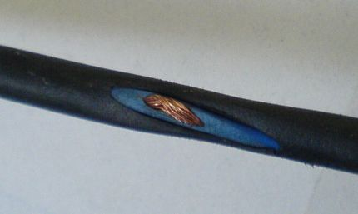
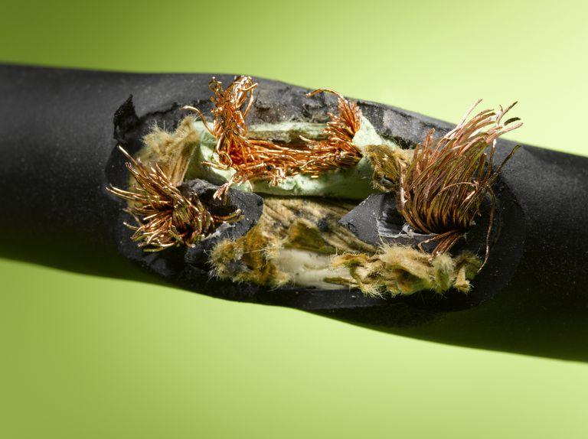
What Is Nerve Damage?
Notes:
EARLY … PROGRESSIVE
The insulation or rubber coating on the nerve is the myelin sheath. As nerve conditions progress, they continue actively eroding the sheath, exposing, and damaging the nerves until you do something to stop the progression of the disease and heal the nerves and damaged tissues.

Slide 35
Extreme Dangers of Pain and Numbness
Each year in the United States there are about 86,000 diabetes/neuropathy-related amputations, one of the most feared complications of the disease.
1/3 adults over 65 fall, with 10% of falls being fatal. Falls are the leading cause of injury death in the elderly.
Notes:
86,000 diabetics every year lose an extremity.
Source: Centers for Disease Control: Falls Among Older Adults: An Overview, 2012; Hwang et al., Medication-Related Falls in the Elderly: Causative Factors and Preventive Strategies, 2012.

Slide 36
PAIN CONDITIONS Address the Cause!
Plantar fasciitis
Facial pain
Inflammation in the muscles, joints, ligaments, and tendons
Systemic inflammation & oxidation
Toxic exposure
Back/neck – herniated disk, spinal stenosis
Post-surgical
Old accidents and injuries
Sports injuries
Posture, Repetitive Motion Injury, Sleep positions
Notes:
Many of the same causes of Neuropathy plus..

Slide 37
Causes of Fibromyalgia
Toxicities
Thyroid problems
Leaky gut syndrome
Adrenal burnout
Gene mutations
Full-scale inflammation caused by:
Spinal cord and nerve stress
Glutathione deficiency and
subsequent extreme oxidation
Food intolerances
Auto-immune conditions

Slide 38
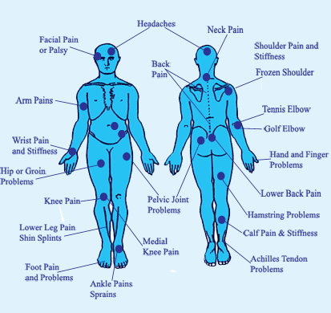
Universal Joint and Body Pain?

Slide 39
Options For Care
1. Do nothing
2. Drugs or Surgery
3. Address causes
Notes:
What are your options?

Slide 40
Medical
1. Medications
2. Testing
3. More Medications
4. Surgery and medications
Notes:
Engagement question? “Who here has been to a neurologist?”
When you go to neurologist they will run some nerve tests, confirm that you have neuropathy, then likely prescribe medication.
What medication do they prescribe?
That’s correct the same medications.

Slide 41

Many people have been told…
“Nothing Can Be Done”
“You Have To Live With It”
Notes:
This is what I hear from my patients on daily basis, “my doctor told me there was nothing he can do for me, I'm just going to have to live with it.”
Now who here has had THIS happen to them?

Slide 42

Have you been told you’d have to live with it or nothing could be done?
National Institute of Health says:
“Peripheral nerves have the ability to regenerate as long as the underlying nerve cell has NOT been killed.”
Notes:
The National Institute of Health says ““Peripheral nerves have the ability to regenerate as long as the underlying nerve cell has NOT been killed.”
What does that mean? Not been killed… It means that if you wait too late to where the nerve is dead, it can not be helped.

Slide 43
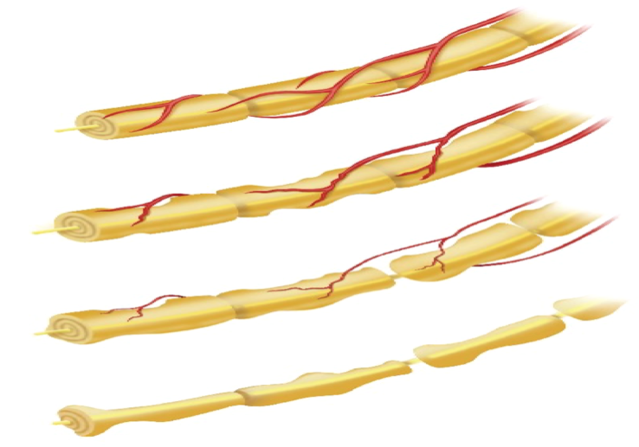
Best Type and Timing for Care
Notes:
At the top is a healthy nerve: it is whole and with full blood supply
As the disease progresses, the nerve deteriorates, you can see the rat bites taken out of it, and the blood supply diminishes. At this point, you’re having problems, but people will often ignore the problems here or just take medication. If you ignore or cover with drugs – what happens?
Level 3 – late stages of the disease, but as the NIH said, there’s still a “live” or viable nerve left so we can still turn this around.
At level IV, the nerve is dead and there’s nothing that can be done.
What’s the best timing to catch this diease?

Slide 44
Neuropathies and Joint Issues are a Progressive Disease
Notes:
When should you start?

Slide 45
Steps to recovery for Nerve, Joint, and Muscle Disease:
Testing to see what can be done
Determine if anything can be done
Notes:
So, there are 4 keys to feeling better:
Rejuvenate by increasing blood flow
Stimulate the nerves
Activate through therapy
Empower by decreasing inflammation

Slide 46
5 STEPS TO RECOVERY
1. Correct the spine and nervous system.
2. Light therapy to increase circulation and boost the body’s ability to heal nerves and damaged tissue.
3. Address inflammation with diet.
4. Anti-inflammatory supplementation.
5. Assess any inherent, poor genetic coding.

Slide 47
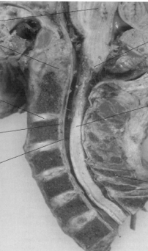
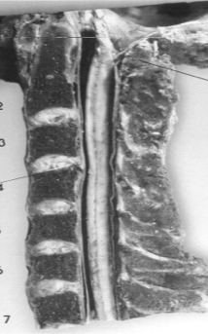
Stabilize Subluxation Degeneration

Slide 48
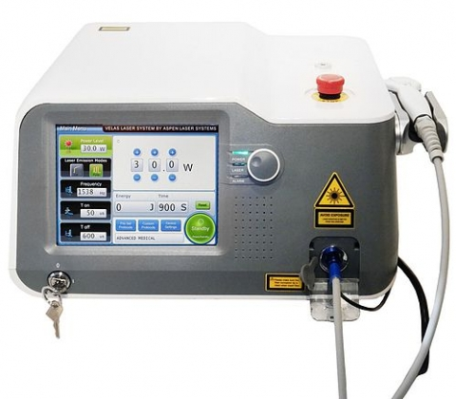
CLASS IV LASER THERAPY

Slide 49
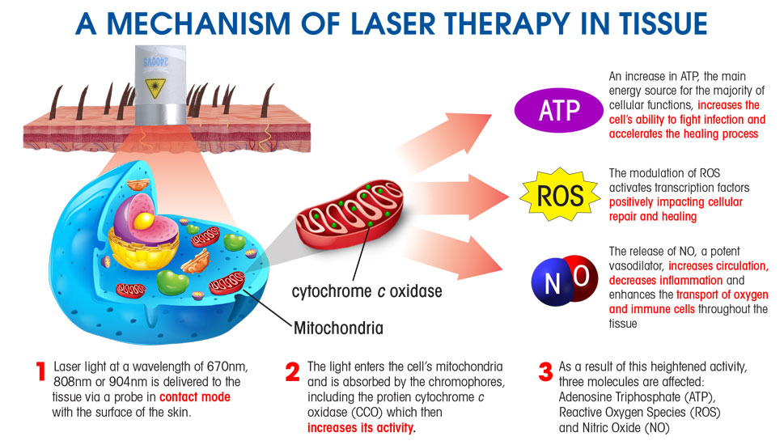
HOW LASERS WORK

Slide 50
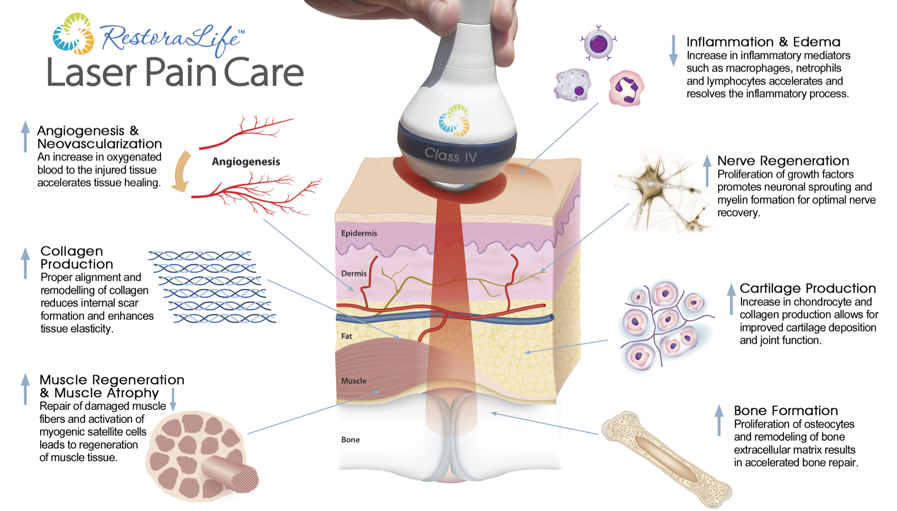
Laser Therapy: Repairing Damaged Nerve and Muscle Tissue

Slide 51
Laser Use In Healthcare
Virtually every branch of medicine utilizes laser light therapies.
There are over 2,000 references in the Index Medicus relative to promoting healing and pain relief.
Notes:
The device is used to heal the damaged nerves and tissues

Slide 52
Laser in Traditional Medicine
“If the traditional avenues did not work, our patients were without much hope. Adding MLS Laser Therapy to our practice has revolutionized how we can care for our patients. What we’re finding is that over 90% of our patients are experiencing significant improvement of their symptoms in as little as two treatments.“
-Ronald S. Lederman, MD
Center for Orthopedic Surgery, Sports Medicine & Physical Therapy

Slide 53

Why Doesn’t My Doctor Know About This?
Notes:
Some of you may be asking yourself ‘why doesn’t my doctor know about this?” - Well, that’s a fair question.
According to the Journal of American Medical Association study “it takes over 23 years for information that has been researched to actually get into clinical practice” – lets remember medical doctors are primarily trained to treat symptoms, and they typically do this with medications. Haven’t most of you experienced this? (raise hand, wait for audience to acknowledge)
The key is to get the right help, from highly focused professionals who deal with your issues on a daily basis. Does that make sense, everyone?

Slide 54

Imagine for a moment…
Sleeping through the night peacefully
Walking with confidence and feeling steady again
Taking trips and enjoying family outings again
Feeling like you’re 10 years younger
Notes:
So, imagine for a moment….
Sleeping through the night peacefully
Walking with confidence and feeling steady again
Taking trips and enjoying family outings again
Feeling like you’re 10 years younger
Who here would like to feel these feelings again?

Slide 55
WHO SHOULD COME SEE US IMMEDIATELY?
If you have ever been diagnosed with:
Fibromyalgia
Plantar Fasciitis
Chronic Fatigue
Arthritis
Facial neuralgia
Or suffer with:
Chronic pain from an accident or injury
Pain from past surgery
Pain in the joints, neck, back, or extremities
Bulging or ruptured disc in the neck, mid, or low back

Slide 56
Next Steps
Set up a consult
If qualified: Set evaluated and tested
Review treatment plan to address the causes of your problem
Notes:
Here are your simple next steps…
Reserve your spot
Get your Consultation
We will perform an evaluation
Recommended treatment plan
Don’t want to waste anyone’s time or money. If the nerve is still viable, you will see results. 400% increase in circulation and the PEMF/laser work 93% of the time. Part of the initial evaluation is actual treatment. Between the test and treatment, we’ll know if we can help or even save your life.

Slide 57
You will receive a….
7-Point Advanced Neuro Qualifying Assessment
Notes:
Then we do a very thorough neuropathy assessment, it’s a 7 point neurological evaluation. Most of our patients tell us it is the most thorough evaluation they have ever had.
Our consultation process is a two visit process in most cases, the reason is the first visit is about gathering all the information that we need – performing your detailed exam. Then we have you come back and we go through what we found, and discuss if we can help you or not. If we can, then we go through our recommended treatment.
Not everybody that I see on the first visit is set up for a second visit. Sometimes we know immediately that you aren’t in the right place. Some patients come in and the neuropathy is gone way too far and there is nothing we can do for them.

Slide 58
Who Qualifies For Care?
Notes:
OUR NUMBER 1 RULE IS THAT WE DON’T WANT TO WASTE ANYONE’S TIME OR MONEY
We will only accept you in for an appointment if it is a condition we believe we can help.
We’re also a very busy office. So please, do not make an appointment unless you’re serious about your health and truly want to get better.

Slide 59
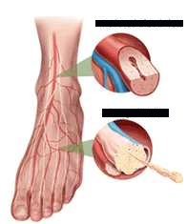

Reduced Blood Flow
Nerve Damage

Slide 60
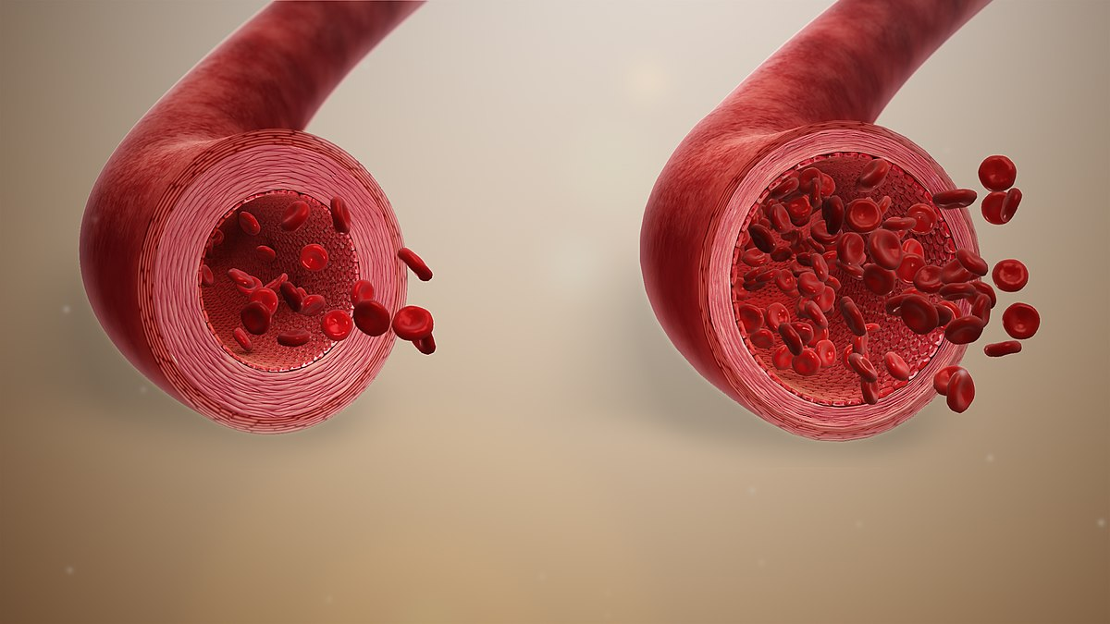
Why is N.O. Essential?
Regulates cardiovascular function– circulation & microcirculation
Red blood cells require adequate NO to deliver oxygen to the cells
Supports neurotransmitter function

Slide 61
BLOOD PRESURE
Nitric oxide is produced by nearly every type of cell in the human body and one of the most important molecules for blood vessel health.
Nitric oxide is a vasodilator, meaning it relaxes the inner muscles of your blood vessels, causing the vessels to widen. In this way, nitric oxide increases blood flow and lowers blood pressure

Slide 62
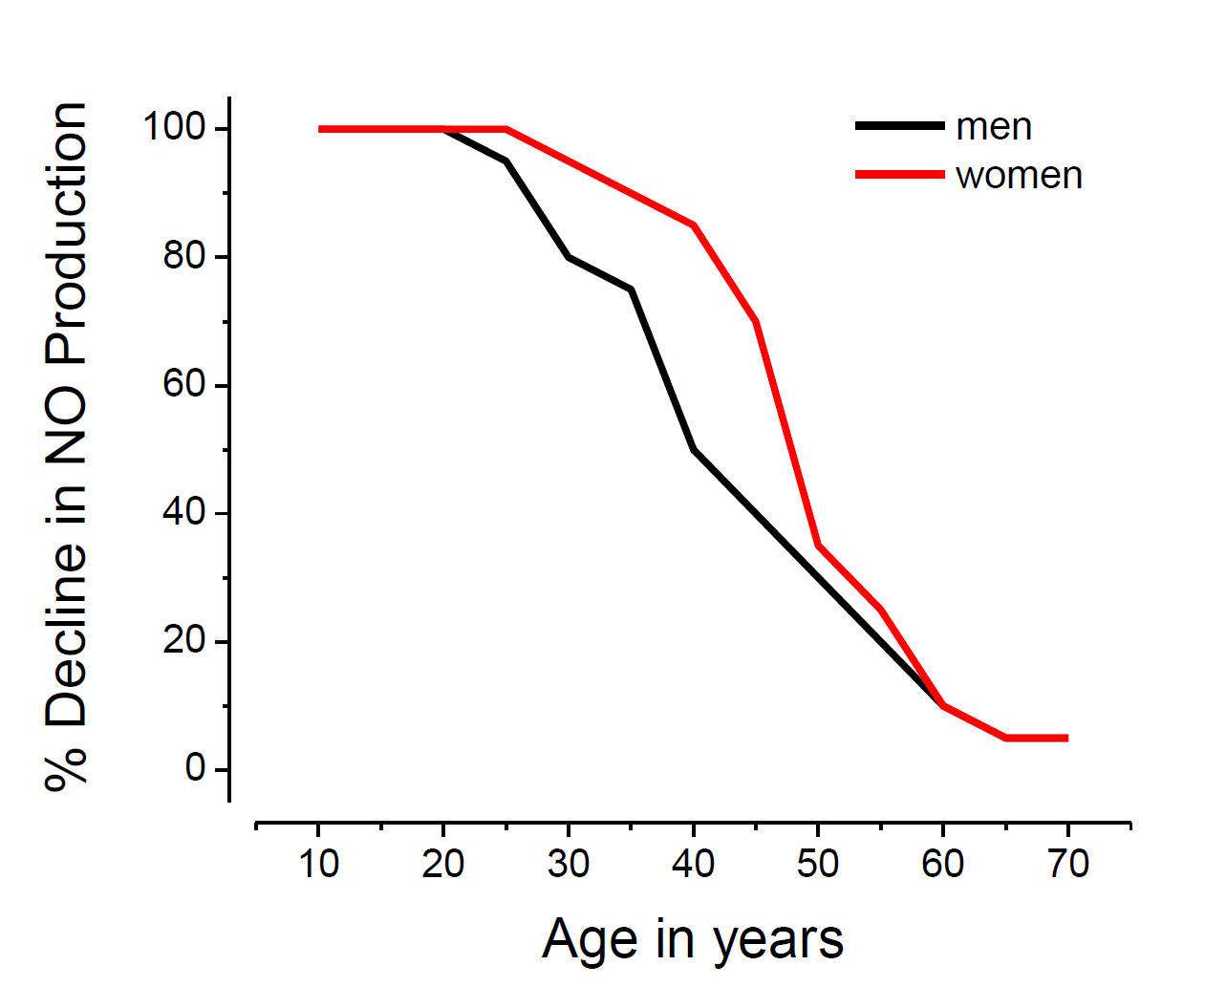
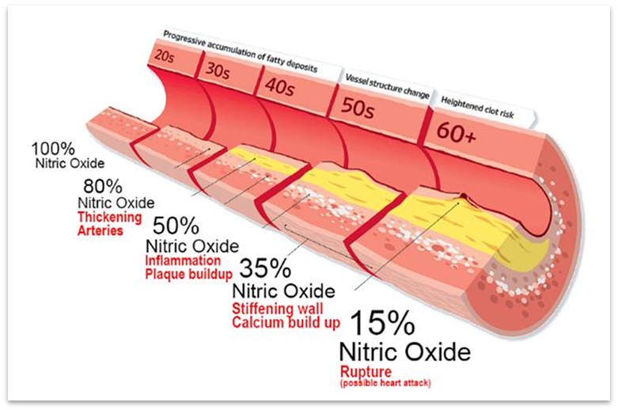
Nitric Oxide Decline
Nitric Oxide Decline with Age
Progression of Endothelial Dysfunction

Slide 63
Diabetic Peripheral Neuropathy (DPN), in particular, is a common complication of diabetes. 70% of diabetics develop DPN within 5 years and almost all will develop DPN after 5 years.
Nitric Oxide (NO) is implicated in the etiology of neuropathy and neuropathy linked complications in at least 2 ways:
Impaired blood flow
NO is a neurotransmitter in some autonomic fibers

Slide 64
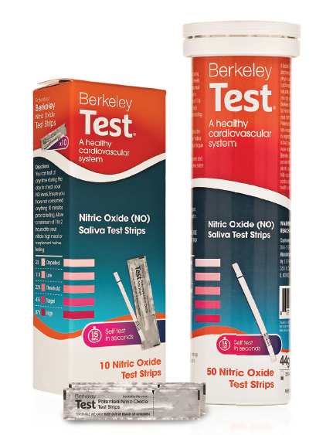

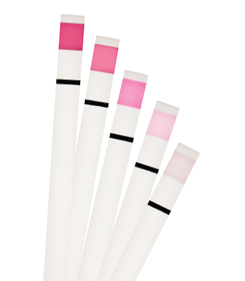
REALLY…Empowering Our Patients
Testing Not Guessing
#1
#2
#3
Notes:
Work through the process of doing the test
Cheated as I took my samples earlier
For any of you testing at home, let us know what result you got!
The color scale that you see here is a measure of nitrite in saliva and it tells us a number of things about the person taking the test:
Nitrite in saliva is an accurate indicator of nitric oxide in serum.
If they have consumed nitrates in the form of diet or supplementation and they don’t see a color change then there is a potential problem with their oral or intestinal microbiome which needs to be address.
How compliant they are being with the protocol of diet or supplement change you have put them on.
Best practice from Practitioners who are using the test strips well -
Those at home - depleted or low result is most common - 95% of the people who do the test for the first time see this result.
The reality is that it is easily changed and in just 90 mins. Taking two of our capsules, most people up to Threshold or Target at least.
For those of you at home testing, take two of the capsules provided and set a timer for 90 mins before testing again and see the difference.
Using these types of before and afters show patients the type of quick improvement they can see.
This is a process you can repeat exactly with patients and potential patients.
Option here to include the video of the process: https://lifes2good.box.com/s/ws8ne7kpdvx9nojkhhhb2hvb43bopldk

Slide 65
