Slide 1
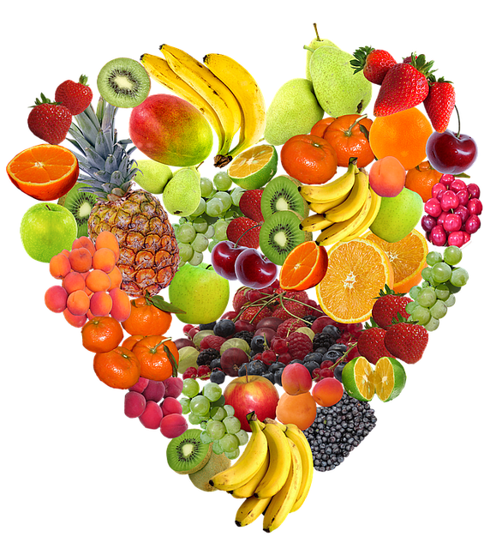
DETOX THE BODY

Slide 2
GOALS:
Identify main sources of toxicity so that we can minimize exposure to them.
Understand how they effect our health.
Learn what we can do to help the body function optimally so it can naturally eliminate and process toxins by following.

Slide 3
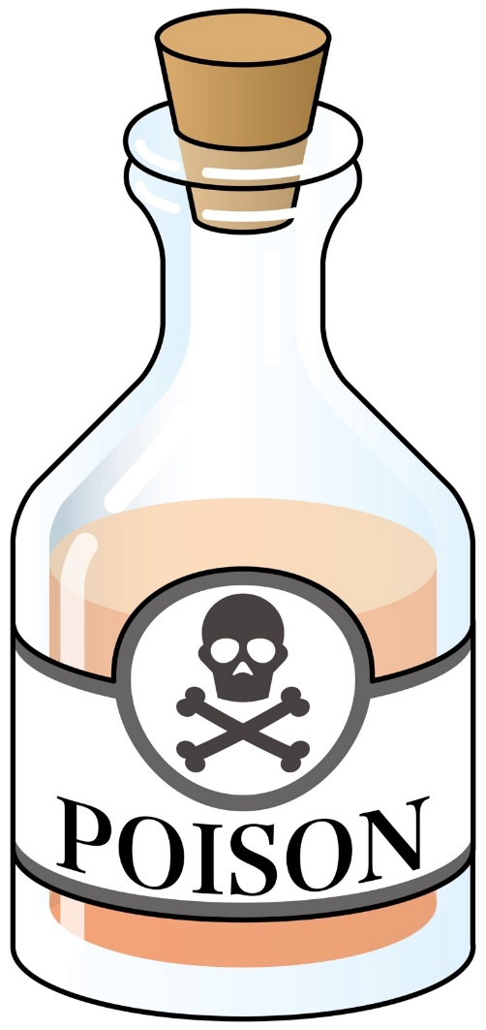
Defining the Problem…
What is a toxin?
A biological poisonous substance, (Like mold, anthrax, or a virus) capable of causing disease when introduced into the body tissue.
A harmful, non biological substance such as a pollutant.
Source: American Heritage Dictionary of the English language
Notes:
In order to do something about the problem, we have to first understand that there is a problem.
Many Toxic chemicals in our environment such as mercury, lead, and certain manmade chemicals have been linked to cancer, birth defects, and brain impairments. Reducing or eliminating the load of these dangerous chemicals in the products we buy, the air we breathe, the food we eat, and the water we drink can help reduce the toll of human disease and suffering.”
The Center for Disease Control (CDC) found 219 different chemicals in your blood and urine, 75 never seen before. CDC Fourth Report on Human Exposure to Environmental Chemicals can be accessed here: http://www.cdc.gov/exposurereport/. Here are some highlights:
Since 1999, CDC has measured 219 chemicals in people’s blood or urine.
The CDC Fourth Report includes results for 75 chemicals measured for the first time in the U.S. population.

Slide 4


Toxins are EVERYWHERE!
Outside the body
Agricultural, Food
Medications
Environmental
Consumer products
Inside the body
Metabolic by-products
Things above breathed & swallowed

Slide 5
Diseases of the New Millennium
The result of this chemical culture is a myriad of epidemic levels of New Millennium Diseases:
Heart Disease
Cancer
Rheumatoid Arthritis
Chrone’s Disease
Ulcerative Colitis
Lupus
Alzheimer’s
Autism
A.D.D
Depression
Chronic Fatigue
Fibromyalgia
Asthma
Allergies
Obesity
Multiple Sclerosis
Diabetes
Etc…

Slide 6
Chase Symptoms with Medications!
If The Toxic Cell Bucket Overflows…
SYMPTOMS
DYSFUNCTION
DISEASE
POOR IMMUNITY
NON-VITAL
TOXIC MOLD EXPOSURE
MEDICATIONS
ENVIRONMENTAL TOXINS
TOXIC HOMES
VACCINES
MOM & DAD

Slide 7

Personal Care Products
Phthalates (soaps, shampoos, hair sprays, and nail polishes)
Oxybenzone
(sunscreen)
Formaldehyde releasers (cosmetic preservatives)
Notes:
According to The Environmental Working Group (ewg.orfg):
“Phthalates: A growing number of studies indicate that chemical family damages the male reproductive system. According to the CDC, They are used in hundreds of products, such as vinyl flooring, adhesives, detergents, lubricating oils, automotive plastics, plastic clothes (raincoats), and personal-care products (soaps, shampoos, hair sprays, and nail polishes).
Oxybenzone: Sunscreen agent and ultraviolet light absorber, found in the bodies of nearly all Americans, according to the U.S. Centers for Disease Control and Prevention. In human epidemiological studies, oxybenzone has been linked to irritation, sensitization and allergies. A study of 404 New York City women in the third trimester of pregnancy associated higher maternal concentration of oxybenzone with a decreased birth weight among newborn baby girls but with greater birth weight in newborn boys. Studies on cells and laboratory animals indicate that oxybenzone and its metabolites may disrupt the hormone system.
Formaldehyde releasers – Bronopol, DMDM hydantoin, Diazolidinyl urea, Imidzaolidinyl urea and Quaternium-15: Cosmetics preservatives that slow form formaldehyde to kill bacteria growing in products. Formaldehyde is a known human carcinogen. The preservatives and the formaldehyde they generate can trigger allergic skin reactions. Formaldehyde releasers are widely used in US products. Not surprisingly, more Americans develop contact allergies to these ingredients than Europeans.”

Slide 8

Soaps
Triclosan & Triclocarban (in bars of soap and liquid soap)
DEA (foaming agent in bath and shower products)
Phthalates
(fragrance)
Source: The Environmental Working Group
Notes:
According to The Environmental Working Group (ewg.orfg):
“Triclosan & Triclocarban: Antimicrobial pesticides typically found in bars of soap and liquid soap. Often found as contaminants in people due to widespread use of antimicrobial cleaning products. Triclosan disrupts thyroid function and reproductive hormones. American Medical Association and the American Academy of Microbiology say that soap and water serves just as well to prevent spread of infections and reduce bacteria on the skin. Overuse may promote the development of bacterial resistance.
Phthalates: A growing number of studies indicate that chemical family damages the male reproductive system. Pregnant women should avoid nail polish containing dibutyl phathalate. Everyone should avoid products with “fragrance” indicating a chemical mixture that may contain phthalates.”

Slide 9


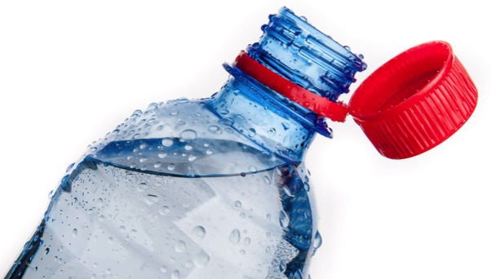
Household Products: The Main Culprits
Cleaning products
Air fresheners
Candles
Laundry products
Telfon cookware
Plastics
Notes:
According to The Environmental Working Group (ewg.orfg):
“BHA: The National Toxicology Program classifies butylated hydroxyanisole (BHA) as “reasonably anticipated to be a human carcinogen.” It can cause skin depigmentation. In animal studies, BHA produces liver damage and causes stomach cancers such as papillomas and carcinomas and interferes with normal reproductive system development and thyroid hormone levels. The European Union considers it unsafe in fragrance. It is found in food, food packaging, and personal care products sold in the U.S.”

Slide 10

At-A-Glance: Sources of Common Hormone Disruptors
Phthalates
Wall Coverings Tablecloths Floor Tiles Furniture Upholstery Shower Curtains Garden Hoses Swimming Pool Liners Rainwear Baby Pants Dolls Shoes Automobile Upholstery and Tops Food Packaging Sheathing for Wire & Cable Medical Tubing | Blood Storage Bags Carpets Paints Glue Insect Repellants Hair Spray Nail Polish Rocket Fuel Carpet Back Coating Adhesives Cosmetics Pesticides Toothbrushes Automobile Parts Tools Toys Aspirin
Benzene
Pesticides Wildfire Smoke Plastics Resins Synthetic Fibers Rubber Lubricants Dyes Detergents Drugs Vehicle Exhaust Groundwater
Toluene
Paint Thinners Paintbrush Cleaners Nail Polish Glues Inks Stain Removers Vehicle Exhaust Cigarette Smoke Groundwater
Parabens
Personal Care Products: Soap Shampoo Cosmetics Perfume
Styrene
Cigarette Smoke Packaging Household & Building Products Vehicle Exhaust Emissions from Copy Machines
C R Biol. 2017 Sep - Oct;340(9-10):403-5
Circulation: Arrhythmia and Electrophysiology 2019 July (7):12
Notes:
Common volatile chemicals and their sources

Slide 11

Cleaning Products
PEGs/Ceteareth/Polyethylene compounds: a probable human carcinogen and which readily penetrates the skin.
Parabens (specifically Propyl-, Isopropyl-, Butyl-, and Isobutyl-parabens): Parabens are estrogen-mimicking preservatives.
Notes:
According to The Environmental Working Group (ewg.orfg):
“PEGs/Ceteareth/Polyethylene compounds: A family of conditioning and cleaning agents that go by many names. These synthetic chemicals are frequently contaminated with 1,4-dioxane, which the U.S. government considers a probable human carcinogen and which readily penetrates the skin. Cosmetics makers could easily remove 1,4-dioxane from ingredients, but tests documenting its common presence in products show that they often don’t.
Parabens are estrogen-mimicking preservatives used widely in cosmetics. The CDC has detected parabens in virtually all Americans bodies. According to the European Commission’s Scientific Committee on Consumer Products, longer chain parabens like propyl and butyl paraben and their branched counterparts, isopropyl and isobutylparabens, may disrupt the endocrine system and cause reproductive and developmental disorders.”

Slide 12
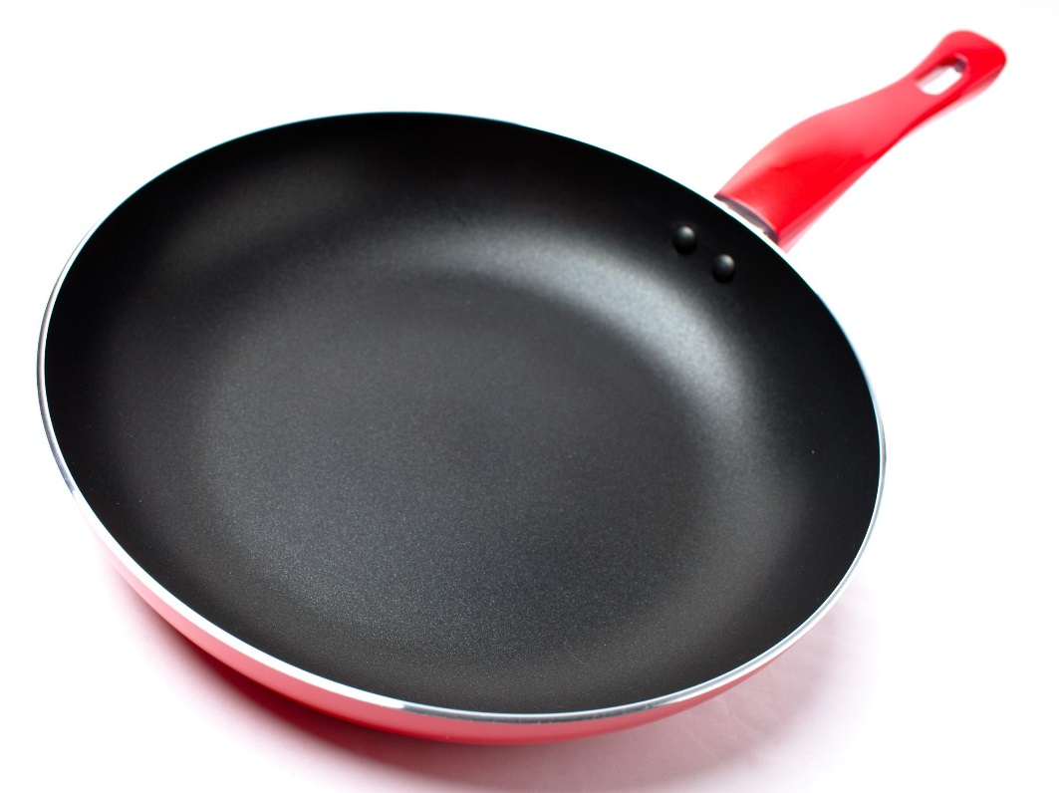
Teflon Cookware
Contains PFOAs which can cause:
Childhood development problems
Liver, pancreas, testicular, and mammary gland tumors
Damages thyroid hormone and function

Slide 13

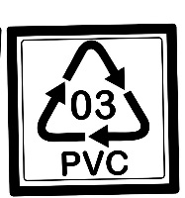
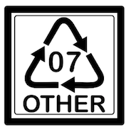

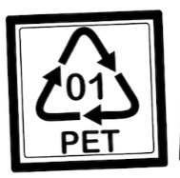

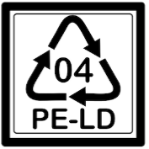
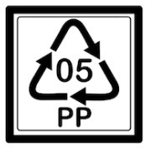
Plastics
Avoid plastics with the # 3, or 7
Plastics with a #1, 2, 4, or 5 may be better choices if glass/ceramic are not available.
Glass and ceramic options are always a better choice then plastic.
Notes:
As reported by The Environmental Working Group:
#3 PVC is often mixed with phthalates, a toxic additive that makes plastic more flexible.
#7 These plastics are rigid and transparent, like plastic food storage containers and water bottles, among other things. Trace amounts of BPA can migrate from these containers, particularly if used for hot food or liquids. Soft or cloudy-colored plastic does not contain BPA.
A recent study from Harvard University found that college students drinking their cold drinks from polycarbonate bottles had 93% more BPA in their bodies than during the weeks that they drank liquids from other containers.

Slide 14
Products Containing Fragrance
Fragrances are in everything. Products like air fresheners, candles, shampoo, deodorant, lotion, laundry detergent fabric softener, dryer sheets.
They can contain hormone disruptors and are among the top five allergens in the world.
Source: Safer Suds: Eliminating a Cancer-Causing Chemical in Shampoos and Soaps. Center for Environmental Health, May 2014. CEH.org
Notes:
Federal law doesn’t require companies to list on product labels any of the chemicals in their fragrance mixture. Recent research from EWG and the Campaign for Safe Cosmetics found an average of 14 chemicals in 17 name brand fragrance products, none of them listed on the label. Ewg.org

Slide 15
Sick Home Syndrome
According to the EPA, our indoor environment is two to five times more toxic than our outdoor environment, and in some cases, the air measurements indoors have been found to be 100 times more polluted.
The International Agency for Research on Cancer and the World Health Organization have concluded that 80% of all cancers are attributed to environmental rather than genetic factors

Slide 16
Toxins and Allergies
Studies are illuminating the correlation between environmental pollutant exposure and allergies.
Parabens, which are ubiquitous toxins, are found in many personal care products such as lotions, shampoos, and makeup and in processed food. Data from the National Health and Nutrition Examination Survey (NHANES) 2005-2006 found that urinary methyl-paraben was detected in 99.1% of individuals and propyl-paraben in 92.7% of individuals.
Environ Health Perspect. 2010 May;118(5):679-85
J Allergy Clin Immunol. 2012 Aug;130(2):453-60

Slide 17
The Pollution in Newborns
A benchmark investigation of industrial
chemicals, pollutants and pesticides in
umbilical cord blood
287 chemicals we detected in umbilical cord blood, we know that 180
cause cancer in humans or animals, 217 are toxic to the brain and nervous
system, and 208 cause birth defects or abnormal development
Environmental Working Group, July 14, 2005

Slide 18
Toxins and the Gut
A number of studies have indicated a correlation between environmental pollutant exposure and gut dysbiosis (an imbalance in the gut microbiota).
A study of children from eleven urban daycare centers in Finland, researchers measured polycyclic aromatic hydrocarbons (PAH) from soil and air around the facilities.
Environ Int. 2019 Sep;130:104894

Slide 19
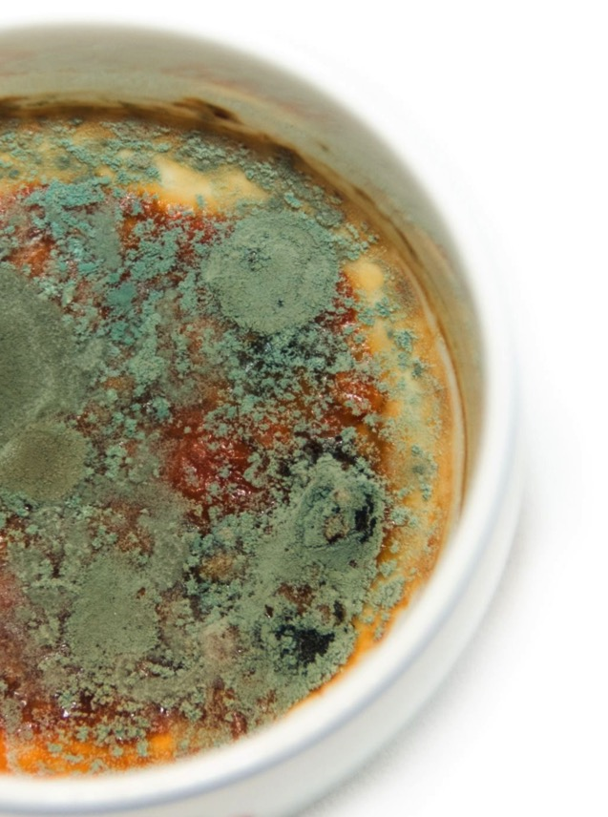
Where are Environmental Toxins Hiding?
Mold, mildew or water stains at home or work.
Leaky sinks, pipes, water damaged basements, ceilings or carpets.
A sick building will commonly have poor heating, ventilation, and air conditioning (HVAC) systems.
Notes:
Mold is the primary biotoxin. Do you have mold, mildew or water stains at home or work? Leaky sinks, pipes, water damaged basements, ceilings or carpets? These are all store houses for neurotoxic molds. Heating, ventilation and air conditioning (HVAC) systems have been identified as a leading contributor to the production of molds! If you are living in mold, mold is living in you!

Slide 20
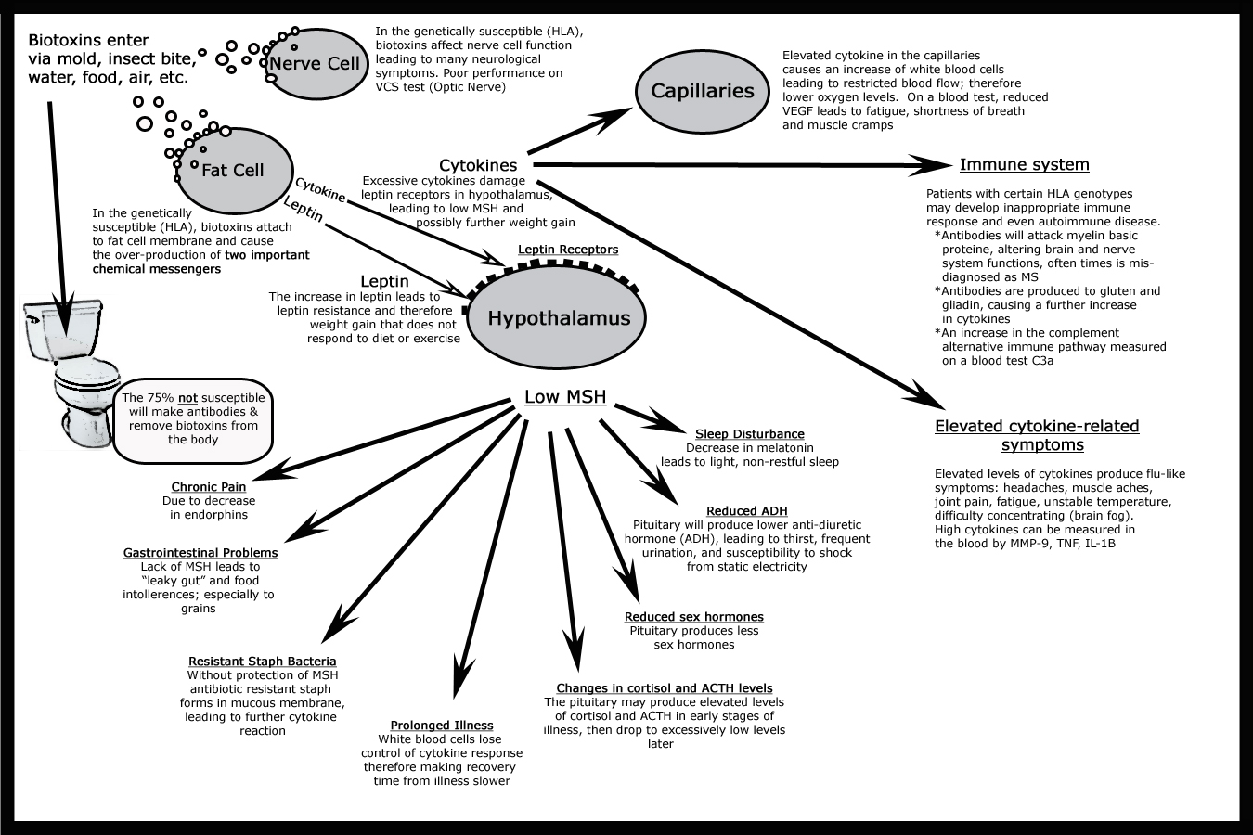
Above Figure altered from Mold Warriors, Dr. Ritchie Shoemaker, 2002.
Notes:
Complex damage caused by Mold impacting immunity, fat storage the brain and nervous system, and leading to chronic inflammation

Slide 21
Heavy Metals
LEAD: Found in old building, foreign products, and passes through the placenta
ALUMINUM
Aluminum is used as an adjuvant in many vaccines today.
Aluminum is known to affect the brain, nervous system, and multiple organ systems negatively.
When it’s HEATED, it LEACHES. So cooking with aluminum pots, pans, and foil will continually expose you to aluminum.
MERCURY
Mercury is the second most toxic substance on earth next to radioactive plutonium (used in making nuclear weapons).
A known neurotoxin with an affinity for binding to organ tissues.
Found in amalgam fillings and vaccines

Slide 22

What are Agricultural Toxins?
Chemicals that kill living organisms like insects, bacteria, and fungi.
These chemicals include:
Pesticides
Herbicides
Fungicides
Antibiotics
Source: The Environmental Working Group
Notes:
“

Slide 23
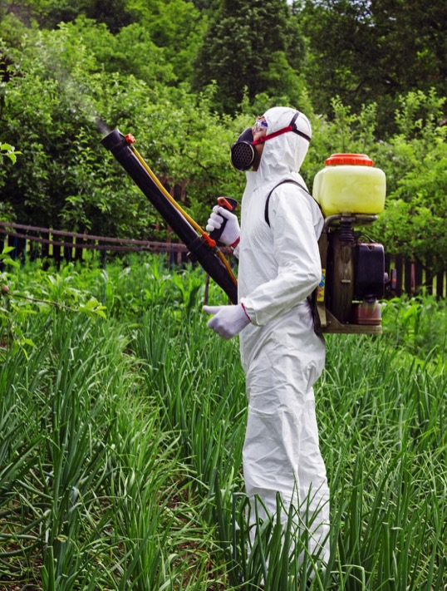
The Problem…
Humans are living organisms!
These chemicals may not be lethal when consumed in small doses, but they can damage our internal systems making us sick over time.
Source: The Environmental Working Group
Notes:
“Many synthetic chemical have intrinsic hormonal activities, making them endocrine disruptors. While pressure groups are calling for all synthetic environmental chemicals which have the potential to cause harm to be phased out or banned, the chemical companies argue that such action must be based on proof of harm.” R.M. Sharpe, senior research scientist, and D Stewart Irvine, clinical consulatant- BMJ: British Medical Journal, 2004 ncbi.nlm.nih.gov
Nearly two-thirds of the 3,015 produce samples tested by the U.S. Department of Agriculture in 2013 contained pesticides. Environmental Working Group’s 2015 Shopper’s Guide to Pesticides. EWG.org
In 2012, the American Academy of Pediatrics issued a report that said that children have “unique susceptibility to potential toxicity.” They cited research linking pesticide to pediatric cancers, decreased cognitive function, and behavioral problems.
These problems have been confirmed by independent research scientists and physicians across the world. The European Union is seeking stronger regulations on agricultural chemicals that fall into the endocrine disruptor category.

Slide 24

Does this mean I have to eat all organic foods?
No! We know it’s hard on your wallet to eat all organic produce, and the good news is, you don’t have to. Some fruits and vegetables are more heavily treated than others.
Every choice counts! Do the best you can.

Slide 25

Choose Organic
Choose Conventional
Apples
Peaches
Nectarines
Strawberries
Grapes
Celery
Spinach
Sweet bell peppers
Cucumbers
Cherry tomatoes
Snap peas
Potatoes
Hot peppers
Kale/collard greens
Avocados
Sweet corn (non GMO)
Pineapples
Cabbage
Sweet peas frozen
Onions
Asparagus
Mangos
Papayas
Kiwi
Eggplant
Grapefruit
Sweet Potatoes
Source: Environmental Working Group’s Clean and Dirty lists for 2015.
Notes:
The Environmental Working Group updates these two lists every year. The lists above are current for 2015 exposures to environmental toxins.

Slide 26
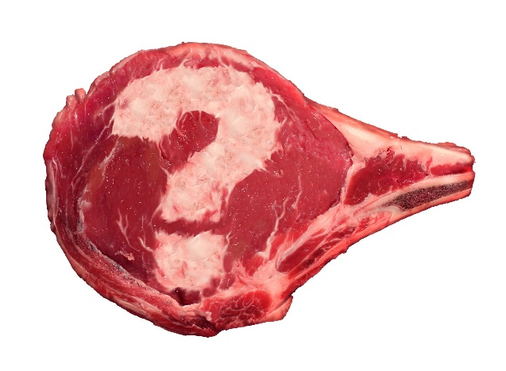
Meat
Why is everyone making such a big deal about grass-fed or free-range beef and organic dairy, and poultry?
There are three main issues with conventional animal products:
Corn diet
Antibiotics
Hormones
Glyphosates
Notes:
What you think happens is often different than what actually happens. Let’s take a look.

Slide 27
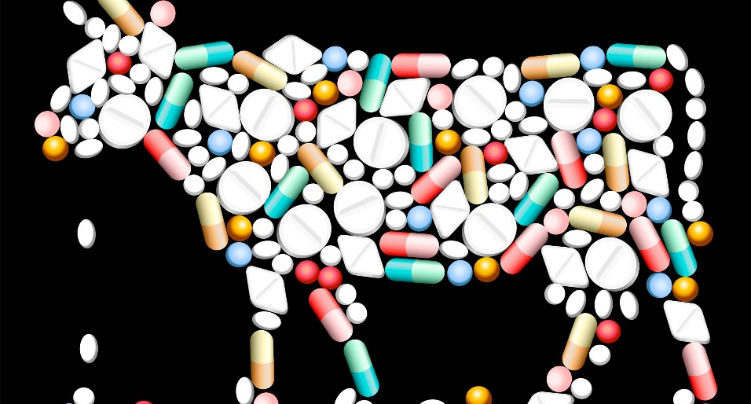
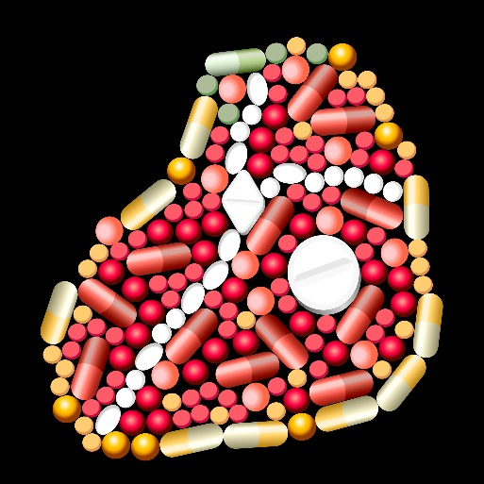
Antibiotics
=
“Up to half of antibiotic use in humans and much of antibiotic use in animals is unnecessary and inappropriate and makes everyone less safe.”
-Center for Disease Control 2013 “Antibiotic Resistance Threats” report
http://www.cdc.gov/drugresistance/threat-report-2013/pdf
Notes:
Here’s the problem: Antibiotics are over used. In animals they are used added to food and water to accommodate for poor living conditions and to cause the animal to grow bigger.
More antibiotics are used on livestock and poultry and not humans, according to the FDA. (http://www.fda .gov/downloads/ForIndustry/UserFees/ AnimalDrugUserFeeActADUFA/UCM338170.pdf )
“The problem arises when drugs used for food production are medically important for human health, as evidence shows that pathogens that have developed resistance to drugs in animals can be transmitted to humans.” World Health Organization (Excerpt from 2011 Statement on 2011 World Health Day: Combat drug resistance: no action today means no cure tomorrow, 4/6/11, http://www.who.int/mediacentre/news/statements/2011/whd_20110407/en/index.html)
According to the 2013 CDC study referenced in the slide, antibiotics used in animals enter the human system through two paths: the meat itself, and animal feces which ends up in fertilizer (used for growing food) or water. The following information is taken from directly the study, word-for-word: http://www.cdc.gov/drugresistance/threat-report-2013/pdf/ar-threats-2013-508.pdf#page=6
“Resistant bacteria can contaminate the foods that come from those animals, and people who consume these foods can develop antibiotic-resistant infections.
Scientists around the world have provided strong evidence that antibiotic use in food- producing animals can harm public health through the following sequence of events:
Use of antibiotics in food-producing animals allows antibiotic-resistant bacteria to thrive while susceptible bacteria are suppressed or die .
Resistant bacteria can be transmitted from food-producing animals to humans through the food supply .
Resistant bacteria can cause infections in humans .
Infections caused by resistant bacteria can result in adverse health consequences for humans.
”According this same study, “… taking an antibiotic when it is not needed can lead to the development of antibiotic resistance . When resistance develops, antibiotics may not be able to stop future infections . Every time someone takes an antibiotic they don’t need, they increase their risk of developing a resistant infection in the future.”

Slide 28
Hormones
Recombinant bovine growth hormone (rBGH or rBST), is injected into cows to increase milk production.
Canada, Japan, Australia, and the European Union (25 countries) have banned it’s use.
http://www.fda.gov/AnimalVeterinary/SafetyHealth/ProductSafetyInformation/ucm055436.htm
Notes:
According to the FDA: “Since the 1950s, the Food and Drug Administration (FDA) has approved a number of steroid hormone drugs for use in beef cattle and sheep, including natural estrogen, progesterone, testosterone, and their synthetic versions. These drugs increase the animals’ growth rate and the efficiency by which they convert the feed they eat into meat. The FDA approves these drugs only after information and/or studies have shown that the food from the treated animals is safe for people to eat, and that the drugs do not harm the treated animal or the environment. The drugs also have to work as intended.” http://www.fda.gov/AnimalVeterinary/SafetyHealth/ProductSafetyInformation/ucm055436.htm
However, critics and watchdog groups speculate that injecting animals with hormones can cause everything from breast and ovarian cancer to premature onset of puberty in young women. Studies are ongoing to gauge the effects on humans, but one study at the University of Colorado found reproductive abnormalities in the sexual development of white sucker fish that were living in estrogen-contaminated water. (Jobling et al., 1998; Mills and Chichester, 2005).

Slide 29
rBGH or rBST
Can cause:
Breast cancer
Ovarian cancer
Premature onset of puberty in young women.
Reproductive abnormalities
(Jobling et al., 1998; Mills and Chichester, 2005)

Slide 30
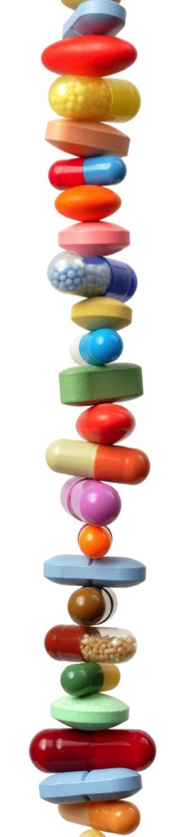
Medication Side-Effects
We now rely on them as a solution for everything from the common cold to managing our stress.
Example: The rate of antidepressant use in the United States among all ages increased nearly 400 percent.
SIDE EFFECTS = TOXICITY
(National Center for Health Statistics. Health, United States, 2010: With special feature on death and dying. Table 95. Hyattsville, MD. 2011.)
Notes:
Data from the National Health and Nutrition Examination Surveys, 2005–2008 (http://www.cdc.gov/nchs/data/databriefs/db76.htm#summary):
Eleven percent of Americans aged 12 years and over take antidepressant medication.
Females are more likely to take antidepressants than are males, and non-Hispanic white persons are more likely to take antidepressants than are non-Hispanic black and Mexican-American persons.
About one-third of persons with severe depressive symptoms take antidepressant medication.
More than 60% of Americans taking antidepressant medication have taken it for 2 years or longer, with 14% having taken the medication for 10 years or more.
Less than one-third of Americans taking one antidepressant medication and less than one-half of those taking multiple antidepressants have seen a mental health professional in the past year.
Antidepressants were the third most common prescription drug taken by Americans of all ages in 2005–2008 and the most frequently used by persons aged 18–44 years (1). From 1988–1994 through 2005–2008, the rate of antidepressant use in the United States among all ages increased nearly 400% (National Center for Health Statistics. Health, United States, 2010: With special feature on death and dying. Table 95. Hyattsville, MD. 2011.)

Slide 31
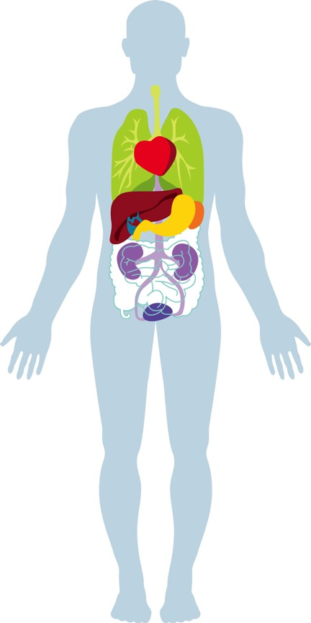
Support Your Body’s Detox Channels
Skin
Lungs
Colon
Kidneys
Liver
Lymphatic system
Fat cells
Notes:
To maximize detox we need to look at all the detoxification channels. They include the skin, lungs, colon, kidneys, liver, lymphatic system and fat cells. Detoxification happens both inside cells and outside of them.
Skin
Lungs
Liver
Lymphatic System
Fat cells – researchers are leaning towards classifying body fat more like an organ rather than simply fat that is hanging around…Refer to visceral fat and its link to major health issues…fat as repository for toxins, carcinogens, and endocrine disruptors
Here is an interesting recent article on increased incidence of major diseases in obese Indian women, linking it to toxins stored in fat as major contributing factor:
http://dailypioneer.com/nation/42244-risk-of-breast-cancer-high-in-obese-indian-women-study.html
Perhaps a quick overview of what each organ/system is responsible for in the elimination spectrum.

Slide 32
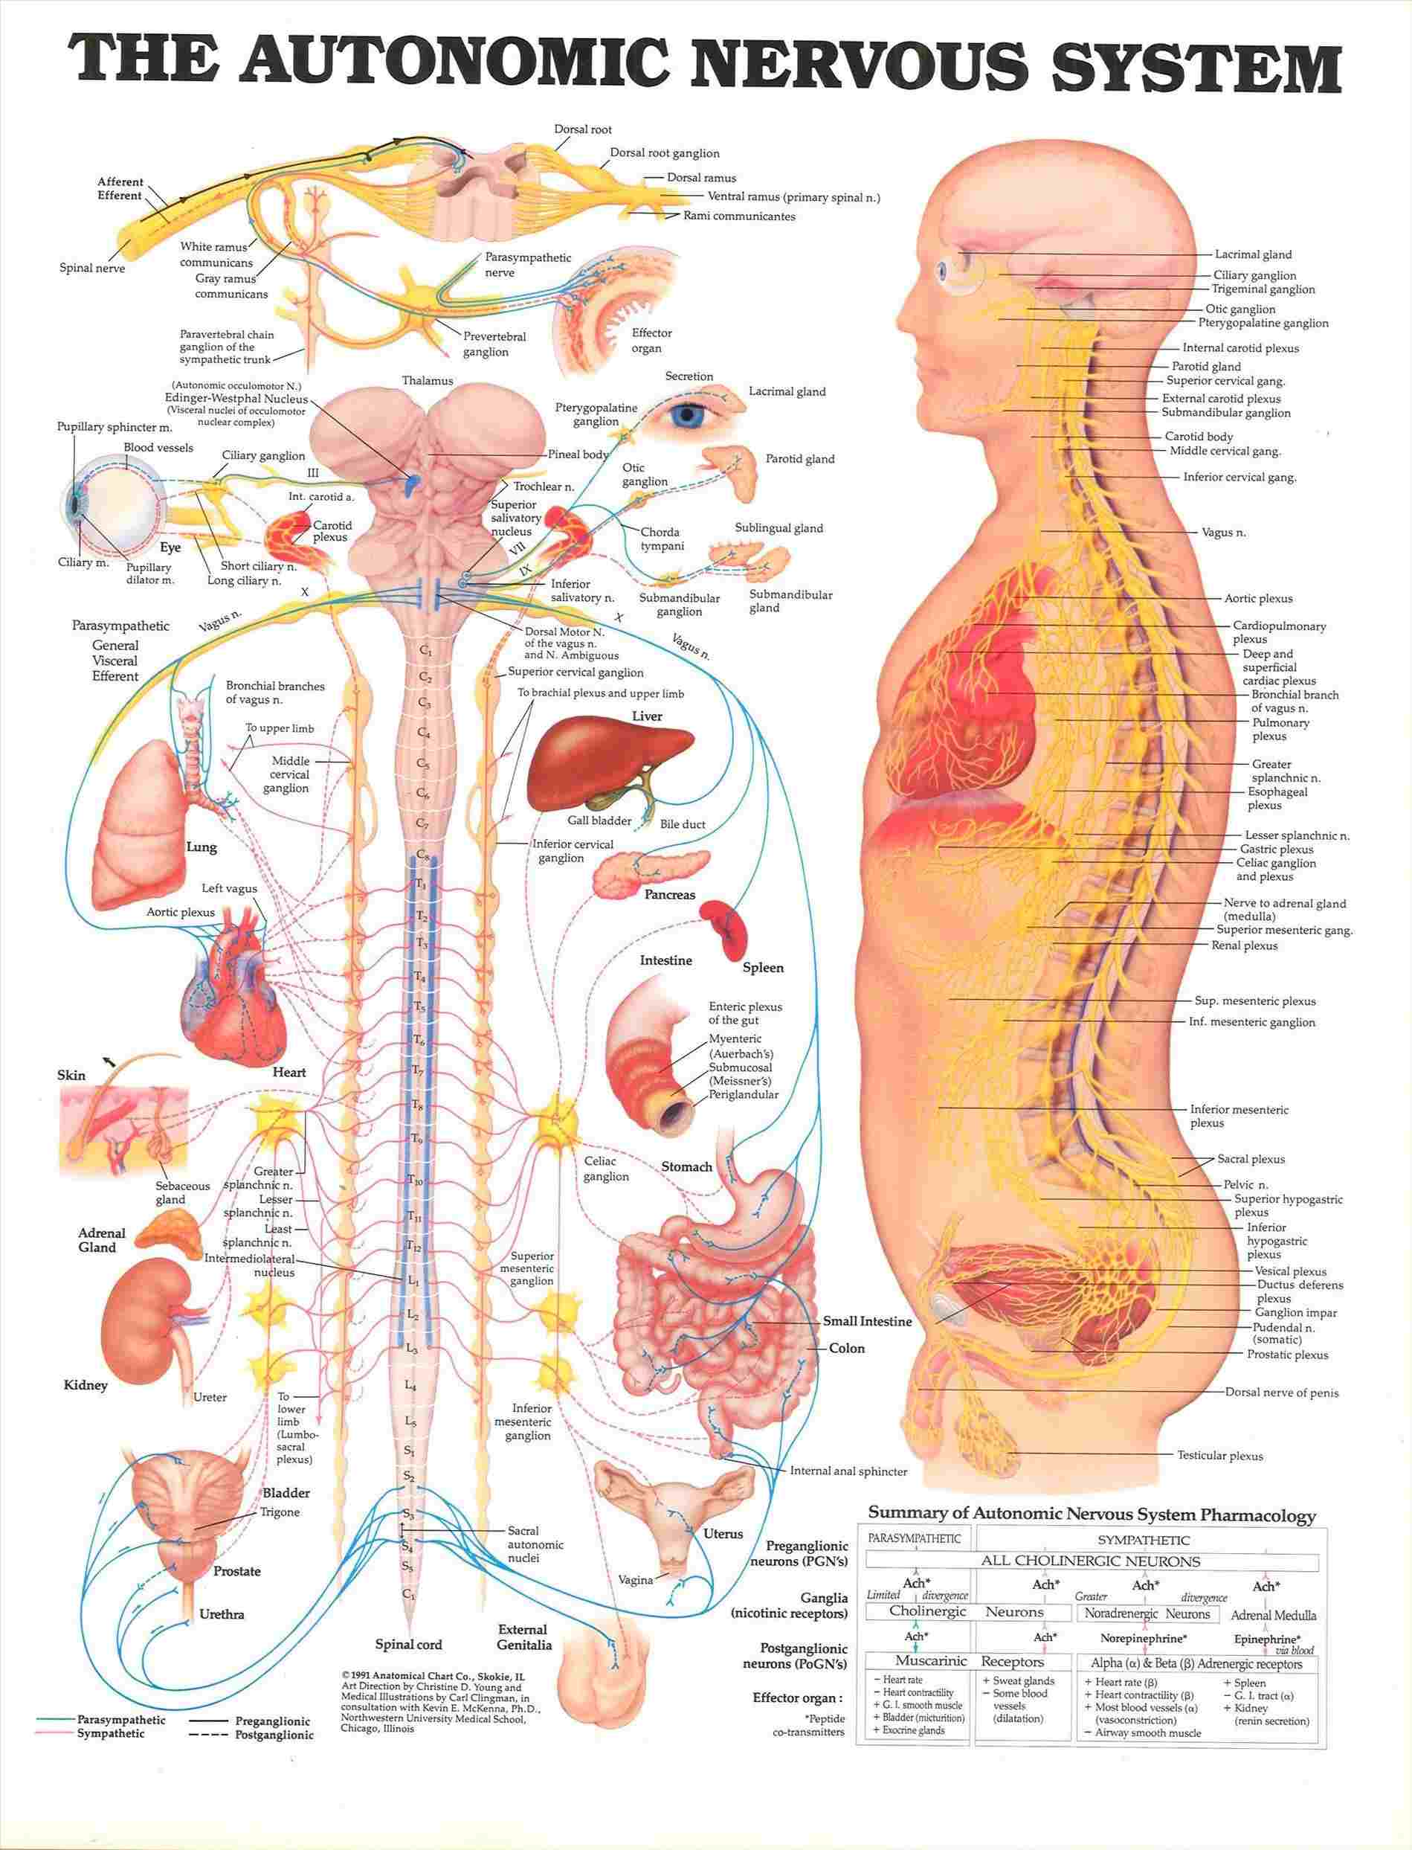
#1- CARE OF THE NERVOUS SYSTEM

Slide 33
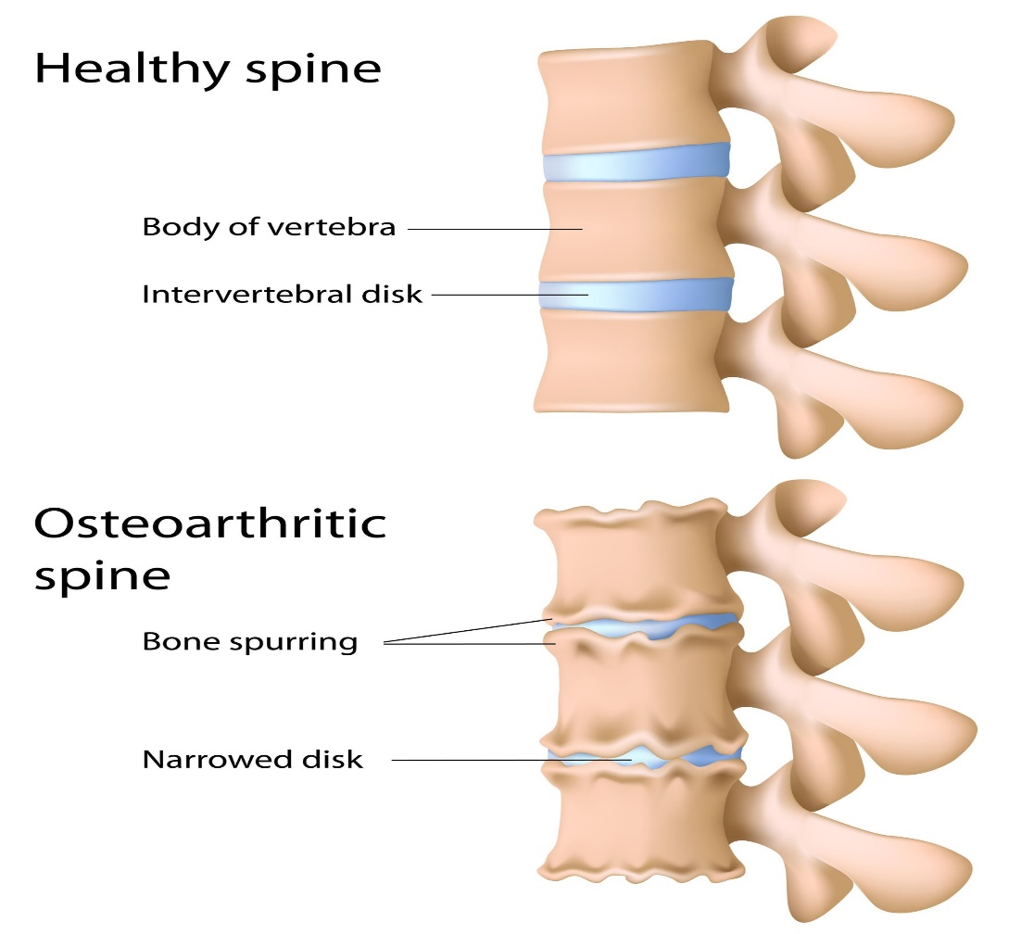

CHIROPRACTIC!

Slide 34

Water
Water is ESSENTIAL to all bodily functions and internal organs (and protects your spinal cord!) Water assists detox through:
Urination
Sweat
Bowel Movements
Sources: Center for Disease Control and Prevention; American Council on Exercise
Notes:
According the American Council on Exercise: “Water is one of the most essential components of the human body. Water regulates the body’s temperature, cushions and protects vital organs, and aids the digestive system. Water not only composes 75 percent of all muscle tissue and about 10 percent of fatty tissue, it also acts within each cell to transport nutrients and dispel waste. And, because water composes more than half of the human body, it is impossible to sustain life for more than a week without it. The Food and Nutrition Board recommends new dietary reference intakes for water. It is recommended that women consume 2.7 liters (91 oz) daily and men consume 3.7 liters (125 oz) through various beverages (80%) or in food (20%). Active individuals need even more, particularly if they’re exercising in hot weather. This is especially important during the 24 hours prior to vigorous exercise. In one hour of exercise the body can lose more than a quart of water, depending on exercise intensity and air temperature. If there is not enough water for the body to cool itself through perspiration, the body enters a state of dehydration. It is important to drink even before signs of thirst appear. Thirst is a signal that your body is already on the way to dehydration.
Source: “http://www.acefitness.org/fitfacts/pdfs/fitfacts/itemid_173.pdf
http://www.cdc.gov/nutrition/everyone/basics/water.html

Slide 35
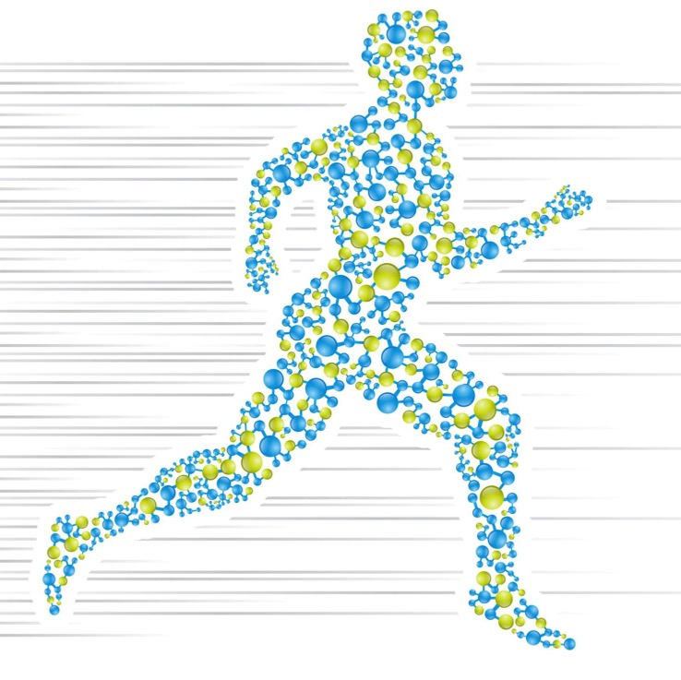
Exercise isn’t just for your waistline
Exercise is a powerful detox system in its own right.
It increases glutathione levels, strengthens the immune system and improves detoxification.
Notes:
Glutathione is the primary antioxidant of the body. It is unique because it actually recycles itself and will continuously seek out and destroy toxins! Glutathione is made up of the amino acids cysteine, glycine and glutamic acid. Sulfur specifically attracts and binds toxins which will allow glutathione to destroy it.

Slide 36
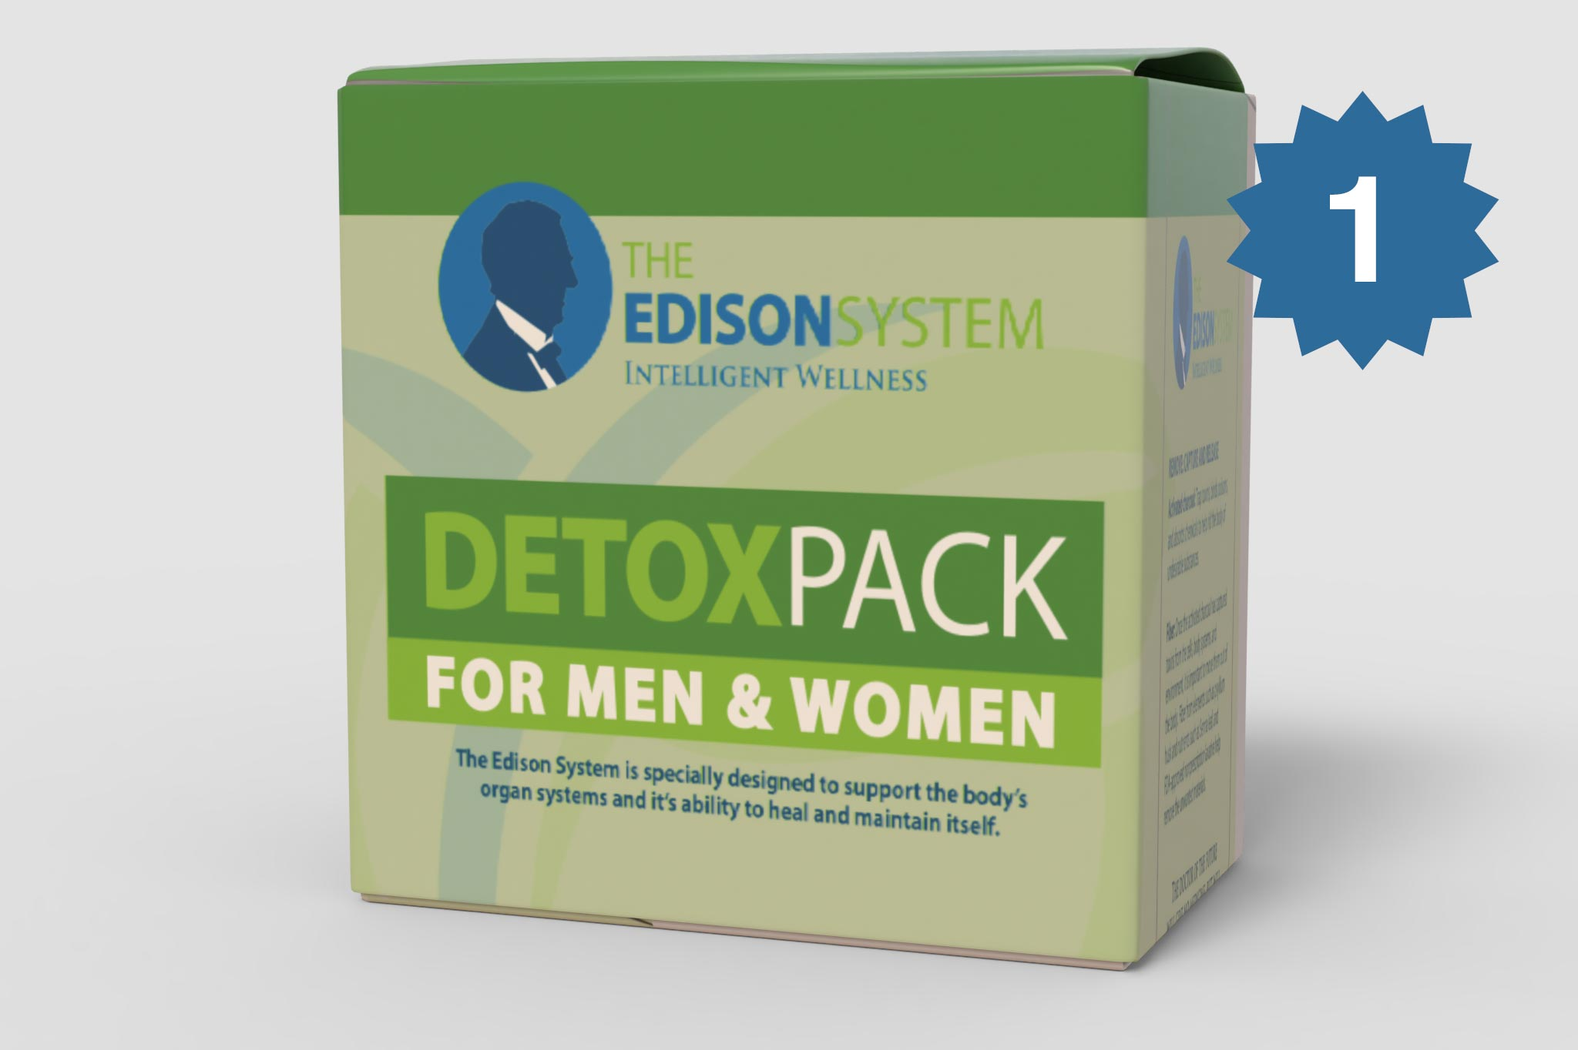
CRITICAL NEEDS FOR DETOX
Glutathione
Pathway support
Activated charcoal
Magnesium
Omega 3s
Fiber
Notes:
To facilitate detoxification you need to load up on known toxin removers. Pure water, fiber, probiotics, activated charcoal, magnesium citrus essential oils and potassium.
Preventing the buildup and stagnancy of toxins in the GI tract is critical to maintaining optimal. Increasing bowel transit time and ease is standard protocol for any detox program.
Water and Fiber could be considered more elementary or primary in support of toxin removal—you absolutely MUST have proper hydration and fiber in the gut for healthy elimination.
Probiotics, Charcoal, Magnesium and Essential Oils could be seen as more of ‘functional facilitators’ when it comes to clearing waste from the body.

Slide 37
Detox Pack – Enhanced Formula Heavy Metals
Lipoic Acid →Supports Detox, Glutathione, Neuro-toxin removal
Humic Acid → GI Health, Heavy Metal & Environmental Toxin Binding, Immunity
Cilantro →Heavy Metal and Detox Support
Modified Citrus Pectin →Binding of Metals & Other Toxins

Slide 38
Detox Pack – Enhanced Formula Gut & Hormones
DIM →Estrogen and Xeno-Toxin Detox
Calcium D-Glucurate →Hormone Detox and Xeno-Estrogens, GI Health: Support for elevated Beta-Glucuronidase (Unfriendly gut bacteria)
Chia Seed Powder → Fiber for Microbiota, Toxin Binding
Glycine → Critical amino acid for detox

Slide 39
Solution! Glutathione: the body’s natural antioxidant
Glutathione is the main antioxidant of the body.
Our bodies naturally produce glutathione, but toxins, stress, trauma, and sickness cause deficiency. This also causes a burden on the liver, which is your body’s detox super organ.
Notes:
Glutathione is the primary antioxidant of the body. It is unique because it actually recycles itself and will continuously seek out and destroy toxins! Glutathione is made up of the amino acids cysteine, glycine and glutamic acid. Sulfur specifically attracts and binds toxins which will allow glutathione to destroy it.
Sulfur Rich Compounds like glutathione bind toxins for removal
Glutathione
Vitamin U
Cultured Dairy Proteins
Whey Proteins (lactalbumin)
Glutathione has multiple functions:
It is the major endogenous antioxidant produced by the cells, participating directly in the neutralization of free radicals and reactive oxygen compounds, as well as maintaining exogenous antioxidants such as vitamins C and E in their reduced (active) forms.
Regulation of the nitric oxide cycle, which is critical for life but can be problematic if unregulated.
It is used in metabolic and biochemical reactions such as DNA synthesis and repair, protein synthesis, prostaglandin synthesis, amino acid transport, and enzyme activation. Thus, every system in the body can be affected by the state of the glutathione system, especially the immune system, the nervous system, the gastrointestinal system and the lungs.

Slide 40
Glutathione: The Master Detoxifier
Potent antioxidant
Major part in many bodily, chemical reactions
Master detoxifier of chemicals, pollutants, and drugs
Used up in processing outside and inside toxicants
Decreases with poorer health and age
Critical in weight loss and antiaging

Slide 41
3 Precursors
Glutathione is made up of 3 amino acids
Cysteine
Glutamate
Glycine
Boosted with Milk Thistle (Sylimarin) and Key Precursors
MARGINALLY BENEFICIAL BY MOUTH

Slide 42
Glutathione Boosting: Amino Acid - Sulfur Rich Foods
Garlic*
Broccoli*
Brussels Sprouts
Kale
*Found in Vitalleo Health formula
Other foods: Asparagus, Avocado Spinach, Onions, Collard Greens, Cauliflower, and Watercress

Slide 43
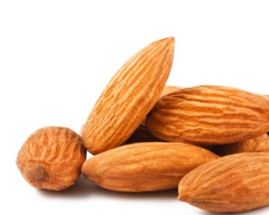
Fiber: think beyond whole grains!
Fiber isn’t digestible by your body, which is why it plays an important part in detox and digestion by helping things move through your system efficiently.
Not all fibers are created equally! You may be tempted to load up on whole grains, but sources of whole food fiber are the healthiest source available.
Almonds
Cauliflower
Broccoli
Brussels sprouts
Flax
Beans
Chia seeds
Green beans
Peas
Berries
Root vegetables including onions and sweet potatoes

Slide 44
Found in “The Master Detoxifier” Detox Pack Part 1
N-Acetyl-L-Cysteine (NAC)*
L-Glutamine*
L-Glycine*
Milk Thistle Seed Extract*
Apple Cider Vinegar (Powder)
Aloe Vera Leaf Powder
Broccoli Seed Extract Powder*
Chlorella
*Increase and enhance Glutathione in the blood
Cinnamon Extract
Dandelion Greens
Garlic Powder*
Green Tea Extract (Polyphenols, Catechins, and EGCG)
L-Glutathione*

Slide 45
Chlorella
Clean and detoxify cells
Effective in detoxifying heavy metals (9)
Lower the impact of heavy metals on the liver, brain and kidneys (10).
Lessen the effect of harmful chemicals found in foods such as dioxin, a hormone disruptor (11)
Helpful in supporting detoxification in the liver, gallbladder and colon (12)
Boosts healthy flora in the intestines
Superfood-antioxidant

Slide 46
Dandelion Greens
Liver cleanser
Helps with mineral absorption
Reduces inflammation and prevents the development of disease. (13)
High in Antioxidants
High antioxidant properties (14)
Cancer killing effect (15)
Preventing urinary tract infections (16)
Rich in Fiber; helping in IBS and diverticulosis

Slide 47
Detox Pack Part 2 “Capture & Release”
Psyllium Husk
Activated Carbon (Charcoal)
Flaxseed
Glucomannan (Konjac Root)
Magnesium (as Magnesium
Citrate 16%)
Acai Berry Powder
Alfalfa (Whole Plant)
Blueberry (Vaccinium corymbosum;
fruit powder)
Brussels Sprout (Whole Plant)
Kale (Organic)
Notes:
Activated charcoal deactivates the mold
MINERALS, FIBER, AND PRE-BIOTICS FOR HEALTHY GUT FLORA AND TO REMOVE TOXINS
Magnesium (as Magnesium Citrate 16%)
Psyllium Husk
Activated Carbon (Charcoal)
Flaxseed
Glucomannan (Konjac Root)
ADDITIONAL FIBER AND ANTI-OXIDANT FOODS TO REMOVE WASTES AND MANAGE OXIDATION FROM TOXICITY AND OTHER CAUSES
Acai Berry Powder
Alfalfa (Whole Plant)
Blueberry (Vaccinium corymbosum; fruit powder)
Brussels Sprout (Whole Plant)
Kale (Organic)

Slide 48
Activated Charcoal - Capture
Used as first aid in poisoning emergencies to stop toxins from circulating throughout the body
Absorb toxins
Bind to avoid “Re-toxification”
Activated: Contains pores created through oxidation
De-activates the mold

Slide 49
Psyllium is a Prebiotic and Fiber “Release”
Substances necessary for probiotic colonies of healthy, good bacteria to grow.
Healthy flora is needed for proper digestion, immune function, to fight infection, manage inflammation, and to maintain and establish well-being in cells and tissues.
Notes:
Release = excrete, make sure you move the toxins out of the system.

Slide 50
DNA DAMAGE
Oxidative DNA damage is part of everyday life.
It is said to occur tens of thousands of times per day, in every single cell in the body (20).
DNA damage is part of the reason we grow older, and it also plays an important role in the development of diseases like cancer.
Berries, veggies contain powerful antioxidants and fiber
Notes:
Berries and veggies are used as fiber, but also contain powerful antioxidants. The formula contains the most powerful on the planet:
Acai Berry Powder
Alfalfa (Whole Plant)
Blueberry (Vaccinium corymbosum; fruit powder)
Brussels Sprout (Whole Plant)
Kale (Organic)

Slide 51
Key Co-Factors (Edison Pack)
Vitamin C
Vitamin E
B Vitamins
Selenium
Magnesium
Zinc
Alpha Lipoic Acid
Milk Thistle
Notes:
In order to build glutathione levels, maintain them, and for the body to optimize glutathione for cleaning up free radicals and detoxification within the cell, these are essential vitamins and minerals the body needs. These are found in the Edison Pack or a similar, complete Professional multivitamin.

Slide 52
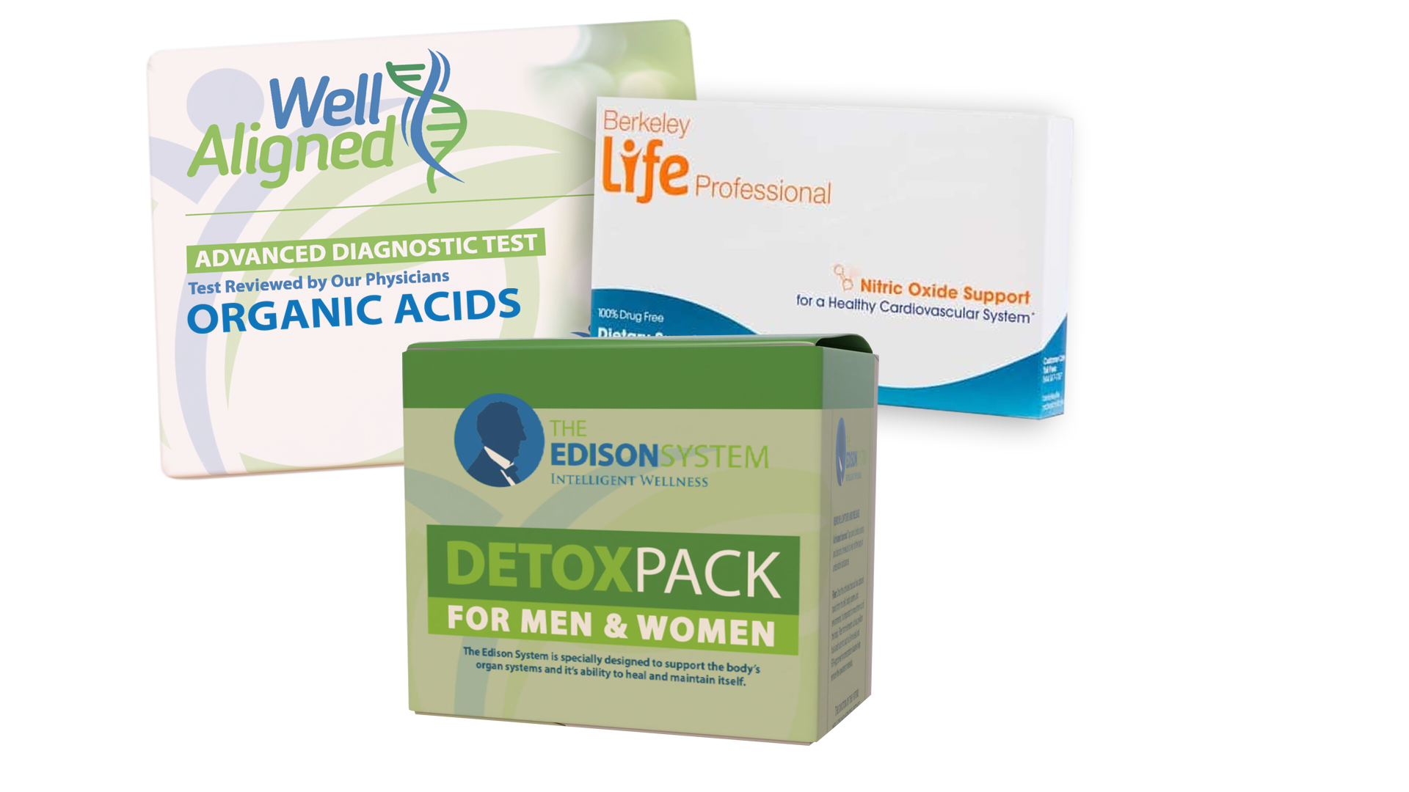
Offer Page For Your Patients!
$10 off OAT test with
Detox Panel
$5 off Detox Pack
$5 off Berkeley Life Supplement

