Slide 1
REVOLUTION NOT
RESOLUTION

Slide 2

YOU CAN’T AFFORD A RESOLUTION!

Slide 3
ep·ic
A story about a hero
Exciting events or adventures
Extending beyond the usual or ordinary
Usually difficult

Slide 4
RE-FORM
Do not conform to the pattern of this world, but be transformed by the renewing of your mind. Then you will be able to test and approve what God’s will is—his good, pleasing and perfect will. -Rom 12:2

Slide 5
CHRIST’S MISSION STATEMENT
…. I am come that they might have life, and that they might have it more abundantly.
– John 10:10 KJB

Slide 6
THE WORD “LIFE”
zōḗ (dzo-ay‘)
Possessed of vitality
Belongs to God
Real and genuine
Blessed

Slide 7
The Word “Abundantly”
Perissós
Exceeding need
Something further, much more
Superior, exceeding rank
Uncommon

Slide 8
BE UNCOMMON
"You can't be common,
the common man goes nowhere;
you have to be uncommon."
- Herb Brooks, Head Coach of the 1980 USA ”Miracle On Ice” Olympic Hockey Team

Slide 9
BE UNREASONABLE
The reasonable man adapts himself to the world;
the unreasonable one persists in trying to adapt the world to himself (Jesus).
Therefore, all progress depends on the unreasonable man (Christ-follower).
- George Bernard Shaw

Slide 10
God’s Multiple-choice Test
This day I call the heavens and the earth as witnesses against you that I have set before you:
Life
Death
HINT: Choose B. Life, so that you and your children may live. (Deut. 30:19)

Slide 11
Food by God Rule #1
The farther something is from nature, the more it is Food by man and not Food by God
“If God didn’t make it, I won’t eat it”
- Jack LaLanne

Slide 12
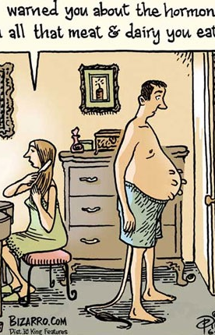
Hormones
BECOME A FAT MELTING MACHINE
Cortisol: Breaks down muscle, stimulates fat storage, raises blood pressure, causes water retention, causes hunger and intense food cravings.
Human growth hormone: Production decreases with age. Increases lean muscle mass, increases bone density, and decreases body fat.
Leptin: Tells your brain to burn fat for energy, and to tell you that you are full and don’t need to eat more.
Notes:
(Study these pathways and know them inside and out)

Slide 13
3 Basic Steps
3/7 BASIC STEPS TO TRANSFORMATIONAL NUTRITION
1. EAT FRUIT IN THE MORNING AND LOAD UP ON VEGETABLES AT ALL OTHER MEALS AND THE REST OF THE DAY.
2. ELIMINATE SOFT DRINKS, SUGAR SWEETENED BEVERAGES AND ANY NON-FRESH JUICES.
3. SWITCH TO GOOD FATS: Cook with coconut oil and butter and put olive oil on salads. Find ways to add chia seeds, flax seeds, and fish from the safe list to your week.

Slide 14
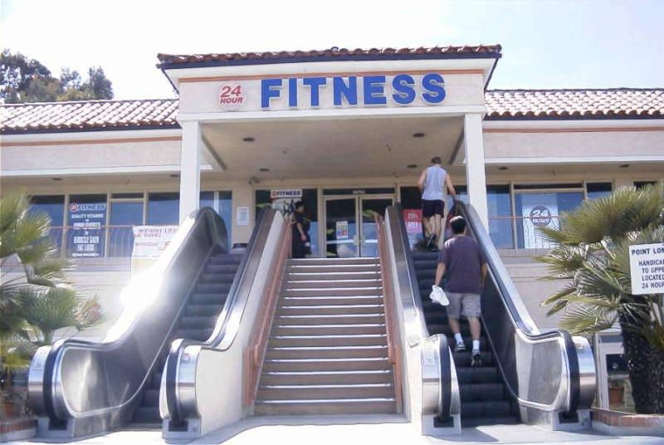

Slide 15

High Intensity Exercise is Best
Optimizing HORMONES
FAT BURNING
MUSCLE BUILDING
Regulating BLOOD SUGAR levels
Increasing LUNG CAPACITY
Improving HEART HEALTH

Slide 16

It’s all about the after-burn
Traditional Cardio
  4hrs after-burn
  Increased cortisol
HIIT (High Intensity Interval Training)
  36hrs after-burn
  Increased testosterone & growth hormone
Notes:
Remember, it’s all about hormones. Traditional cardio raises cortisol which promotes belly and hip/thigh fat.
HIIT is exponentially more effective. This is why people can come in, blast out a 20min workout over at the weights 3x/wk and leave with 6 pack abs, and you’re on the treadmill everyday for an hour and can’t seem to make much progress.
This is how you get shredded in minutes a day. It works 100% of the time as long as you do.
Can’t cheat, have to go all out. This is simple and fun because it becomes like a game since you’re timing yourself.

Slide 17
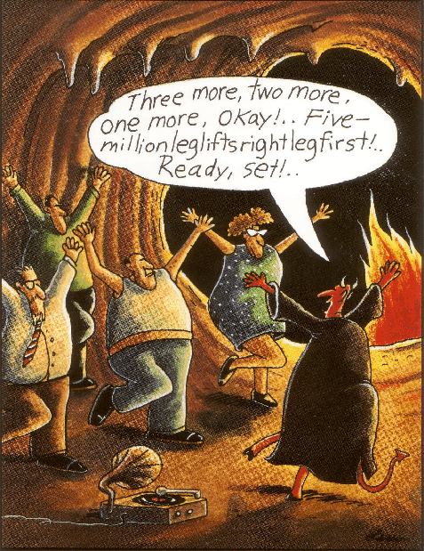

Slide 18
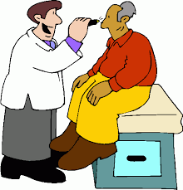
What fits your busy schedule better: exercising for 12 minutes a week or being dead 24 hours a day?

Slide 19


Nutrition Plans
Food by God Plan | Metabolic Plan
Nutrition for healthy families Health maintenance Disease prevention Moderate weight loss | Hormone repair (weight-loss resistance) Inflammation & disease management Accelerated weight loss Complete health restoration
Notes:
Now that we have educated the audience and busted some common myths about Nutrition, let’s show them the plans that will ensure them results and a healthy life. Contrast the purposes of each plan, and let your audience know that if they have lifestyle-related diseases or ailments, the Advanced Plan is designed to help them get better.
Purpose of the Advanced Plan
1. Burn fat
2. Detoxify
3. Reduce inflammation
4. Balance hormones

Slide 20
The Solution: Nutrition Plans
The Food by God Plan
Fat
Good fats vs. Bad fats:
Eat more healthy fats – eliminate damaged fats
Protein
Naturally raised vs. unnaturally raised animal products:
Go organic and natural for animal products
Carbohydrates
Whole carbohydrates vs. refined carbohydrates:
Eat more vegetables – eliminate refined grains and sugars
The Metabolic Plan
Fat
Increase your intake of good fats
Protein
Moderate your intake of protein
Carbohydrates
Eliminate grains, sugars, and fruits
*except berries, granny smith apples, grapefruit in moderation
Notes:
Core Plan: Eating foods closer to the way God made them.

Slide 21
MUST HAVE SUPPLEMENTS!
Multivitamin with:
Vitamin D3/K: Immunity, heart function, breathing, and cancer protection (K2: Keeps calcium on the bones instead of the arteries).
Vitamin E: Your body’s master antioxidant and nutrient for cardiovascular function.
Magnesium: Your ability to manage stress, sleep, contract and relax muscles, and allow cells to function.
Notes:
These need to be in your everyday plan
Do your research. The most expensive vitamin is the one that doesn’t work/ do anything.
By choosing the right type, form, and dose – the Edison Pack gives your body what it needs to survive in a toxic, stressed, nutrient wasteland.

Slide 22
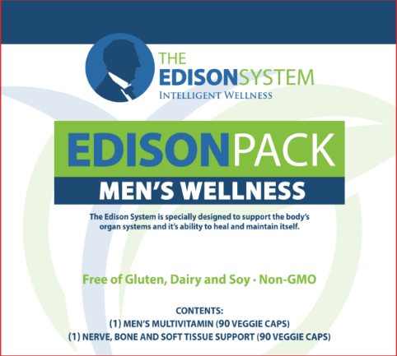
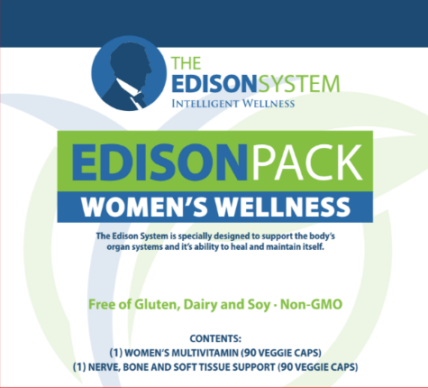
THE EDISON PACK
The Edison Pack is the cornerstone of the Edison System:
1
NERVE, BONE AND SOFT TISSUE SUPPORT
2
MEN’S AND WOMEN’S MULTIVITAMIN

Slide 23
THE BIG 4
SHOP
COOK
PLAN
PREPARE

Slide 24
What is Health?
100%
FUNCTION

Slide 25
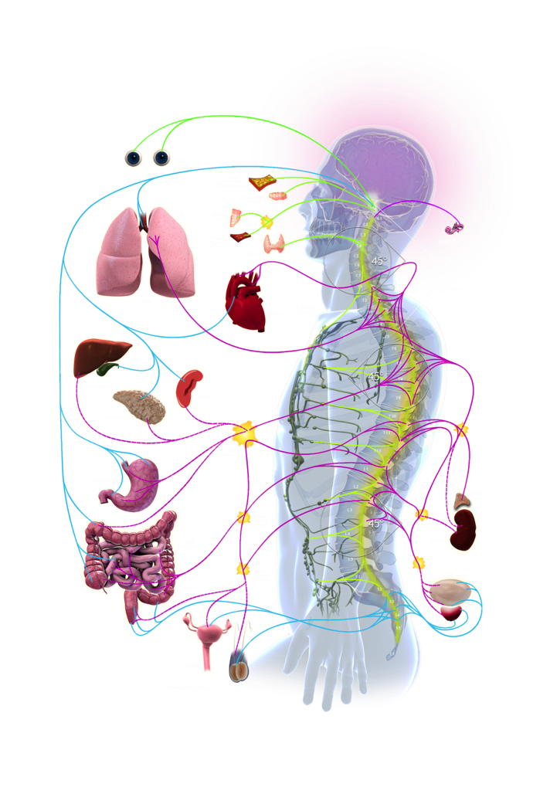
Turn Your Power On
What controls ALL function and healing (health)?
The Nervous System
You can go a month without food
You can go days without water
You can go minutes without air
You CAN’T go 1 second without nerve supply
Notes:
What organ runs and controls all function?
Describe nerve system
Explain subluxation

Slide 26

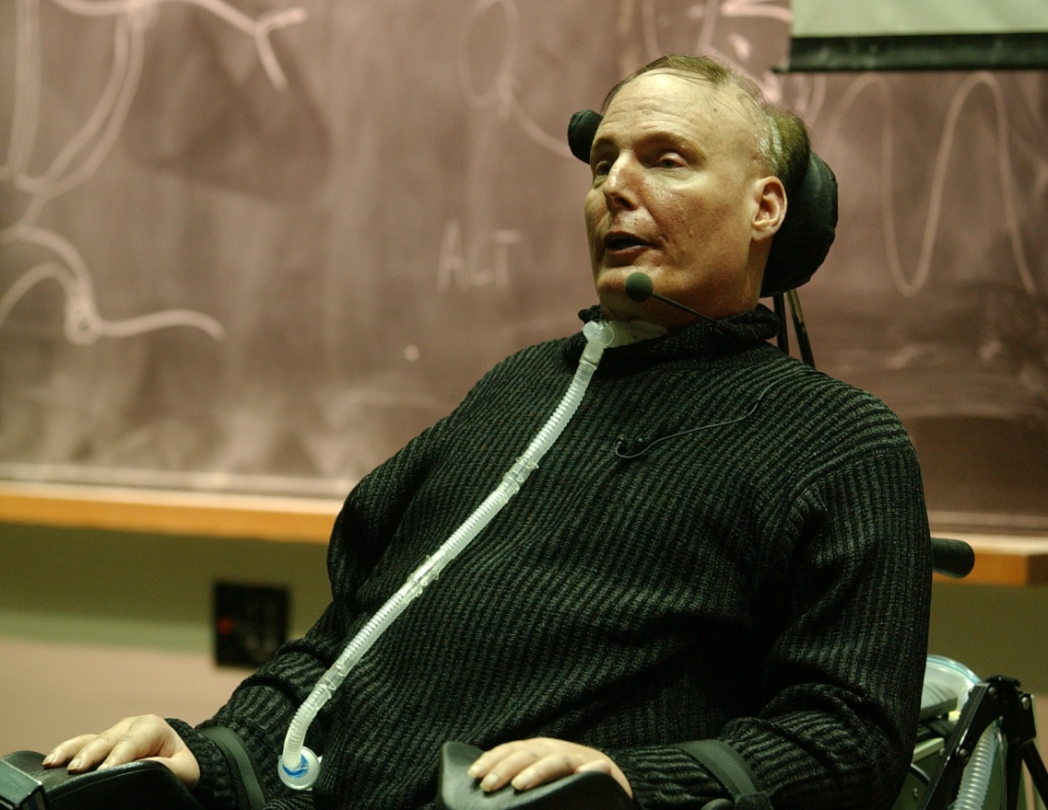
“Every organ, system and function of the human body is under the control of the central nervous system.”
- Gray’s Anatomy
Notes:
Chris Reeve’s story – all from C1
Goes to show you that the nerve system is the most important element of your health
If I gave him the advanced nutrition plan, MaxT3 exercise, highest quality supplements, or detox, what still happens
Only 8% of the nerve system feels pain so how do you know? X-rays

Slide 27
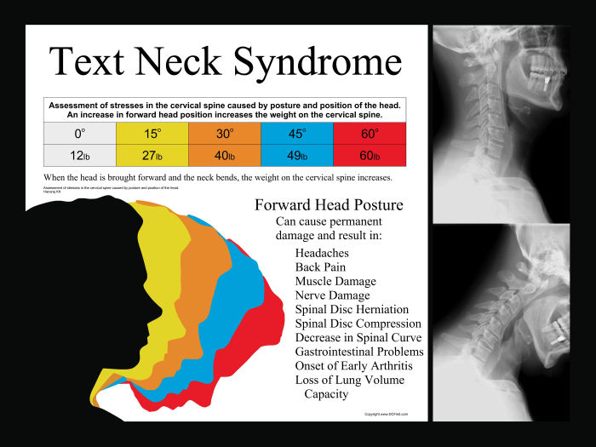
TEXT NECK!

Slide 28
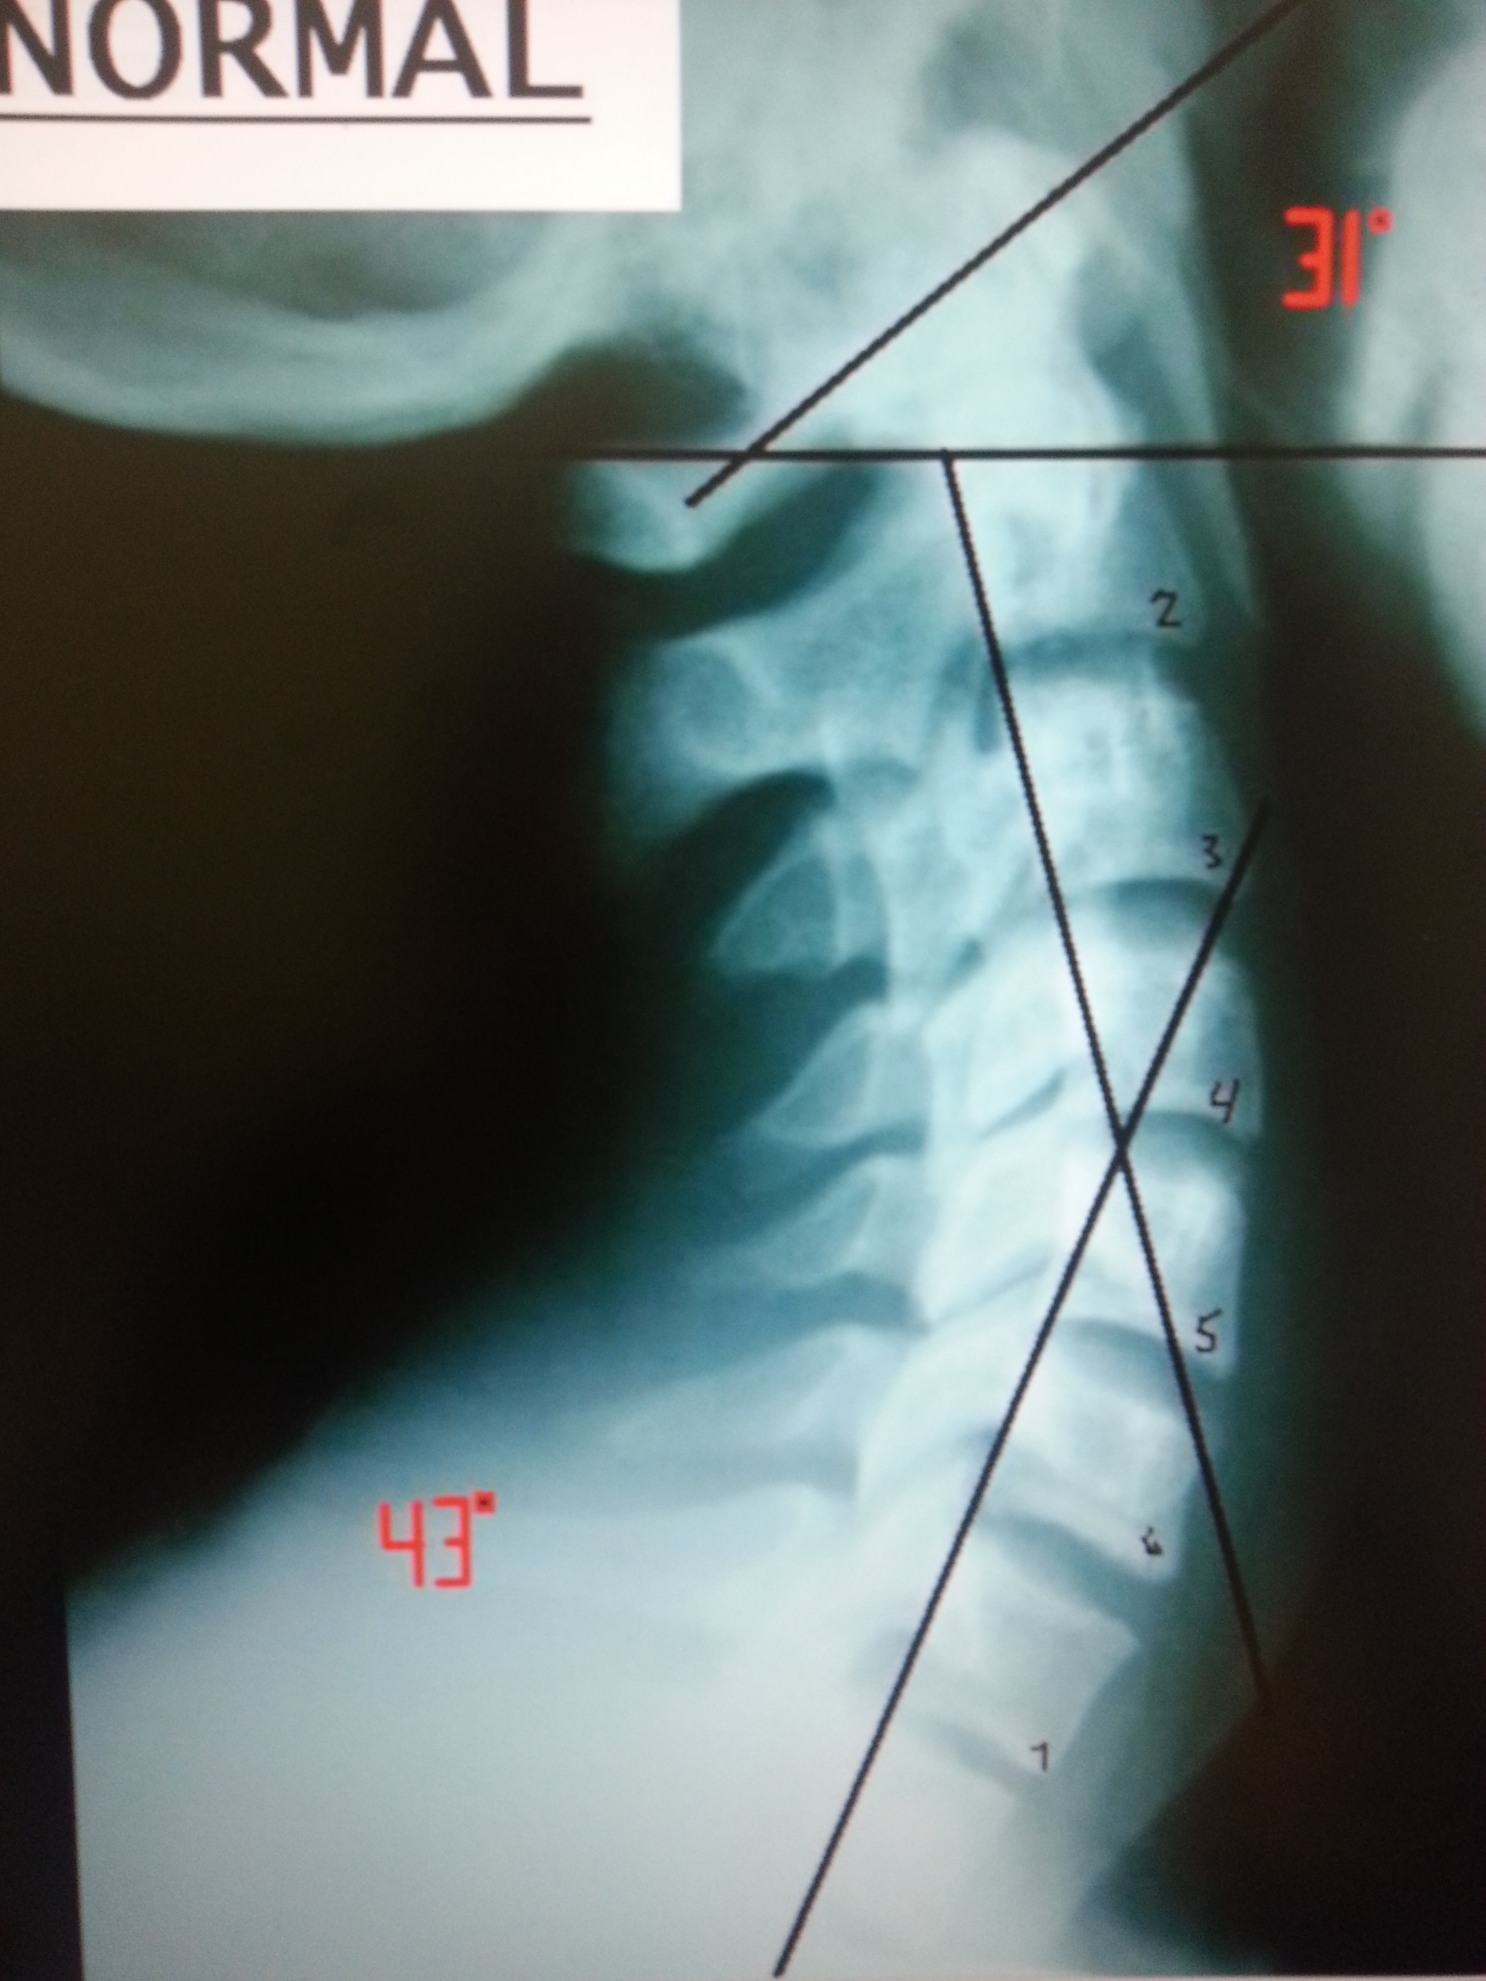
NORMAL CERVICAL SPINE

Slide 29
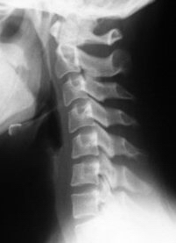
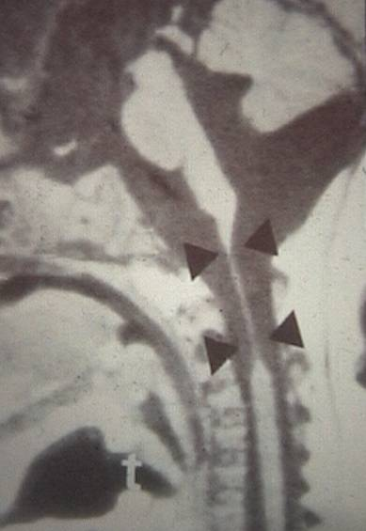
Arc of Life
Physical Nerve Stress: 92% Asymptomatic
Notes:
How does this cause disease process?
How does this happen – injuries, accidents, bad posture over time, even birth

Slide 30
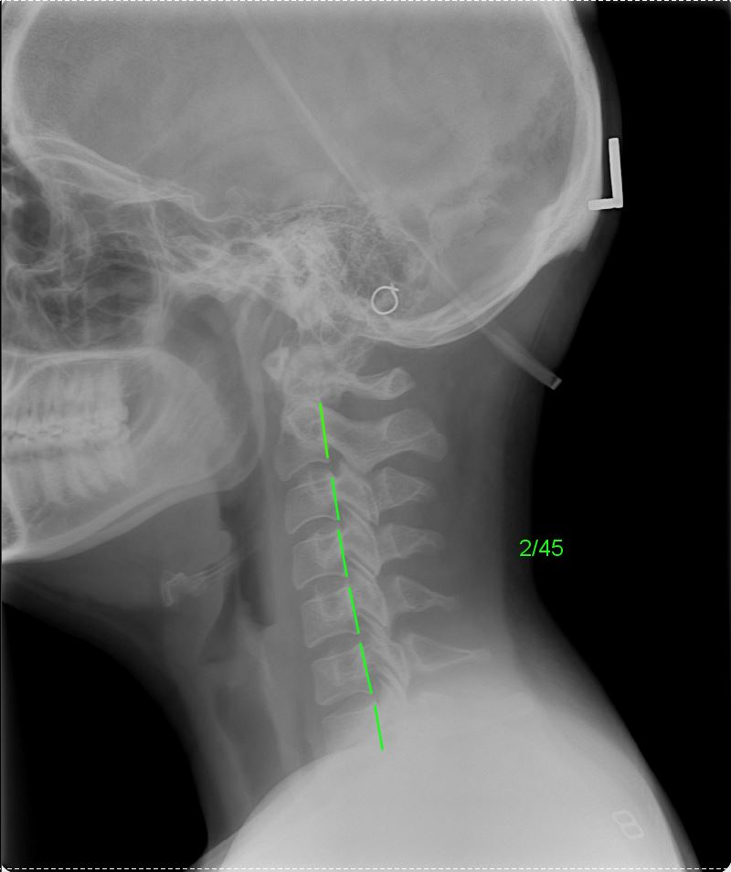
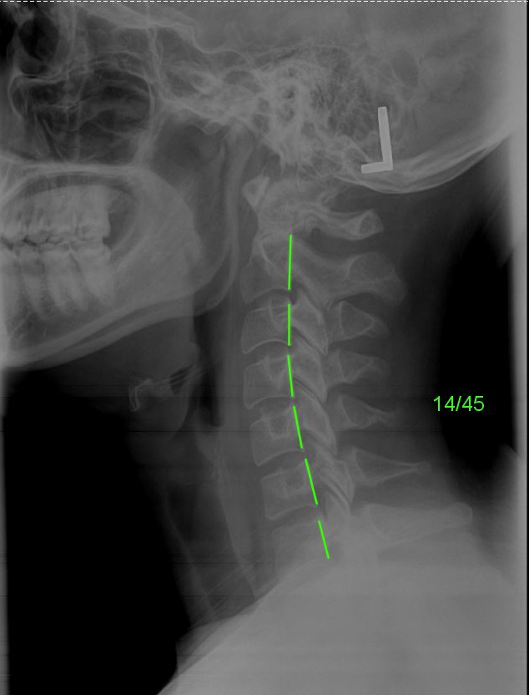
Rebecca - Pre
Rebecca - Post
Notes:
Prednisone for Rheumatoid
Naproxen for N&T in hands
Topamax for migraines
Zoloft for depression
Lisinipril for high blood pressure
Ativan for muscle spasms
Took her through corrective process (explain it)
After 6mo, no N&T, neck pain gone, no more migraines, MD took her off of rheumatoid meds, quit taking antidepressants
So she came off all 6 meds - @ $6k/yr for the meds so what was it worth for her to correct it?
People say it’s expensive to be healthy – Forbes stat - $220k/couple
Your health is the greatest investment you ever make and the most expensive thing when you lose it. Unfortunately when do most people make health a priority? After they lose it – DON’T DO THAT

Slide 31
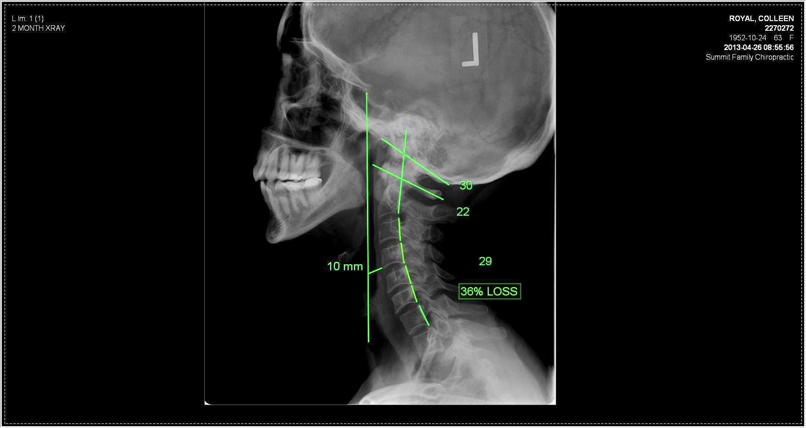
COLLEEN
Notes:
Here’s Colleen. Neck pain, headaches, 2 thyroid medications, fatigued all the time, but ate healthy, exercised, tried everything. Doctor told her she’d be on the meds for the rest of her life.
Raise your hand if you’ve been told you’re gonna have a condition of disease for the rest of your life.
I have good news for you. That’s not true. Your body can heal. You were created to adapt, overcome, and conquer. You have an amazing intelligence inside your body that helps you survive and thrive, and that power is in your nervous system. But you have to remove the interference!
Talk about corrective care
After 6 mo, we restored the curve in her neck, which took pressure off the nerves that go to her thyroid and what do you think happened? Her medical doctor ran her blood work twice to make sure the numbers were right, and took her off her thyroid meds. She has no more fatigue, has way more energy, no more neck pain or headaches.

Slide 32
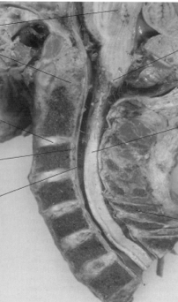
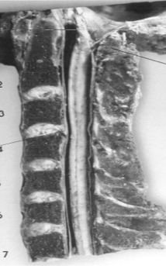
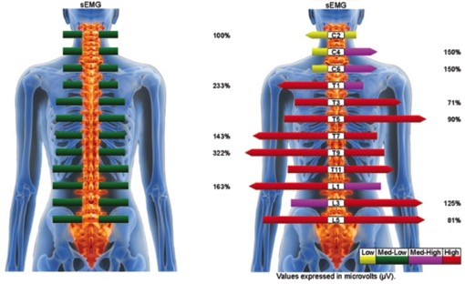
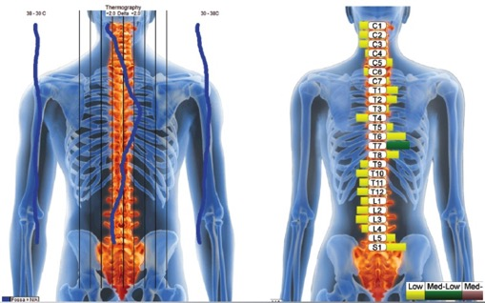
The First Step for Lose to Win
You need to get checked.
Have your spine x-ray taken by a Chiropractor that has been trained in searching for Subluxation.
Notes:
Do your sign up here.

Slide 33
2021 DETOX AND
WEIGHT LOSS PROGRAM
A profession, clinical program that is natural, healthy, and actually works:
· Detoxify
· Super-charge your metabolism
· Balance your hormones
· Lose weight

Slide 34
This is the year to get healthy, get fit, and lose the weight you hate
Evaluate hormone levels
Restore your gut-microbiome with our plant-based shake
Diet Guide based on the world’s #1 nutrition plan
Optimize your adrenal metabolism
Cellular detoxification and toxic elimination

Slide 35
THE PROGRAM OPTIONS:
A Weight loss Test: Evaluate your hormone and metabolism to determine your natural ability to lose weight and manage body composition
Daily Detox Pack: A cellular detox and nutrients designed to help eliminate toxins from the body
Microbiome Plant Protein: To be used as a meal to replenish health and restore your microbiome
Modified Mediterranean Diet: The world’s #1 diet modified to increase plant intake and lower sugar
The Edison Pack: Restore nutrients with a profession grade, clinical nutrients and anti-inflammatory ingredients

Slide 36
Weight Loss Testing
Estrogen
Testosterone
DHEA
Cortisol
Thyroid: TSH
Blood Sugar (A1c)
Immunity: hs-CRP and Vitamin D

Slide 37
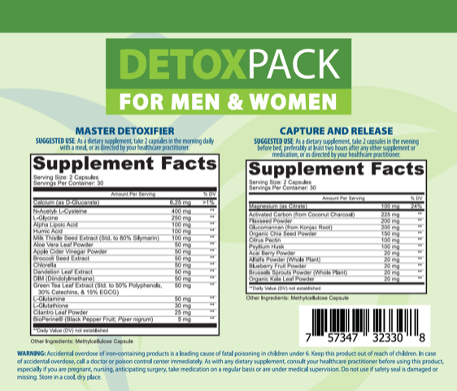
DETOX 2.0

Slide 38
Detox Pack – Enhanced Formula
Heavy Metals
Lipoic Acid →Supports Detox, Glutathione, Neuro-toxin removal
Humic Acid → GI Health, Heavy Metal & Environmental Toxin Binding, Immunity
Cilantro →Heavy Metal and Detox Support
Modified Citrus Pectin →Binding of Metals & Other Toxins

Slide 39
Detoxing Metals and Hormones
Heavy Metals known as “Neurotoxins” wreak havoc on the Central Nervous System” creating mental-emotional, neuro-chemical, and glandular-hormonal issues and disorders.

Slide 40
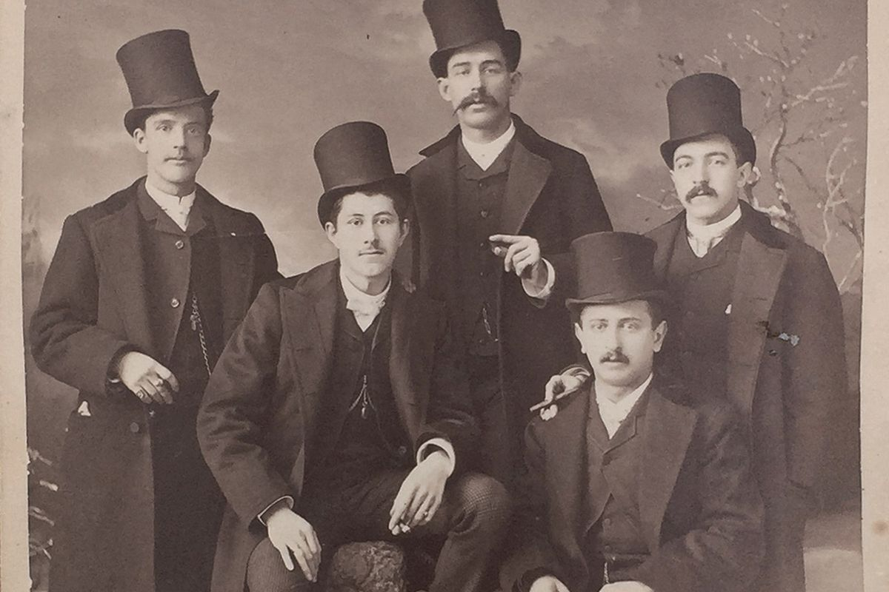
ERETHISM
AKA “Mad Hatter Disease” which affects the whole central nervous system derived from mercury poisoning

Slide 41
Estrogen Clearance
The body's ability to break down estrogens and remove them from the body is critically important as estrogens that are not properly metabolized and cleared by the liver remain in the body, become highly toxic, and generate a host of hormonal problems and disease risks.

Slide 42
