Slide 1
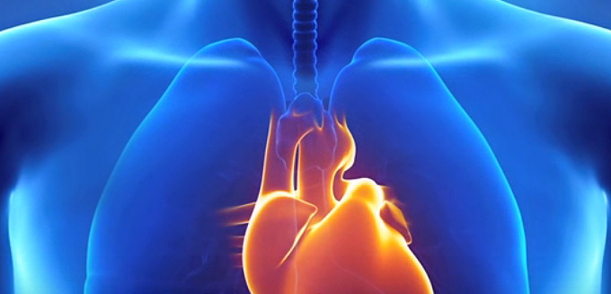
HEART HEALTH

Slide 2

#1Killer:8-900,000 Deaths In The US Each Year One person dies from CVD every 40 seconds
Notes:
It’s far and away the #1 killer – killing almost 2x the number of people each year that die from cancer.

Slide 3
STARTING YOUNG
1 OUT OF 3 DEATHS IS FROM CVD
*25% of children 5 and older already have plaque building up in the arteries! (US News and World Report)
*60% of 15-19 year olds have plaque building up in their coronary artery which supplies the heart!
https://www.ncbi.nlm.nih.gov/pmc/articles/PMC3951799/
Notes:
Tendency is to think that Heart Disease is a disease that adults/older people need to watch out for.

Slide 4
YOU CAN 10X YOUR CHANCES
Northwestern Medical Study on 2000 people: The impact of smoking, weight, exercise, diet, and alcohol on heart disease.
The more of these lifestyle areas you addressed, the lower the chance of disease.
The risk only decreased by 6 percent for participants who changed just one lifestyle factor such as nutrition
The decreased by 60 percent (10 times more) for those who made changes to all five lifestyle factors!
Notes:
The first study evaluated five lifestyle factors: smoking, weight, exercise, diet, and alcohol consumption. More than 2,000 people were recruited for this study. The results showed that healthy lifestyle choices such as not smoking, exercising regularly, and not consuming alcohol excessively dramatically lowered the risk of developing heart disease.
A really important aspect to understand was the more of these lifestyle essentials you addressed, the lower the chance of disease. The risk only decreased by 6 percent for participants who changed just one lifestyle factor such as nutrition, but it decreased by 60 percent (10 times more) for those who made changes to all five lifestyle factors!
“Health behaviors can trump a lot of your genetics,” said Donald Lloyd-Jones, M.D., chair and professor of preventive medicine at Northwestern University Feinberg School of Medicine and a staff cardiologist at Northwestern Memorial Hospital.“ This research shows people have control over their heart health. The earlier they start making healthy choices, the more likely they are to maintain a low-risk profile for heart disease.”
Do not miss our heart disease workshop on…. We will cover the lifestyle factors that are most deadly to your heart and the steps to better living that enjoyably give you a 10x greater chance at long life and good health.

Slide 5
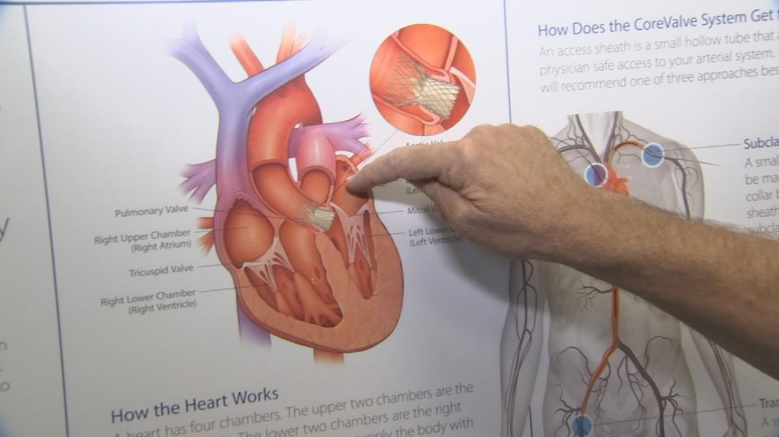
HEART SAFETY: START WITH TESTING

Slide 6
Testing Considerations
HbA1c
hsCRP
Vitamin D
Total Cholesterol (TC), LDL, HDL, and Triglycerides
Cortisol

Slide 7
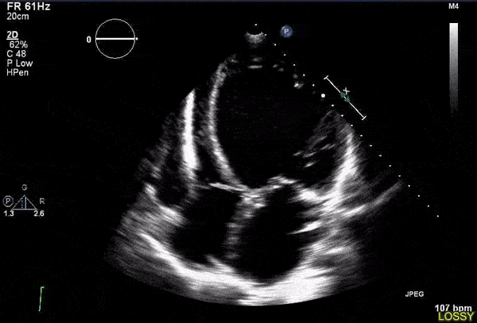
hsCRP
hsCRP levels are an indicator of inflammation and aging (inflamm-aging). Elevated concentrations of CRP are a marker of damage to the lining of blood vessels. Chronic inflammation is associated with coronary artery disease risk, even more so than high cholesterol levels
Notes:
It is important to keep in mind that hsCRP is a non-specific test, as inflammation in areas of the body other than the heart and vascular system may cause an elevated result.
, as indicated in the book by Doctors Jonny Bowden and Stephen Sinatra, The Great Cholesterol Myth. As these doctors point out in their book and Harvard Medical School observed on its website, only half the people who have heart attacks have high LDL cholesterol.⁴ High levels of hsCRP are associated with an increased risk of heart disease,⁵ supporting the damaging role of inflammation in cardiac health. A hsCRP test can also determine if a patient who has already had a heart attack is likely to have another.⁶ People who have had a heart attack whose hsCRP level is high are more likely to have another heart attack compared with people whose hsCRP level is normal.⁶

Slide 8
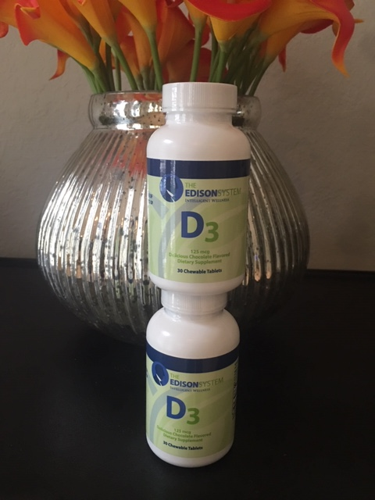
Vitamin D
Low vitamin D levels are a risk factor for heart attacks, congestive heart failure, peripheral arterial disease, strokes, high blood pressure, and cardiovascular-related conditions including diabetes.⁷⁻⁹
Notes:
An analysis of NHANES III 1988 - 1994 found that low vitamin D levels correlated with cardiovascular disease (CVD).¹⁰ The Health Professionals Follow-Up Study, a prospective nested case-control study of 18,225 US men followed between 1993 and 1999, established a relationship between low vitamin D and an elevated risk of myocardial infarction (heart attack) compared with men who have sufficient 25-hydroxyvitamin D [25(OH)D].¹¹
In the blood, measurements can be taken for 25-hydroxyvitamin D or 1,25-dihydroxyvitamin D. 25-hydroxyvitamin D is the primary form in the blood. It is an inactive precursor to 1,25-dihydroxyvitamin D, the active form. 25-hydroxyvitamin D has a long half-life and higher levels in the blood, so vitamin D testing usually measures this form of vitamin D.

Slide 9

Cortisol
Both low and high levels of the stress hormone cortisol can lead to cardiac-related problems.
High cortisol levels: metabolic syndrome and abdominal fat¹⁵
Low cortisol levels: impaired ability to manage inflammation.
Notes:
High cortisol also is linked to elevated CRP.¹⁶ Psychological stress is a contributor to high cortisol levels, and stress is an independent risk factor for heart disease.^{17,18} Additionally, stress leads to impaired sleep, which in turn is a heart disease risk factor.
Therefore, low concentrations of cortisol impair the body’s ability to quench inflammation. Salivary cortisol measurement is considered superior to serum cortisol in evaluating adrenal function and is a non-invasive procedure.¹⁹

Slide 10
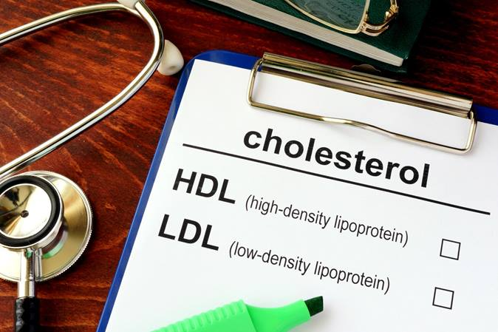
Cholesterol/triglycerides/LDL/HDL Lipid Panel
Harvard Medical School: Only ½ half of people who have heart attacks have high LDL cholesterol.
Notes:
This is standard testing among conventional physicians to monitor a patient’s risk of heart disease. However, among integrative and naturopathic doctors, whether high cholesterol is indeed a cardiac risk factor is a controversial topic. As noted earlier, even Harvard Medical School points out that only half the people who have heart attacks have high low-density lipoprotein (LDL) cholesterol, which is considered the harmful form of cholesterol. However, in mapping out a patient’s overall cardiovascular health, a lipid panel can add to your knowledge base. From a conventional perspective, cholesterol is a risk factor for heart disease because excessive amounts of it can lead to fatty deposits on blood vessel walls. This obstructs blood flow through the arteries, which can lead to a heart attack. Cholesterol deposits on the vessels can also detach and lead to a blood clot that causes a heart attack or stroke.¹²

Slide 11
Heart reporting; ALGORITHM
Healthy HDL:
MEN > 50
WOMEN > 50
Healthy LDL: < 3X HDL
HEALTHY TRIGLYCERIDES: < 150

Slide 12
HEALTH RATIOS
CHOLESTEROL:HDL RATIO
Total cholesterol divided by your HDL number.
HEALTHY RANGE
3.4 or under for men
3.3 or under for women
Triglyceride/HDL ratio (High is bad)
Divide your triglyceride total by your HDL.
HEALTHY RANGE: <2 (The closer to one, the better.)
Example: TG = 120 mg/dL and HDL=40 mg/dL.
120 / 40 = 3.0 and is an elevated risk of heart attack and stroke

Slide 13
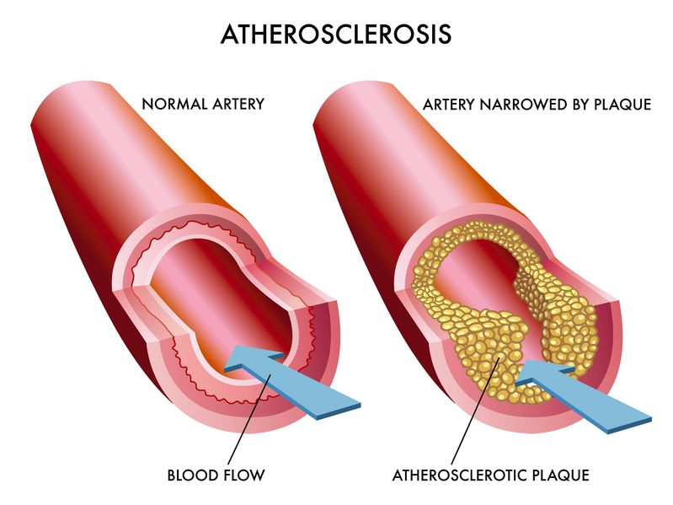
IMPORTANT NUMBERS
When the amount of triglycerides and LDL particles rises in the blood, this increases the chance that these particles will become oxidized and damage the walls of blood vessels, ultimately leading to plaque formation and heart disease.
Notes:
For LDL, biggest concern is particle count and particle size (small is bad, large is good)

Slide 14
Dangers of Cholesterol Medication
▪ Heart failure (heart is a muscle)
▪ Limits protection from cholesterol against cancer
▪ Depression
▪ CoQ10 deficiency
▪ Memory Loss
▪ Liver Damage
▪ Neuropathy
▪ Severe joint pain and ligament rupture
▪ Muscle wasting/atrophy
Notes:
PROBLEM 1: Your brain and nerve tissue is made of 60% cholesterol!
PROBLEM 2: CoQ10, an antioxidant needed to transfer energy from food to our cells, is inhibited when taking statin drugs. DEFICIENCY CAN CAUSE HEART ATTACK OR STROKE.

Slide 15

Functional Wellness To Address Results

Slide 16
High HbA1C & Triglycerides
Gluco Adapt:
Chromium (as chromium polynicotinate)200 mcg
Garcinia cambogia Fruit Extract995 mg
(Supplying 500 mg of (-) hydroxycitric acid (HCA))
Gymnema sylvestre Leaf extract200 mg
Bitter Melon Fruit (Momordica charantia)200 mg
Fenugreek Seed150 mg
Alpha Lipoic Acid100 mg
Vanadium (from vanadyl sulfate)2.5 mg
Other ingredients: Hydroxypropyl methylcellulose (capsule) and vegetable stearate.
Suggested Usage: 3 daily

Slide 17
High hsCRP
Curcumin, Boswellia, Fish Oil
(Edison, E-flamX, and E+)
Curcumin, the primary active component in the spice turmeric, is well studied for its anti-inflammatory properties lowering hsCRP and triglycerides in type 2 diabetic patients.²⁶
With Boswellia; it produced a more healthy inflammatory response with reductions in CRP, as well as other inflammation markers.²⁷
Fish oil is another supplement studied for its effects on CRP, also lowering triglycerides and fasting glucose and raising HDL cholesterol.
Notes:
hsCRP
Turmeric/Curcumin, Boswellia, Fish Oil
Curcumin, the primary active component in the spice turmeric, is well studied for its anti-inflammatory properties. In one of the many double-blind randomized clinical trials on this botanical, a dose of 1,500 mg/day lowered hsCRP and triglycerides in type 2 diabetic patients.²⁶
In rodents, when curcumin was combined with boswellia, it produced a more healthy inflammatory response with reductions in CRP, as well as other inflammation markers.²⁷
Fish oil is another supplement studied for its effects on CRP. One of the many studies on the topic found a combination of EPA and DHA polyunsaturated fatty acids lowered hsCRP in 201 middle-aged and elderly Chinese people.²⁸ In this study, fish oil supplementation for 12 weeks also lowered triglycerides and fasting glucose and raised HDL cholesterol.

Slide 18
Lower LDL, Up-HDL cholesterol, and Reduce Triglycerides
Sustained-Release Niacin
An example of a study investigating its effects was randomized, double-blind, placebo-controlled. Supplementation with niacin led to reductions in total cholesterol, LDL, triglycerides, and lipoprotein(a), a marker of heart disease risk. HDL cholesterol levels increased.
Notes:
Sustained-release niacin is an effective way to support healthy cholesterol without the “niacin flush” that occurs with the immediate-release form. Clinically, it has been used extensively for this purpose.
An example of a study investigating its effects was a randomized, double-blind, placebo-controlled, crossover trial of 85 participants with hypercholesterolemia greater than 5.82 mmol/L (225 mg/dL).³¹ For eight weeks, the subjects consumed an American Heart Association Step I Diet then were randomized into either a group receiving 1,500 mg/day sustained-release niacin or a placebo for two months. At the end of that time, the subjects were crossed over to the opposite group for two months followed by another two-month period where all the subjects took 2,000 mg/day of sustained-release niacin. Supplementation with either dose of the sustained-release niacin led to reductions in total serum cholesterol, low-density lipoprotein cholesterol, triglycerides, and lipoprotein(a), a marker of heart disease risk. In addition, HDL cholesterol levels increased.
High doses of niacin can cause an elevation in liver enzymes in some people, so testing of this parameter is warranted in patients supplementing with this nutrient.
High doses of niacin can cause an elevation in liver enzymes in some people, so testing of this parameter is warranted in patients supplementing with this nutrient.

Slide 19
Cortisol Imbalances and Adrenal Support
ADRENOCARE
Schisandra chinensis, Bacopa monnieri, Rhodiola rosea, Eleutherococcus senticosus, Magnolia officinalis, Rehmannia glutinosa(root), Bupleurum falcatum (root), Panax ginseng (root), Coleus forskohlii, Sensoril® Ashwagandha Extract (Withania somnifera).
Adaptogens are botanical substances that protect the adrenal glands, balance cortisol levels, and protect the body from stress. Some of the most effect adaptogens in regards to reducing cortisol
Panax ginseng and Bupleurum falcatum also are known for their stress-relieving properties.^{39,40}
Notes:
Adaptogens are botanical substances that protect the adrenal glands, balance cortisol levels, and protect the body from stress. Some of the most effect adaptogens in regards to reducing cortisol are Schisandra chinensis, Bacopa monnieri, Rhodiola rosea, Magnolia officinalis and Phellodendron amurense (Relora®), Rehmannia glutinosa, Bupleurum falcatum, and Sensoril® Ashwagandha Extract.³²⁻³⁷ Eleutherococcus senticosus has been shown to both raise or lower cortisol levels, indicating there is “a threshold of stress below which ES [Eleutherococcus senticosus] increases the stress response and above which ES decreases the stress response.”³⁸
Panax ginseng and Bupleurum falcatum also are known for their stress-relieving properties.^{39,40}
Diet
Consuming a diet low in sugar and refined carbohydrates can maintain healthy triglyceride and HbA1c levels. Eating more fiber can also lower triglycerides and cholesterol. Consumption of fish high in omega-3 fatty acids such as salmon can improve hsCRP.
Exercise
Regular exercise is known to reduce the risk of heart disease and to eliminate risk factors for heart disease such as high blood pressure.⁴¹ Some studies indicate frequent exercise is associated with improved HDL cholesterol.⁴²
Lifestyle
Recommend stress-reduction practices such as meditation/prayer and yoga. Also urge patients to receive seven to eight hours of sleep each night.

Slide 20
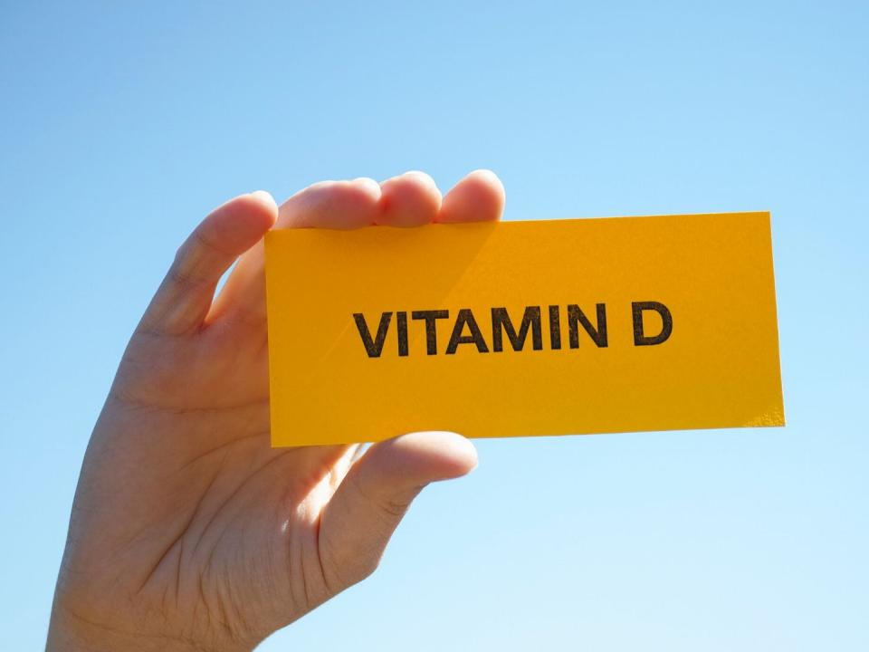
>25 = 5,000 < 25 = 10-50,000

Slide 21
Modified Mediterranean Diet
Research on carbohydrate intake and cardiovascular disease:
Cause atherogenic dyslipidemia (Atherosclerosis)
Increased triglycerides a
Increase small LDL particles
Decreased HDL,
Decrease insulin resistance
Increase obesity
Notes:
A comprehensive review of the research on carbohydrate intake and cardiovascular disease has concluded that a diet high in refined carbohydrate aggravates atherogenic dyslipidemia and is associated with increased triglycerides and small LDL particles, decreased HDL, insulin resistance, and obesity. (1) When the amount of triglycerides and LDL particles rises in the blood, this increases the chance that these particles will become oxidized and damage the walls of blood vessels, ultimately leading to plaque formation and heart disease.
1. Am J Clin Nutr. 2010 Mar; 91(3): 502–509. Published online 2010 Jan 20. doi: 10.3945/ajcn.2008.26285
PMCID: PMC2824150 PMID: 20089734
Saturated fat, carbohydrate, and cardiovascular disease^{1,2,3,4}
Patty W Siri-Tarino, Qi Sun, Frank B Hu, and Ronald M Krauss
https://www.ncbi.nlm.nih.gov/pmc/articles/PMC2824150/

Slide 22
Anti-inflammatory, (Ketogenic) Modified Mediterranean diet
A focus of the Mediterranean diet is Extra virgin olive oil; also found to raise HDLs.
An evaluation of multiple studies involving over 800,000 subjects discovered that olive oil was the best monounsaturated fat to reduce heart disease. ²
Olive oil contains antioxidants known as polyphenols believed to provide heart benefits and create the increase in HDL.³

Slide 23
CHANGE YOUR OIL
Use coconut oil. A randomized, double-blind, clinical trial involved 40 women aged 20-40 years found that it lowered HDL while other studies also revealed that it improves the LDL to HDL ratio important in preventing heart disease.⁴
Up your Omega-3 fatty acids. Eating healthy types of fish or taking fish oil can help to elevate HDL levels, decrease inflammation, and improve cardiovascular function.
Eliminate trans fats. Rancid fats from vegetable, nut, and see oils along with added trans fats or hydrogenated oil negatively affect cholesterol ratios, cause inflammation, and promote heart disease.

Slide 24
Healthy Fats vs. Damaged Fats
Healthy Fats
▪ Olive Oil
▪ Fish Oil
▪ Coconut Products
▪ Raw Nuts
▪ Organic, grass-fed meats* and free-range chicken.
▪ Avocado
▪ Flax & Chia Seeds
Damaged Fats
▪ Trans Fats
▪ Canola/Vegetable Oil
▪ Commercial Meat & Dairy
Notes:
Red meat, saturated fat is a problem for certain genes when eaten regularly

Slide 25
GREAT NEWS
Immediately following a drop in carbs, triglycerides and HDL raises very quickly.⁽⁷⁻⁹⁾

Slide 26
Top Inflammatory Foods
Sugar (Sodas and fruit juices).
Vegetable-Oil.
Fried Foods.
Refined Flour.
Grain-Fed Meat
Artificial Sweeteners.
Artificial Additives.
Processed Meats (Cold Cuts)
Gluten

Slide 27
*Foods that combat inflammation
Include plenty of these anti-inflammatory foods in your diet:
Fish, Coconut, Olive, and Avocado Oil
Green leafy vegetables, such as spinach, kale, and collards
Raw nuts and seeds like chia, flax, almonds and Macadamias
Low Glycemic Fruits: strawberries, blueberries, cherries, and raspberries
*Assuming there are no Food Sensitivities to the above

Slide 28
CHIROPRACTIC AND THE #1 KILLER
Heart rate variability (HRV) is a vital health indicator like blood pressure, cholesterol, or heart Rate.
HRV: Measures how well the heart adapts to changes and challenges.
This adaptive response is managed through the nervous system.
Research by Zhang, MD, PhD proves chiropractic significantly improved HRV after only 1 year of care
Notes:
A healthy HRV is created by a balanced nerve system – there is a proper balance between the SNS and the PNS.
Dr. J. Zhang, MD, PhD. measured the effect of chiropractic care on the autonomic nervous systems measured by way of Heart Rate Variability (HRV). After one year of chiropractic care he found that there was improved neurological balance through an increase in parasympathetic stimulation; which is associated with a slower heart rate and less anxiety and worry. This reduced heart rate can potentially reduce heart attack and other cardiovascular diseases by increasing cardiac reserve and nutrient supply to cardiac muscles.
Zhang J, Dean D, Nosco D: Effect of Chiropractic Care on Heart Rate Variability and Pain in a Multisite Clinical Study. Journal of Chiropractic Education, Vol. 19, No. 1, 2005.

Slide 29
Organ Function and Subluxation
“Records of numerous cases including myocardial ischemia showed lesions of the spinal column are perfectly capable of stimulating accentuating, or making a major contribution to (organic ) disorders. There can, in fact, be no doubt that the state of the spinal column does have a bearing on the functional status of the internal organs”
W. Kunert MD (1965) Functional Disorders of Internal Organs Due to Vertebral Lesions,CIBA Symposium 13 (3) :85-96

Slide 30
Maximize Magnesium
Magnesium Plays Substantial Role in Reducing Inflammation
More than 3,750 magnesium-binding sites and more than 500 enzymes in your body rely on magnesium
Low levels of magnesium are associated with cardiovascular disease and death from all causes.
Notes:
Low levels of magnesium are a culprit in the development of inflammation and may play a role in hardening of your arteries as they inhibit the deposit of lipids on your arterials walls and plaque formation.

Slide 31
Testing Considerations
HbA1c
hsCRP
Vitamin D
Total Cholesterol (TC), LDL, HDL, and Triglycerides
Cortisol

Slide 32
Supplement for the Heart
Edison Pack
E+
Vitamin D
GlucoPro for controlling blood sugar and triglcyerides
BeCalm for inflammation, sleep, and stress

